Slide 1
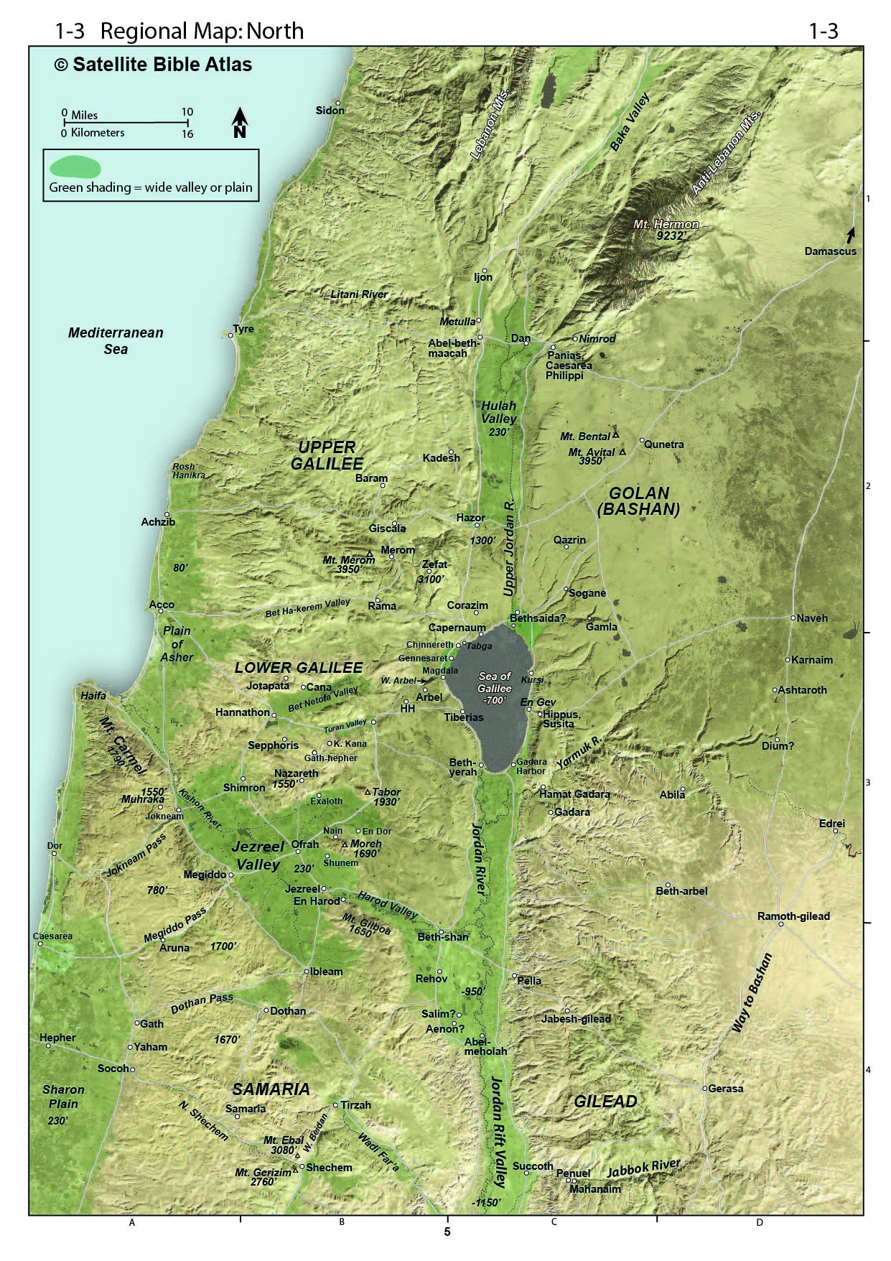

Slide 2
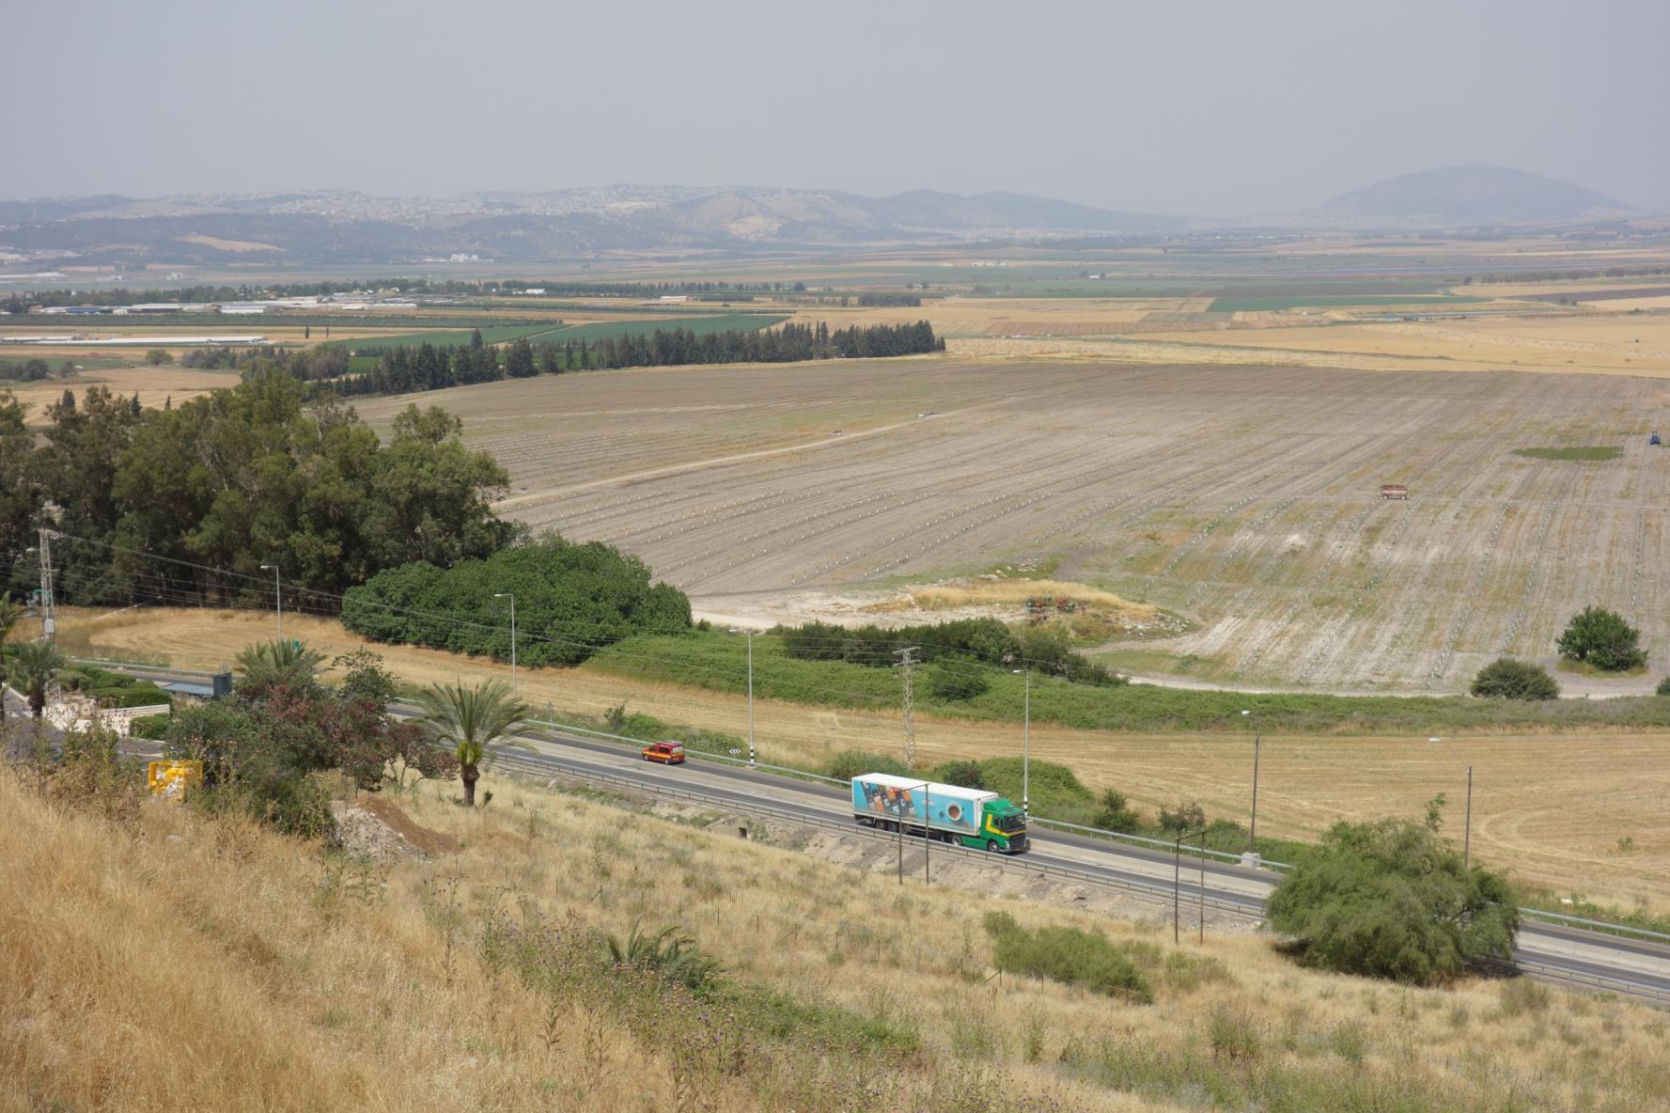

Slide 4
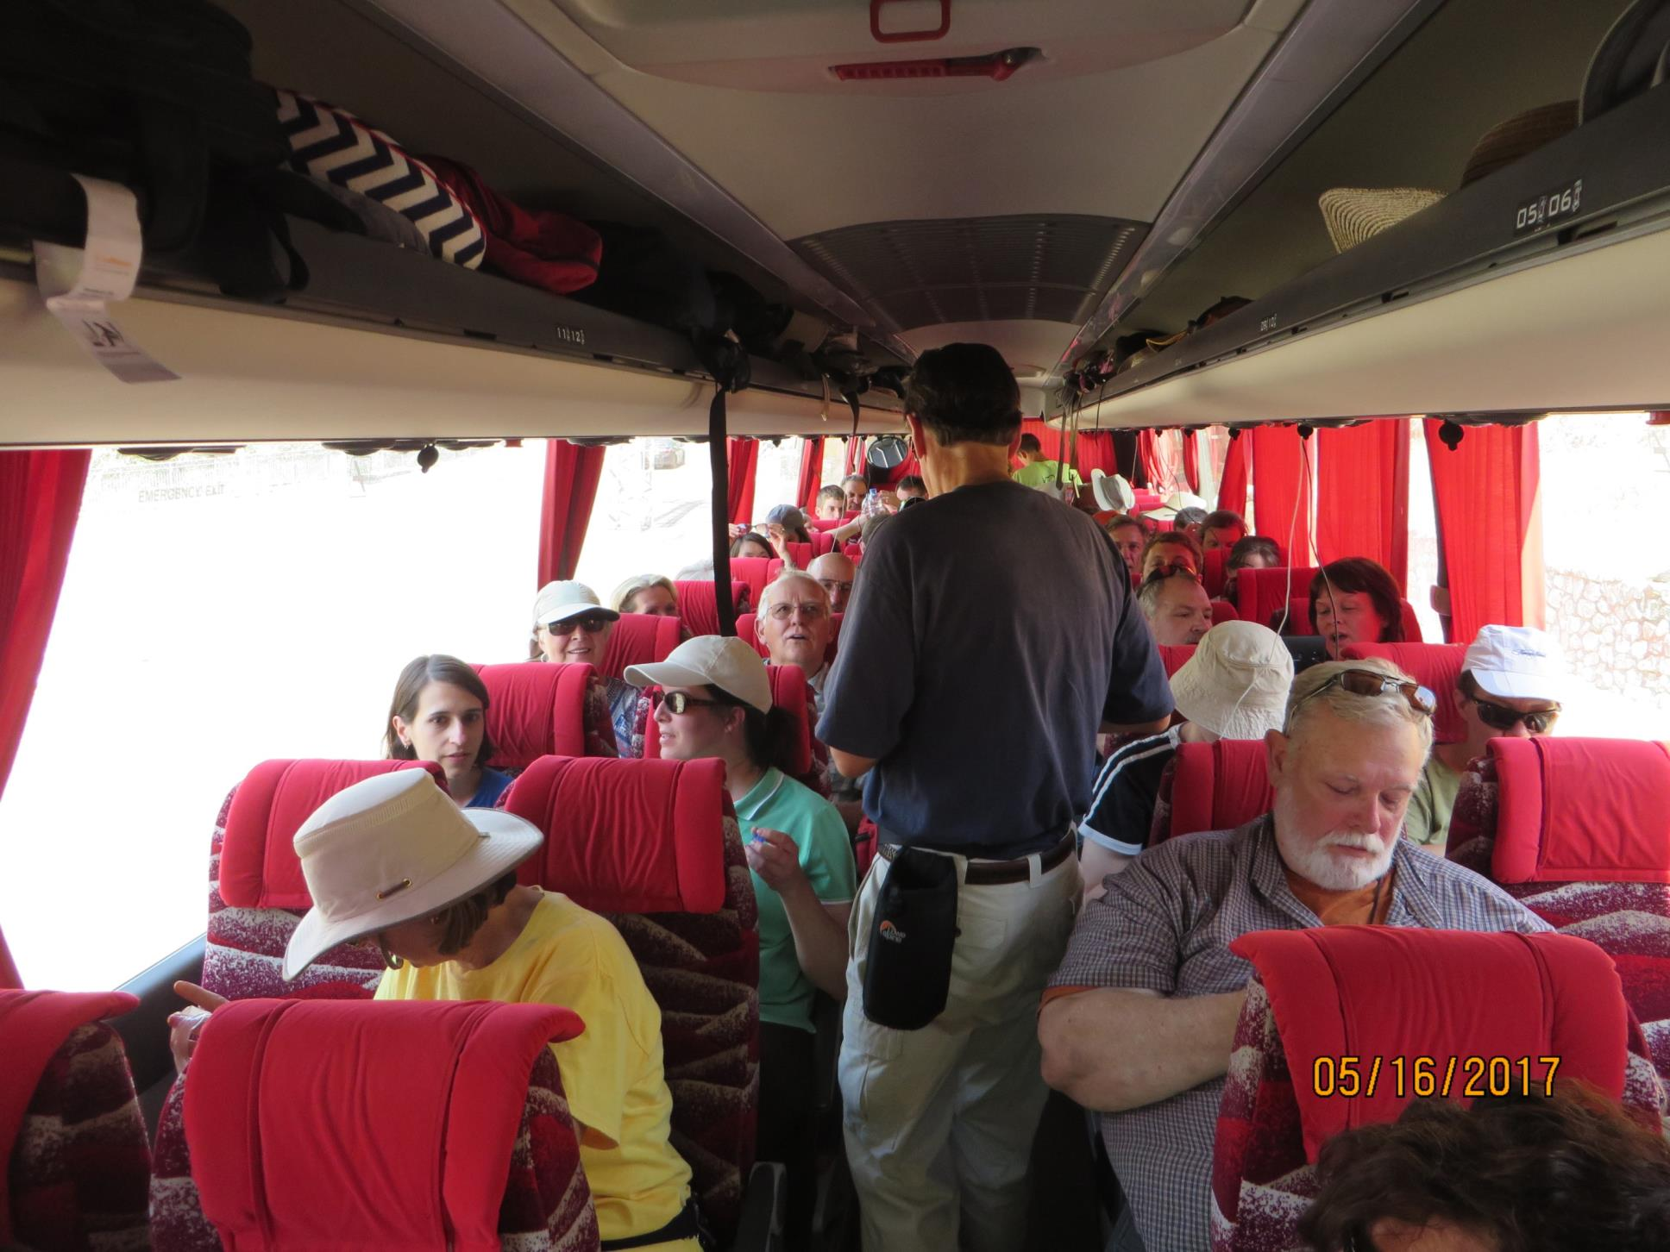

Slide 5
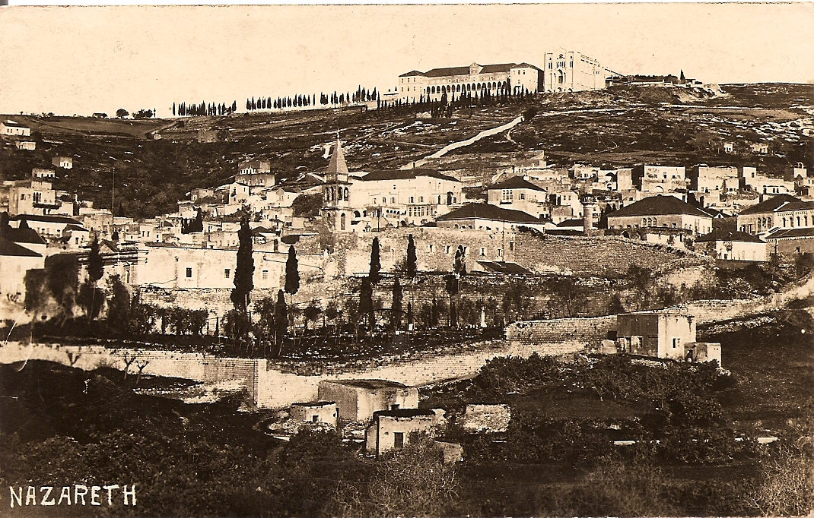

Slide 6
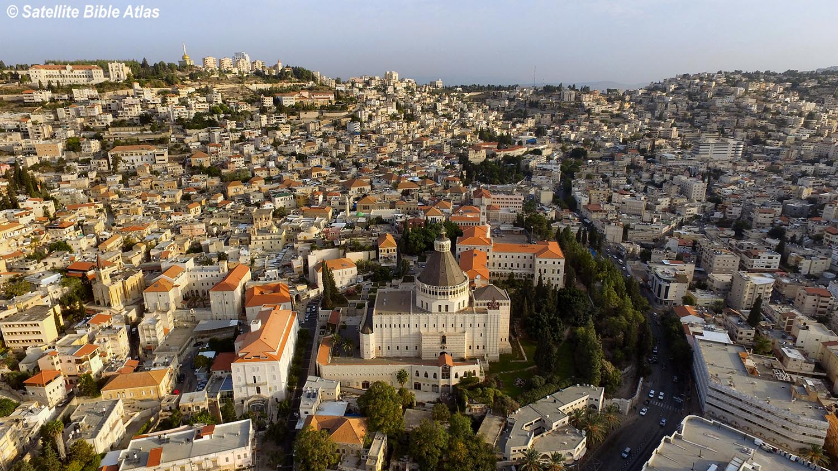

Slide 7
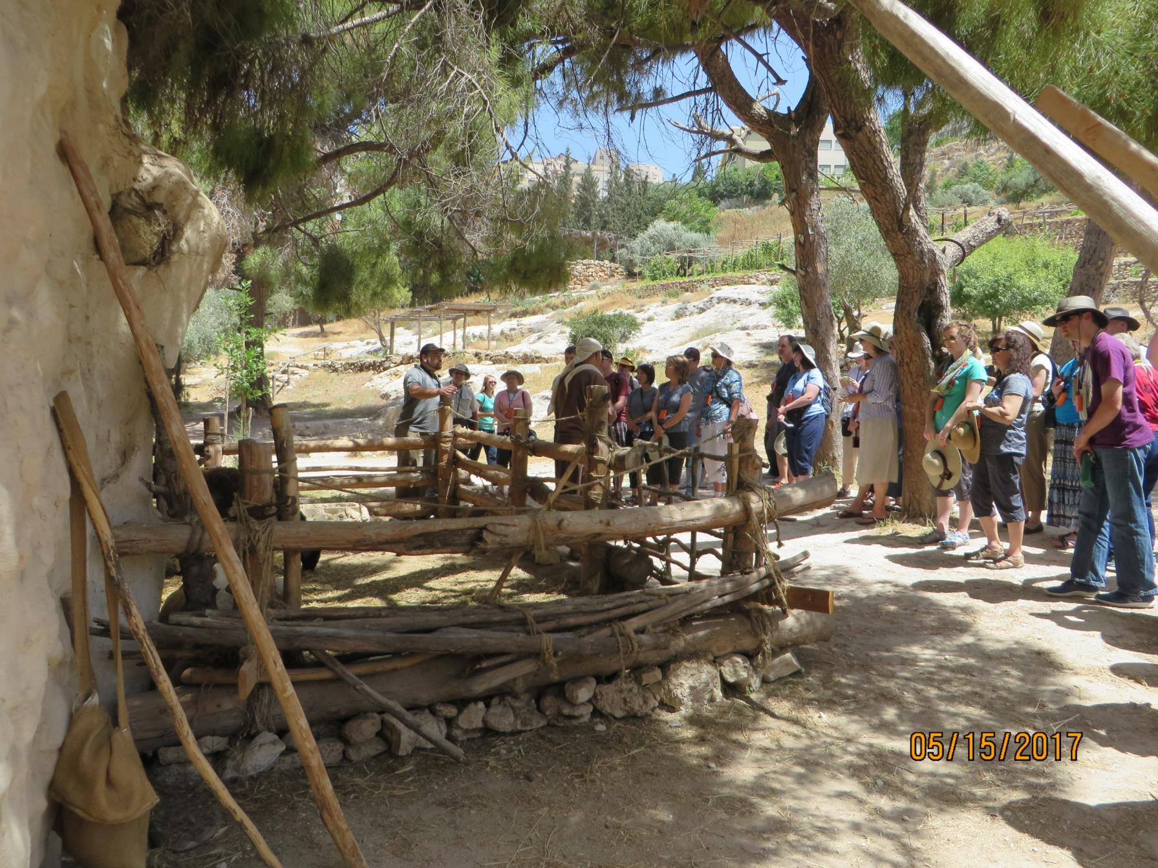

Slide 8
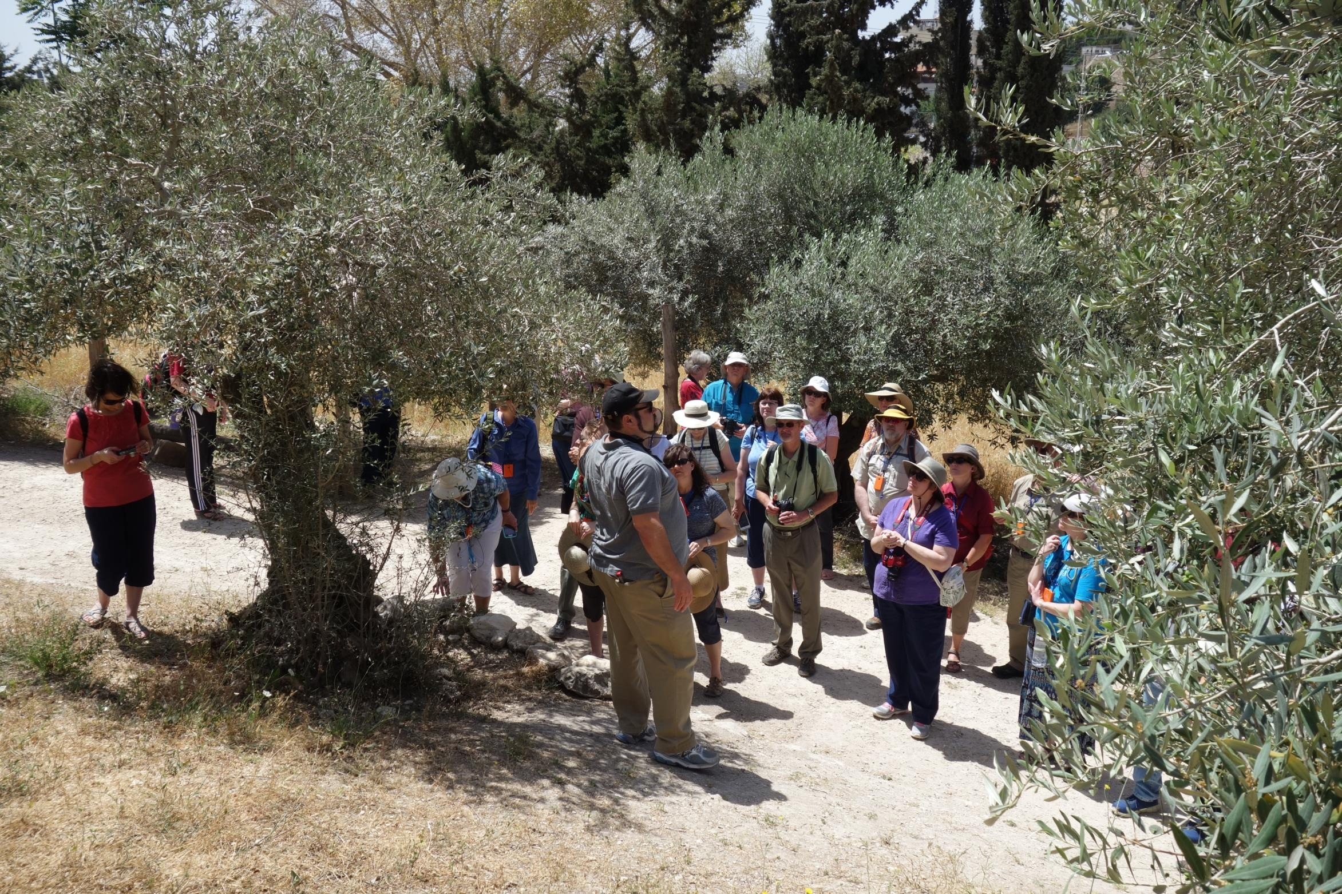

Slide 9
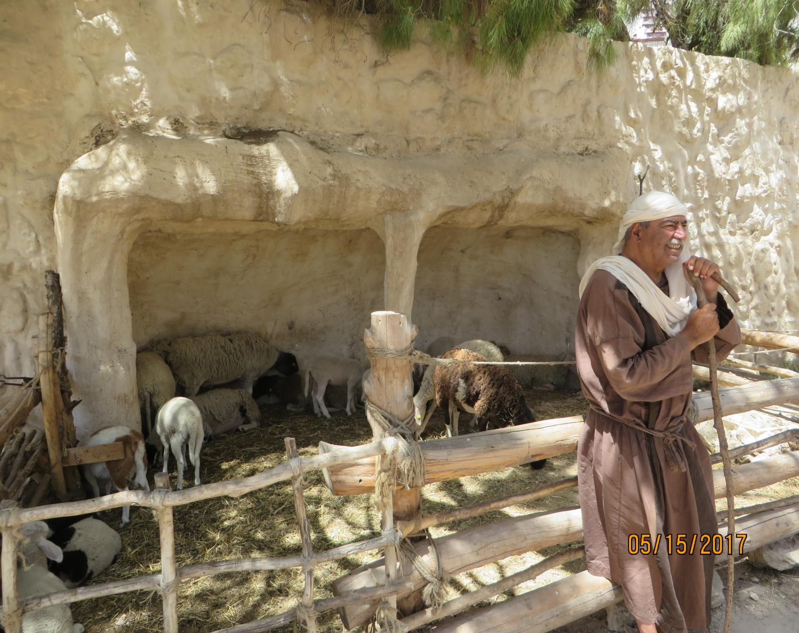

Slide 10
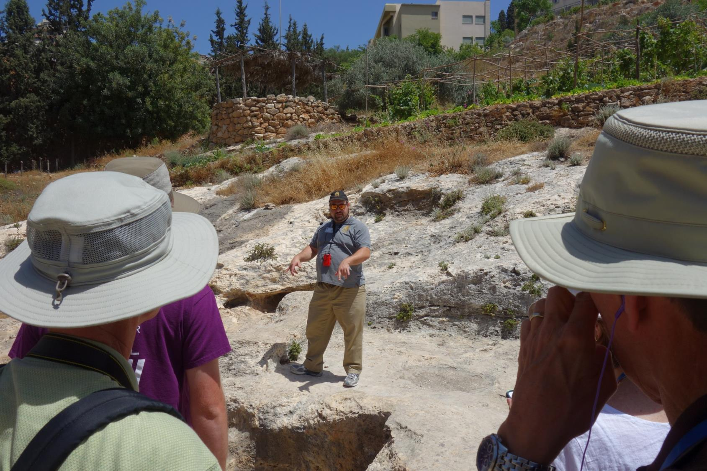

Slide 11
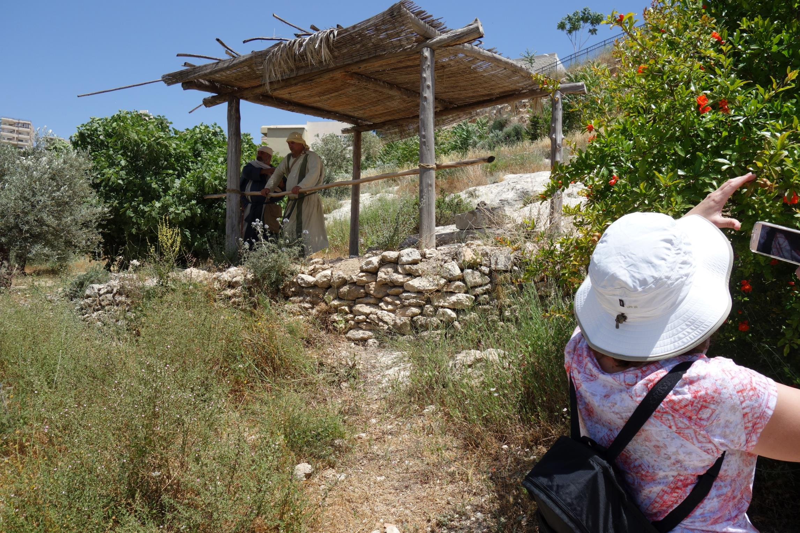

Slide 12
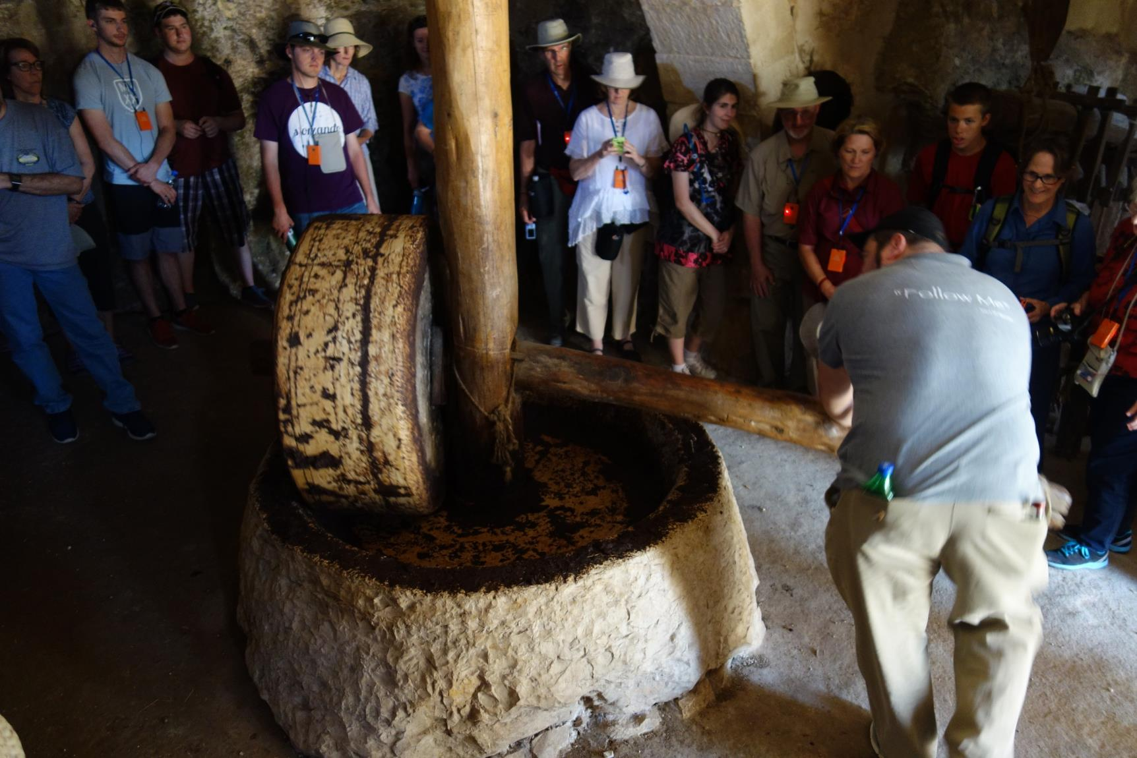

Slide 13
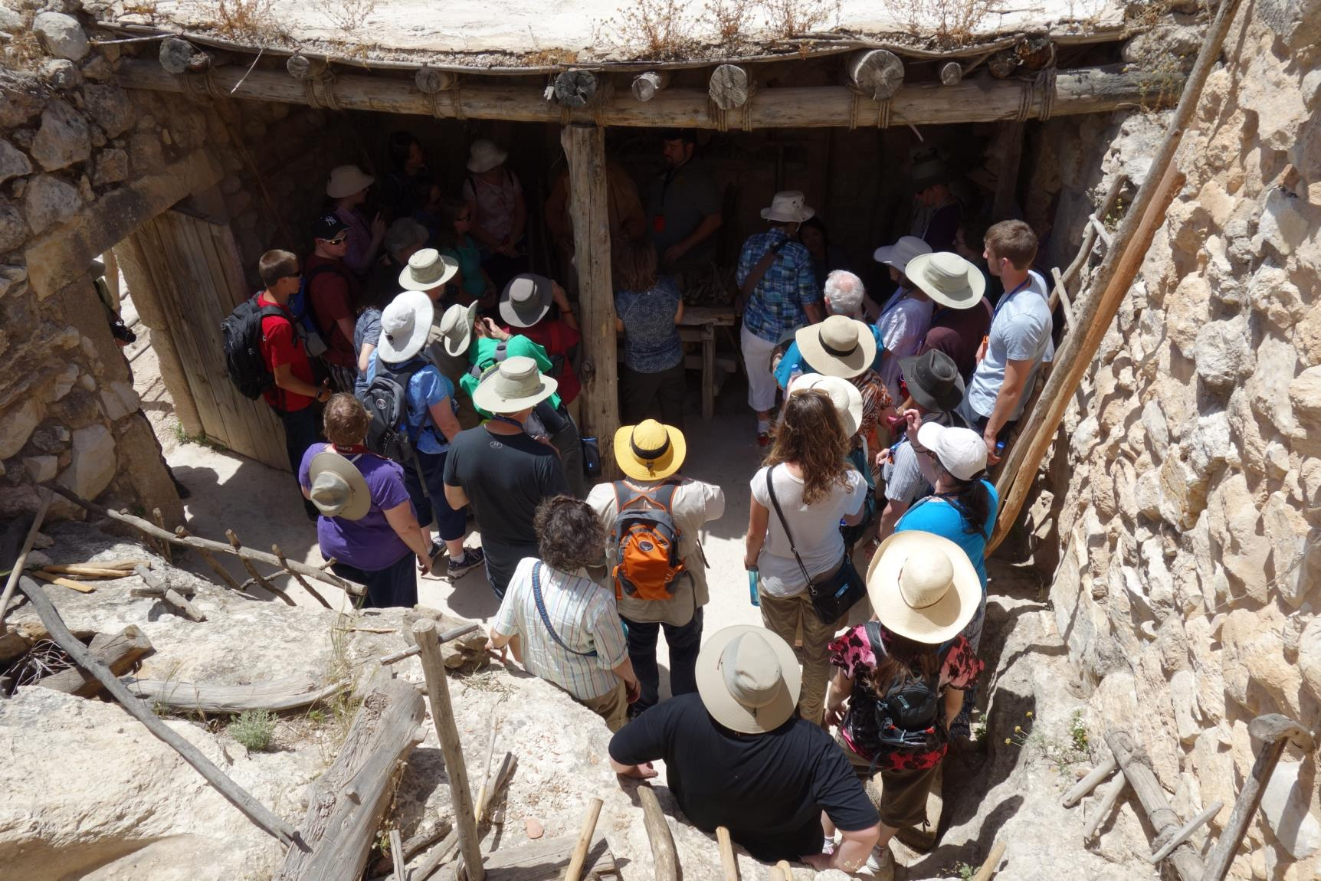

Slide 14
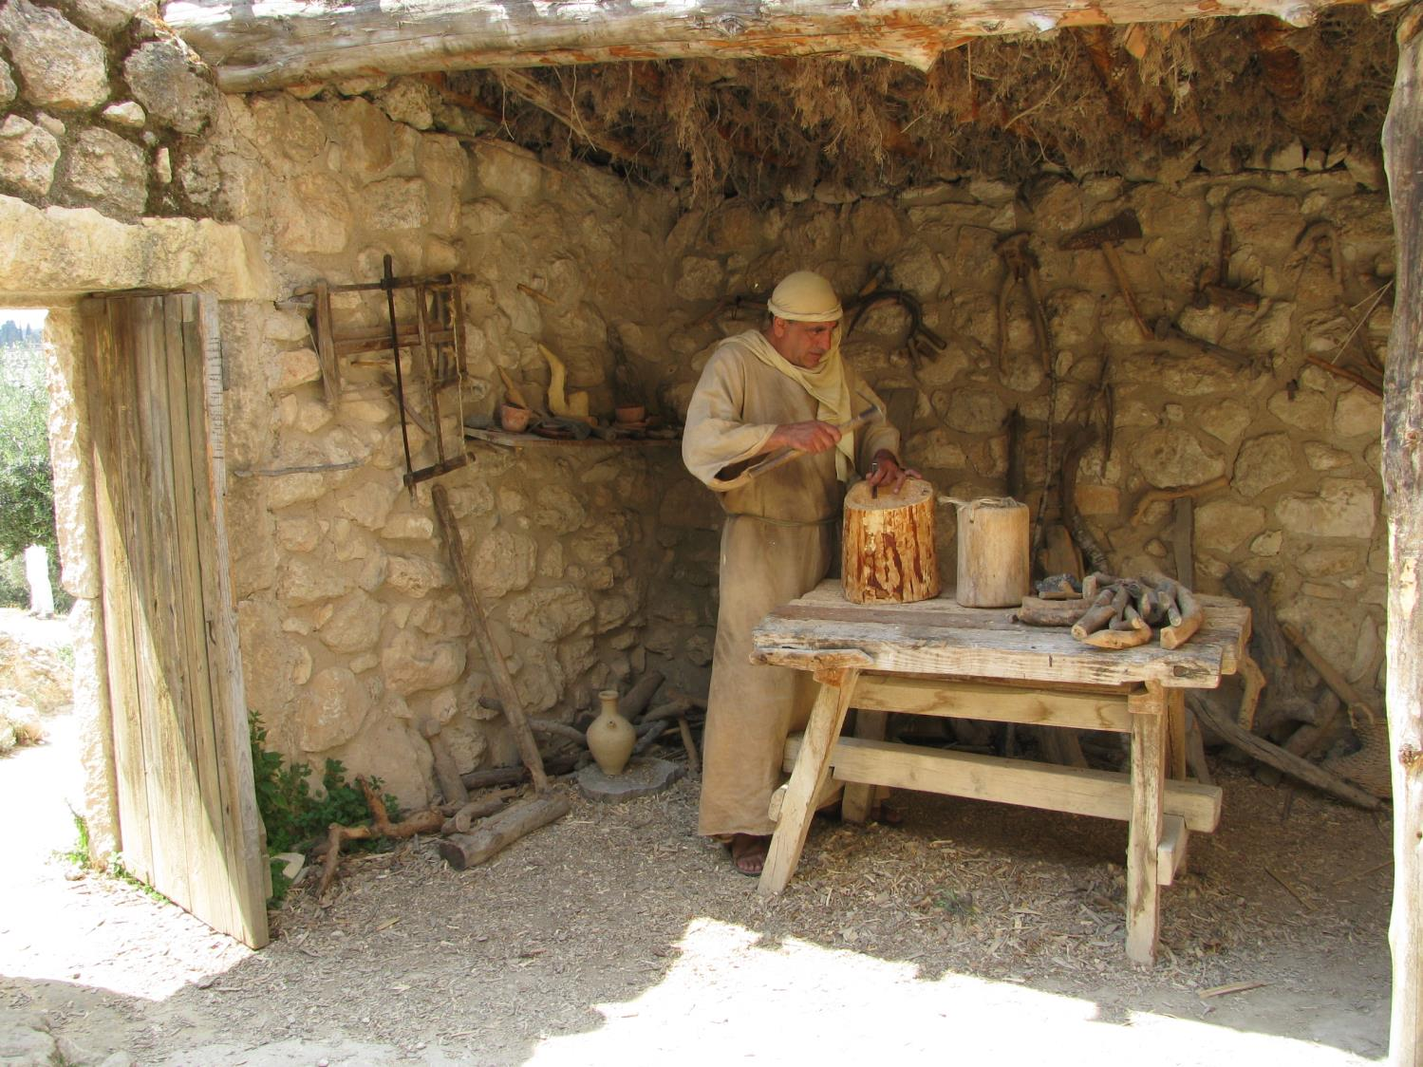

Slide 15
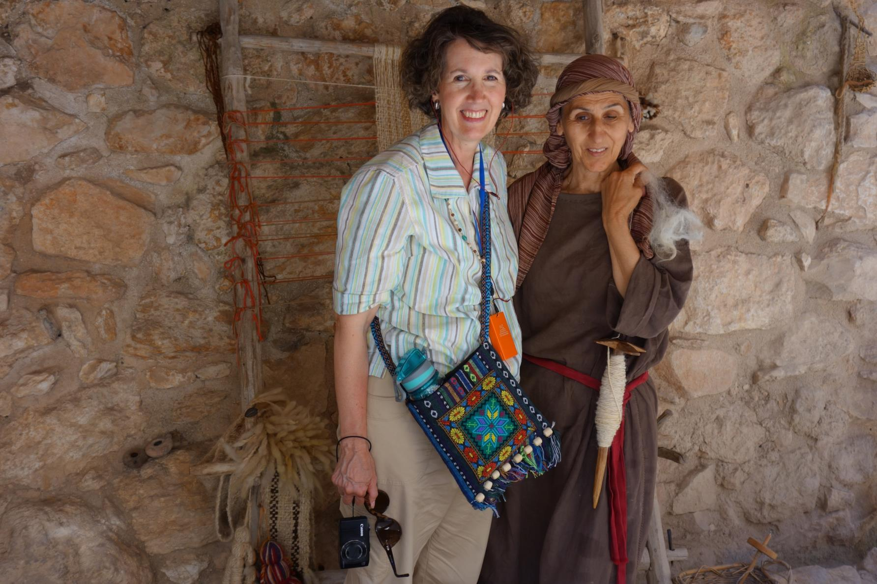

Slide 16
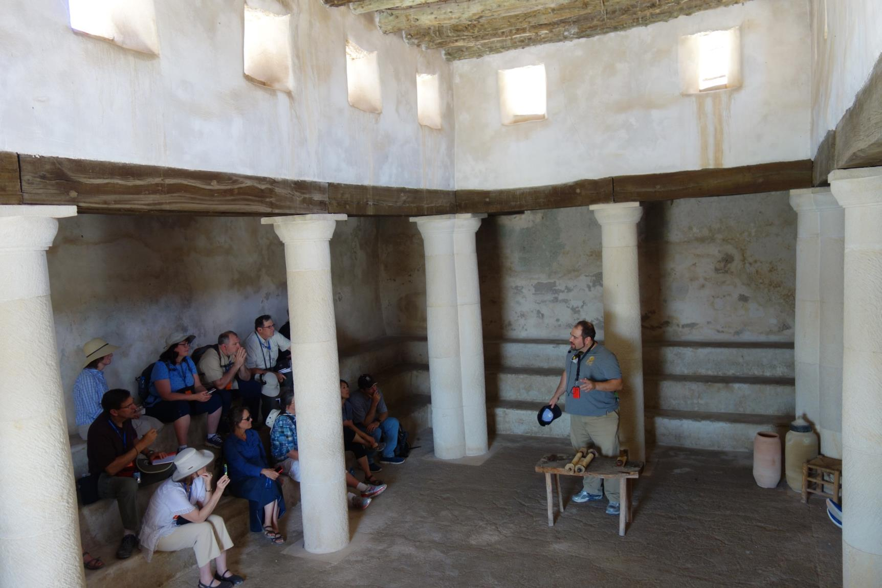

Slide 17
The Spirit of the LORD is upon me, because He anointed me to preach the gospel to the poor. He has sent me to proclaim release to the captives, and recovery of sight to the blind, to set free those who are down-trodden, to proclaim the favorable year of the LORD.
--Isaiah 61:1-2

Slide 18
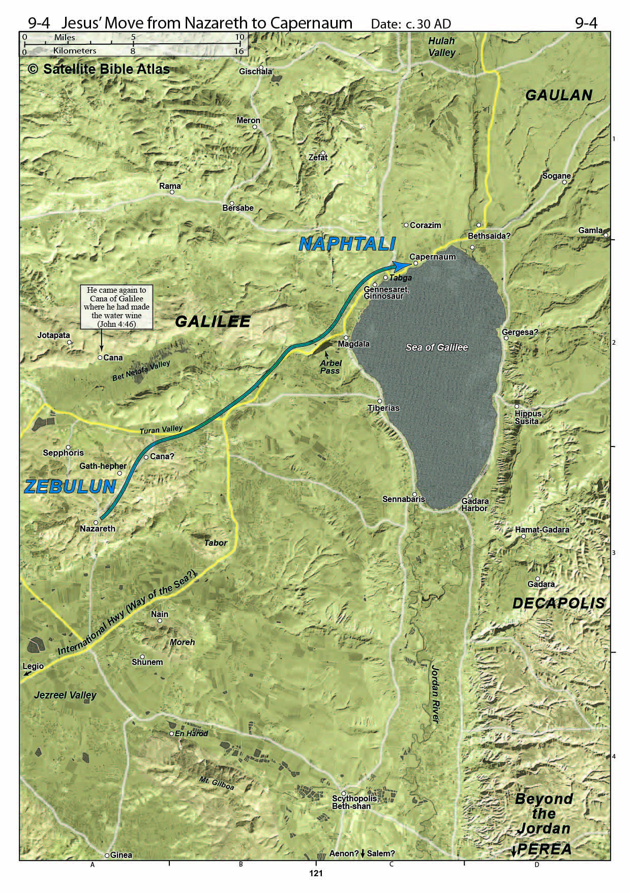

Slide 19
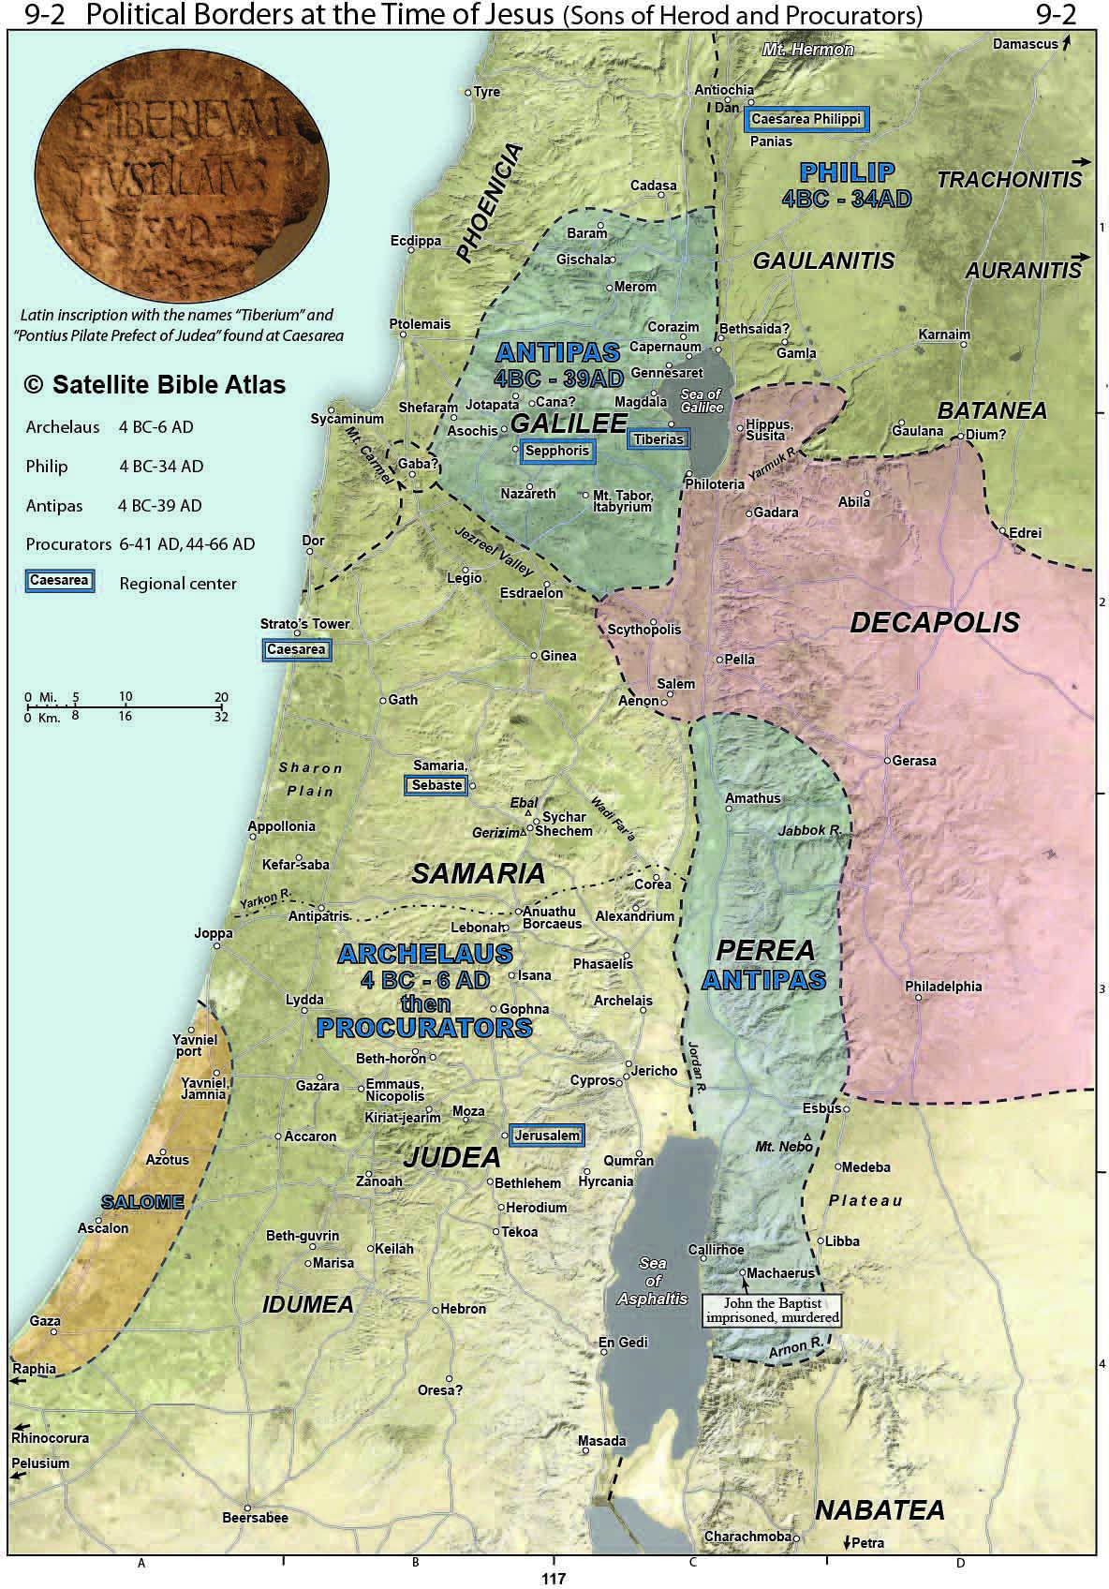
Tiberias was founded sometime around 20 CE in the Herodian Tetrarchy of Galilee and Peraea by the Roman client king Herod Antipas, son of Herod the Great. Herod Antipas made it the capital of his realm in the Galilee and named it for the Roman Emperor Tiberius.^{[6]} The city was built in immediate proximity to a spa which had developed around 17 natural mineral hot springs, Hammat Tiberias.

Slide 21
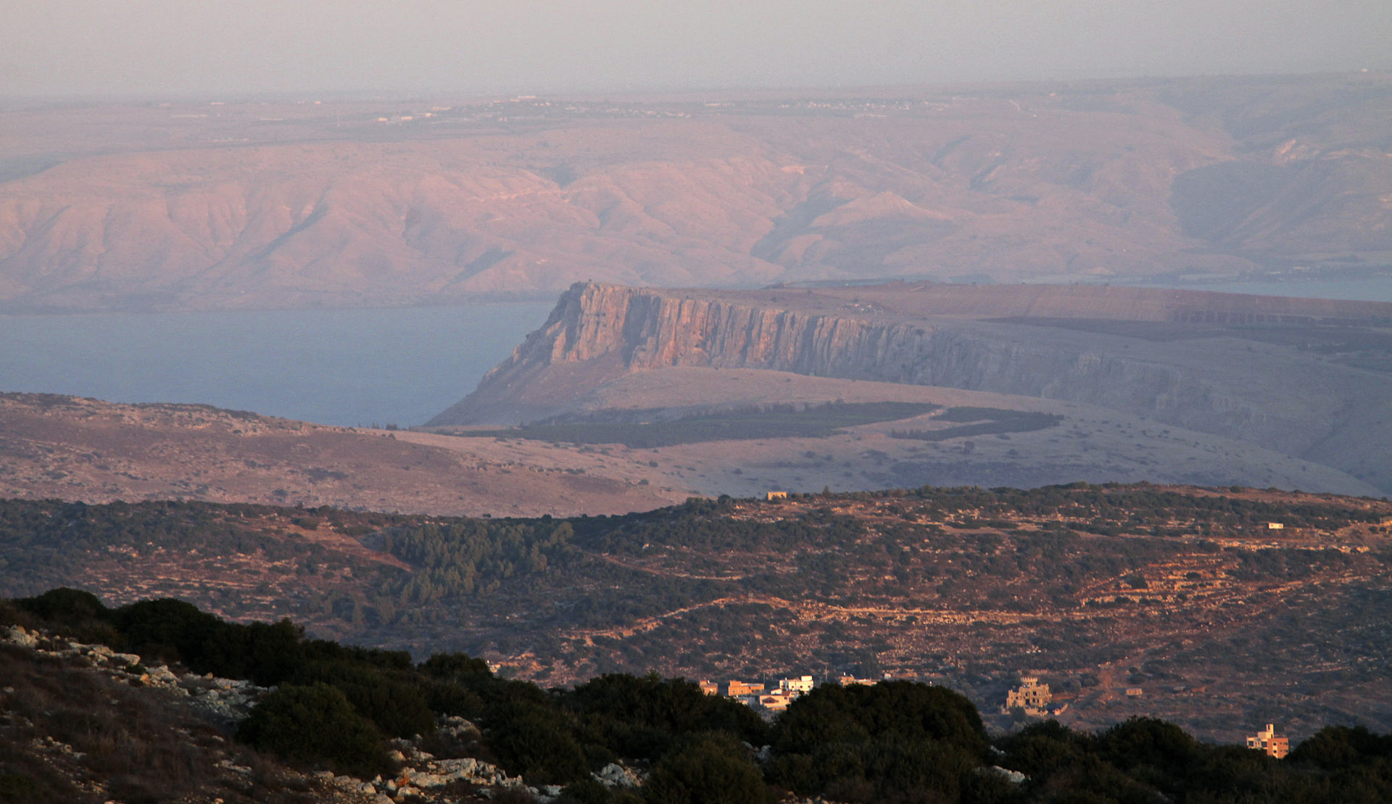

Slide 22
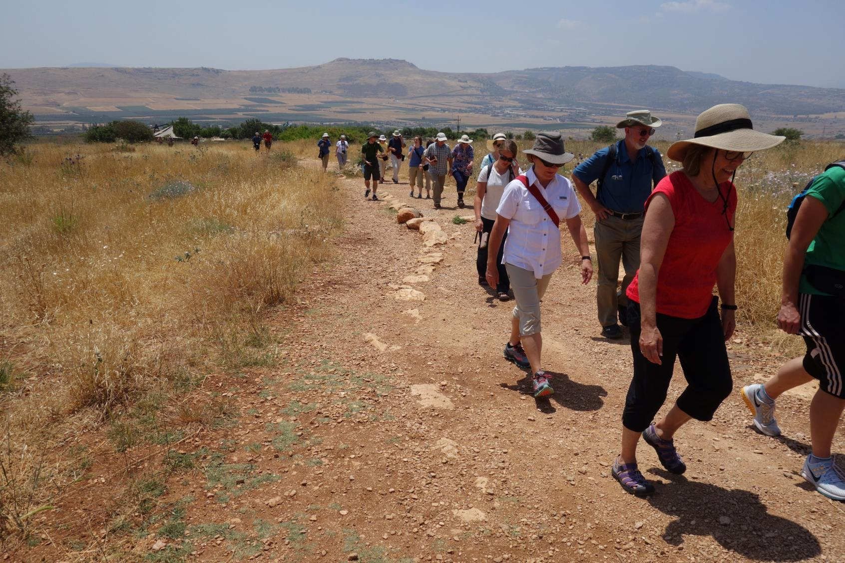

Slide 23
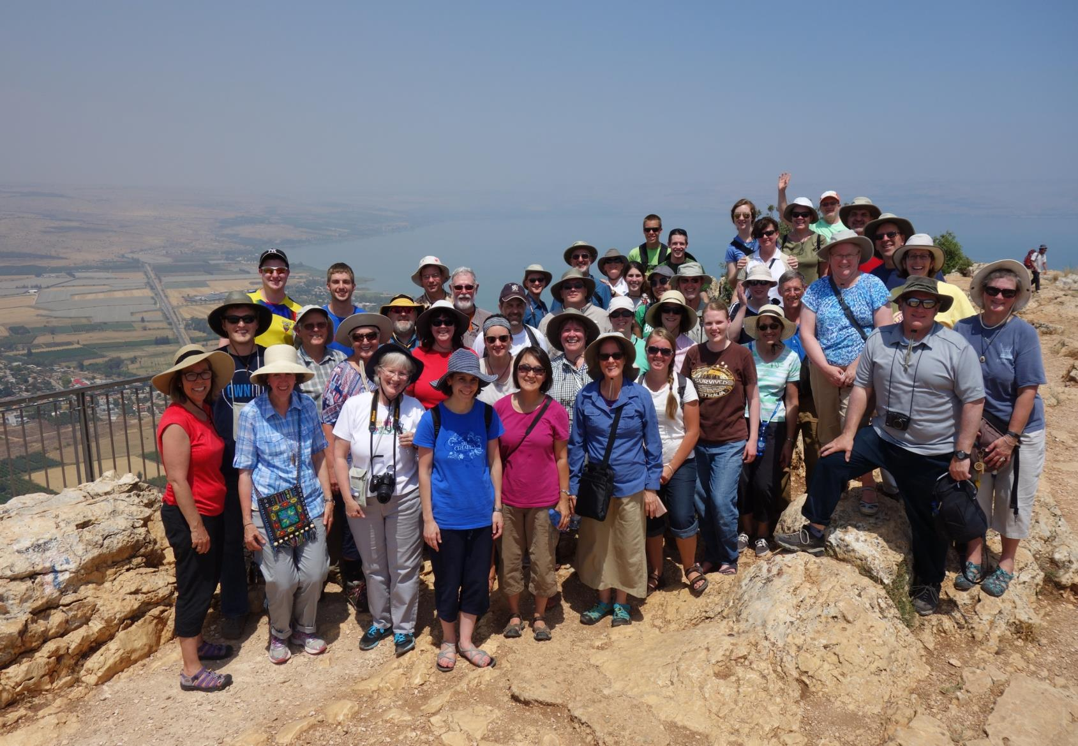

Slide 24
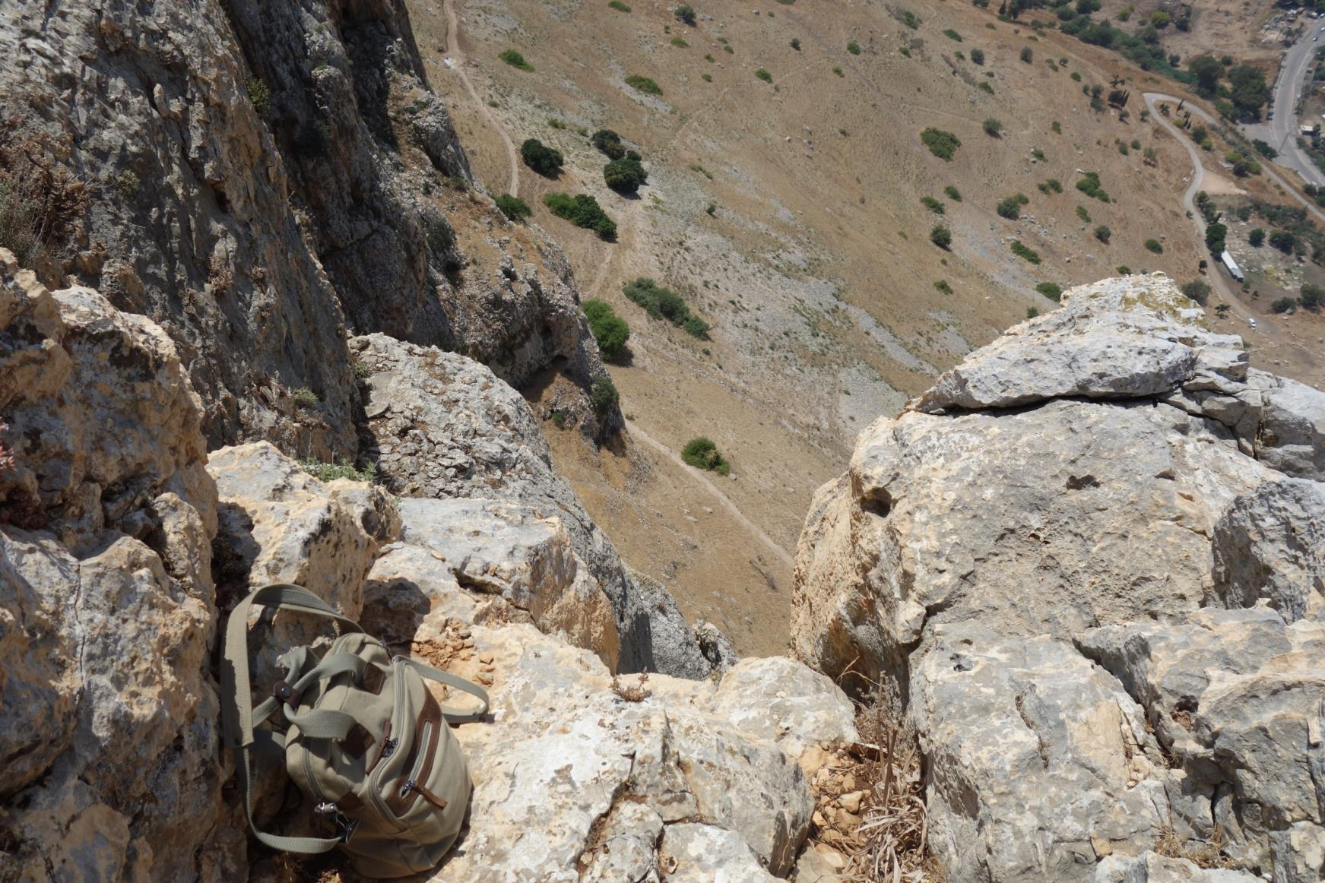
1250 foot prominence. Some 550 feet above sea level (much of surrounding area is below sea level)

Slide 25
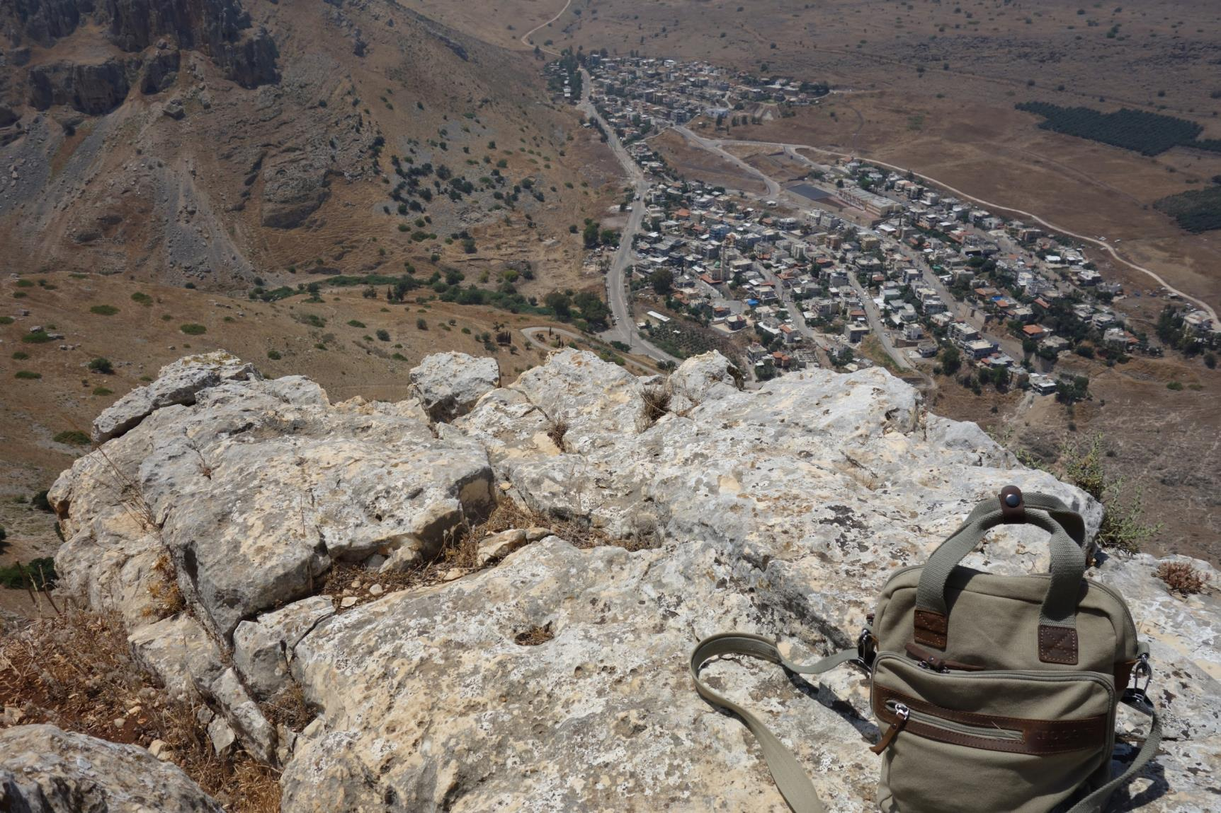

Slide 26
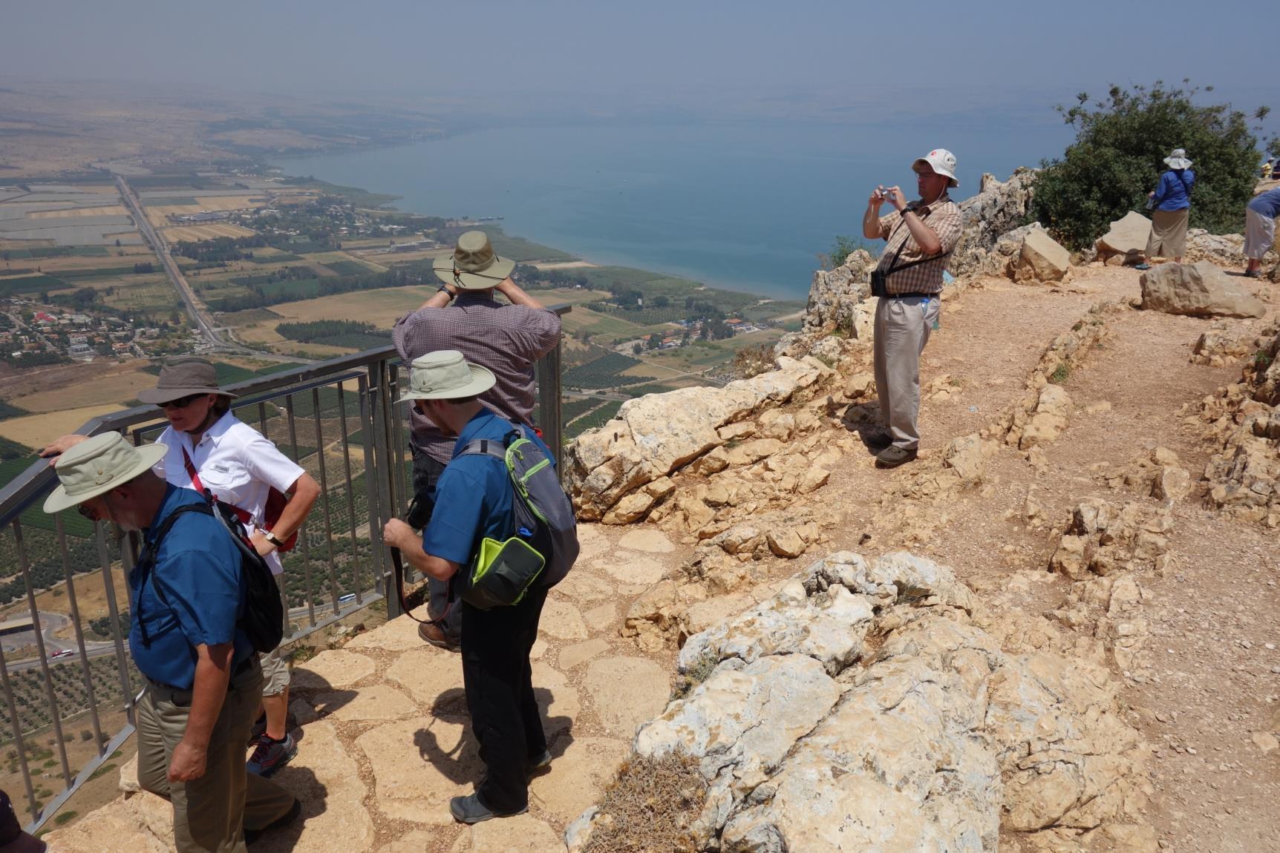

Slide 27
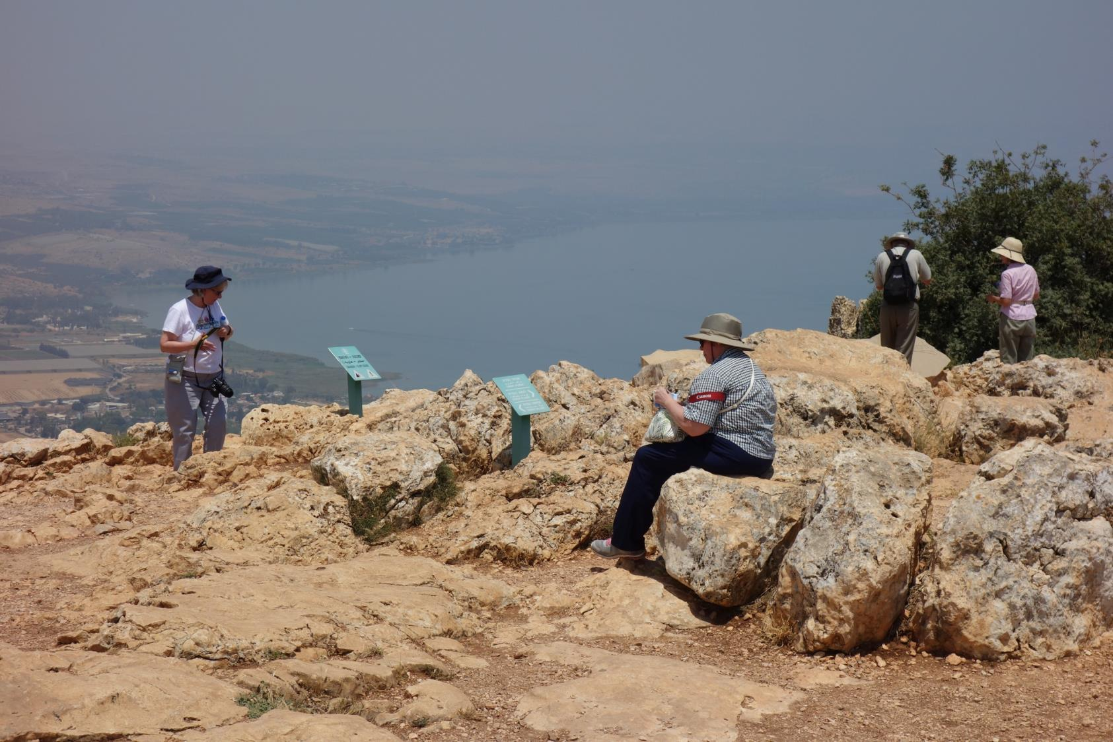

Slide 28
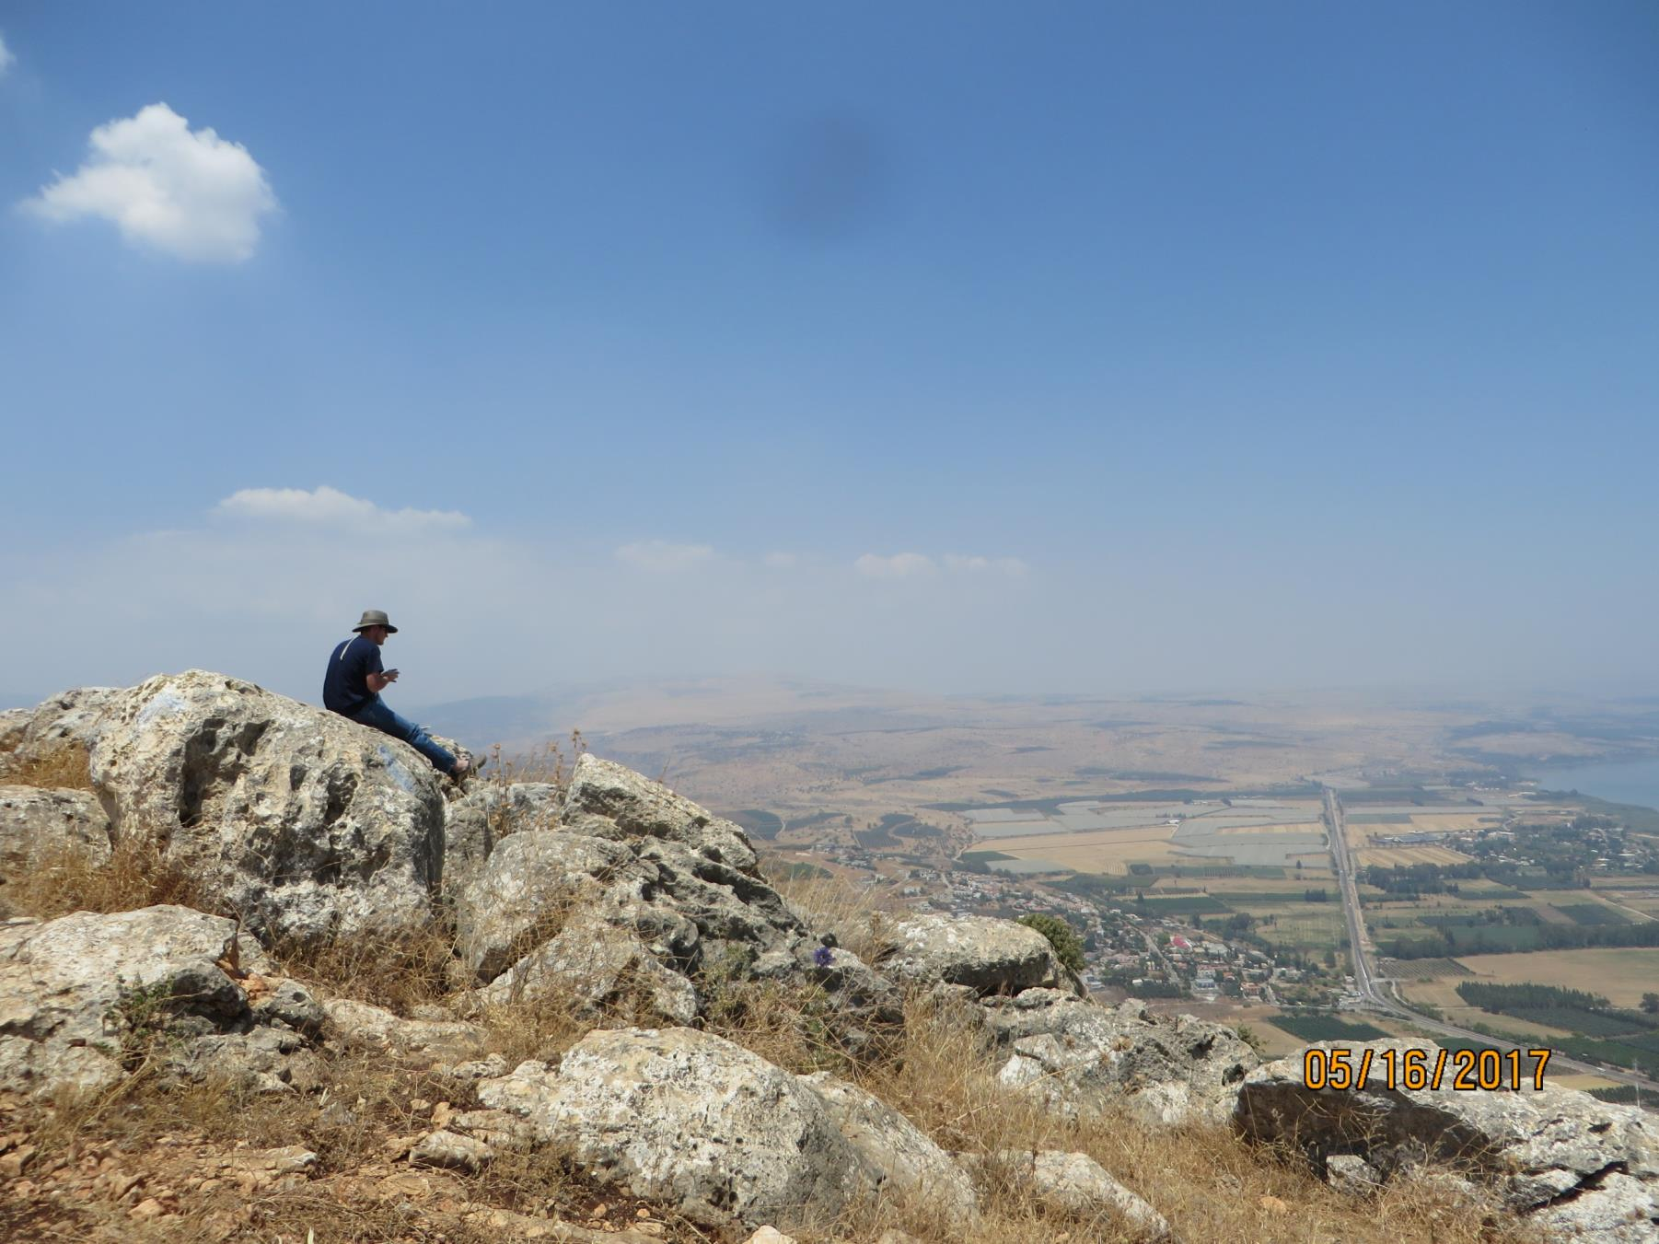

Slide 29
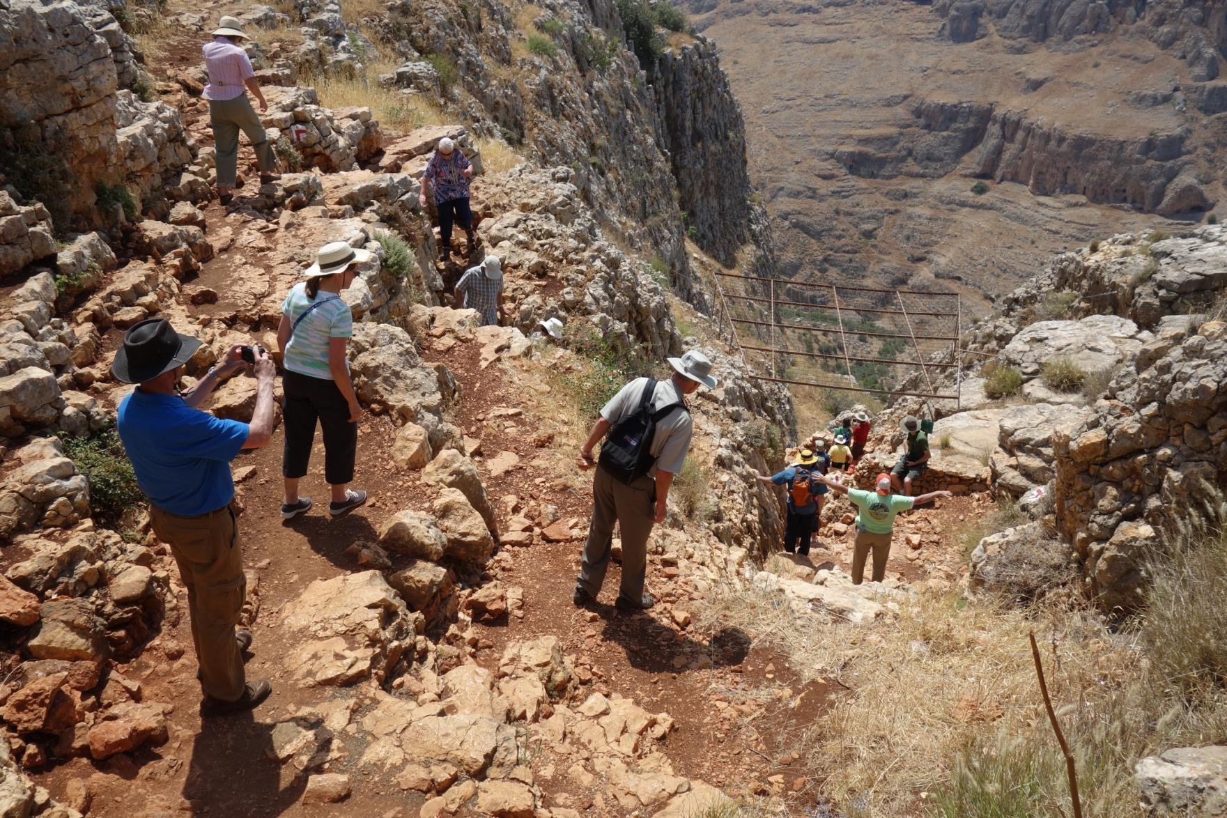

Slide 30
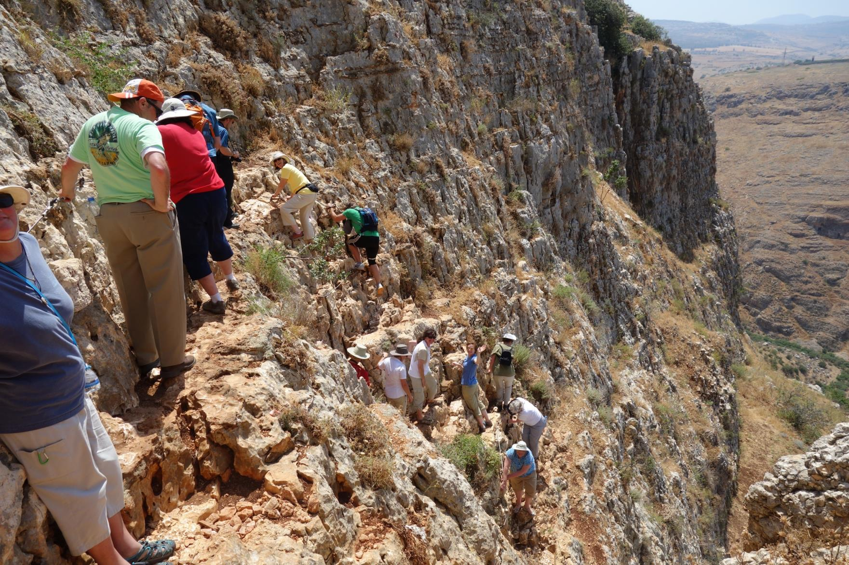

Slide 31
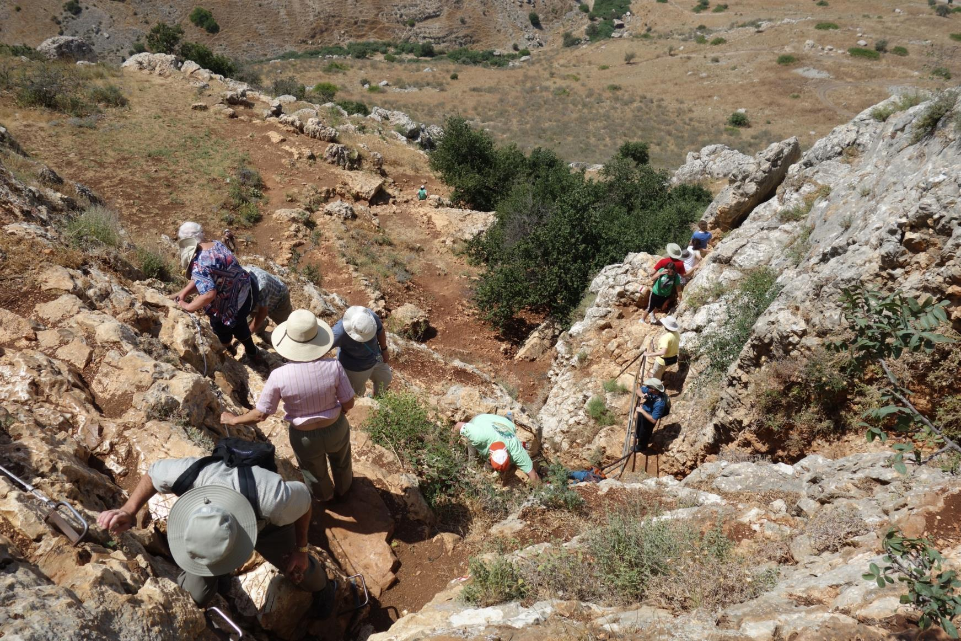

Slide 32
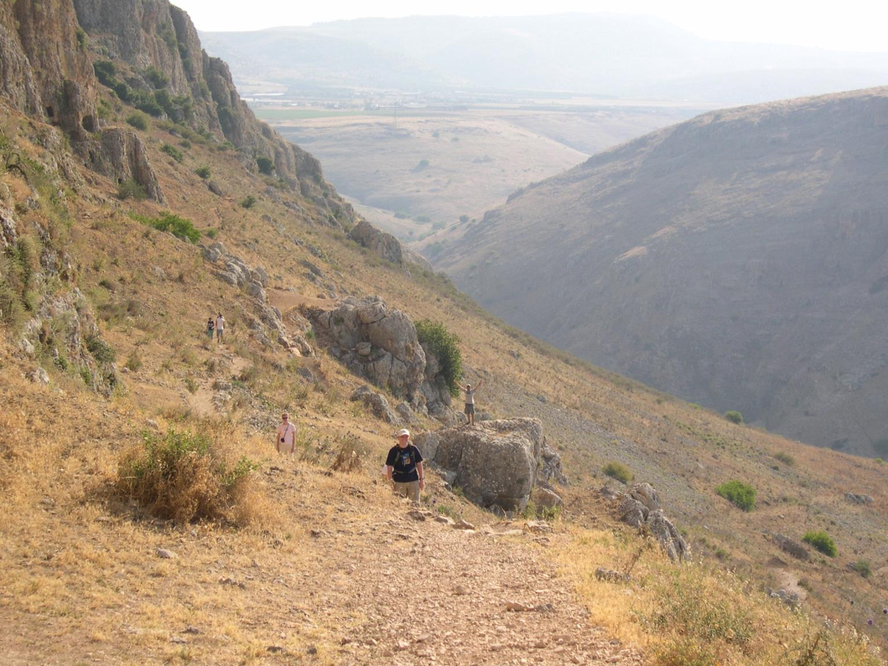

Slide 33
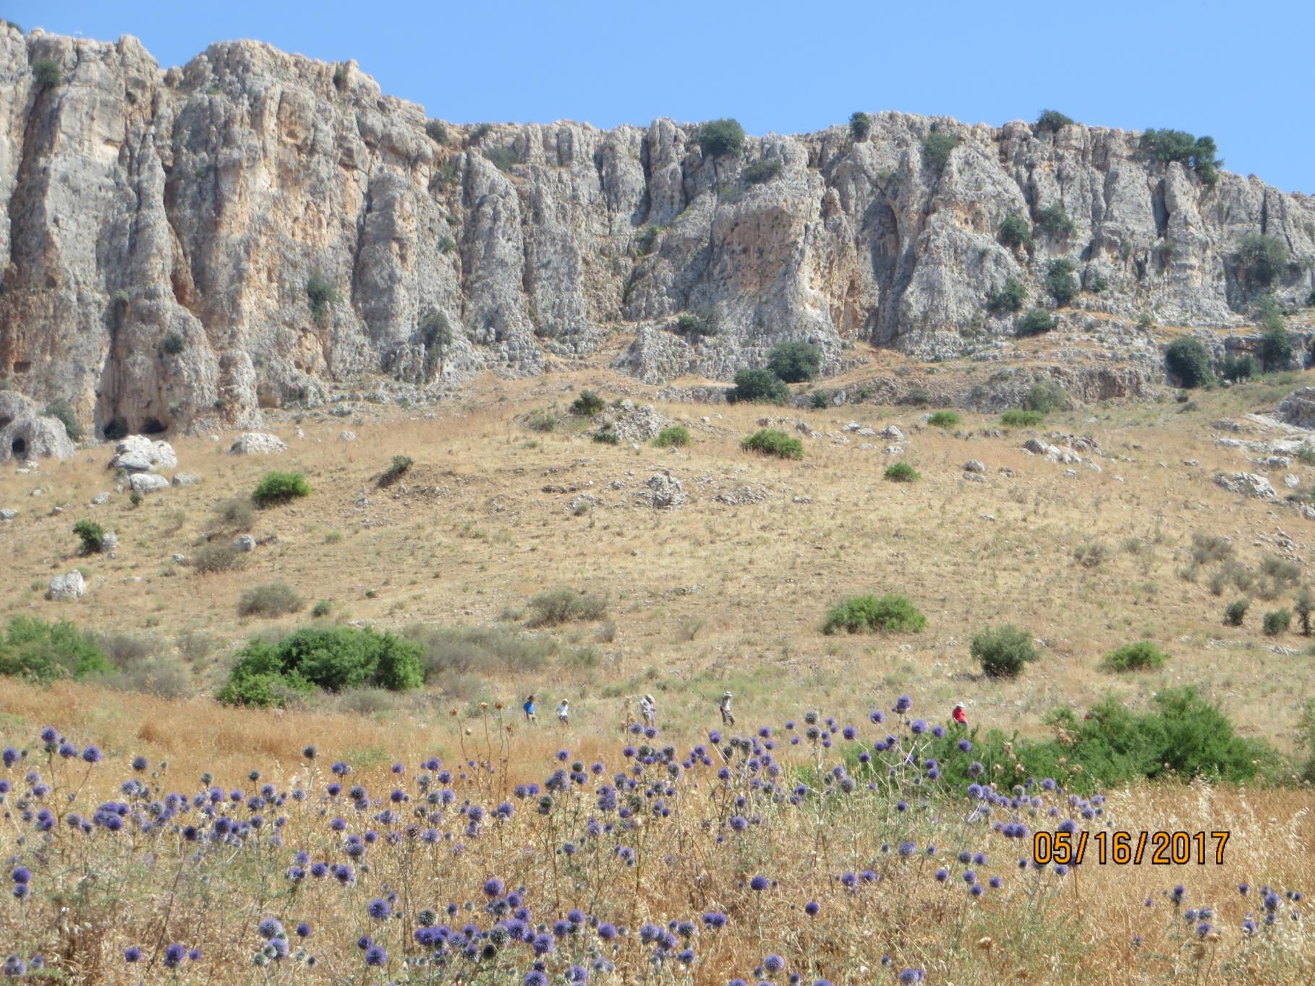

Slide 34
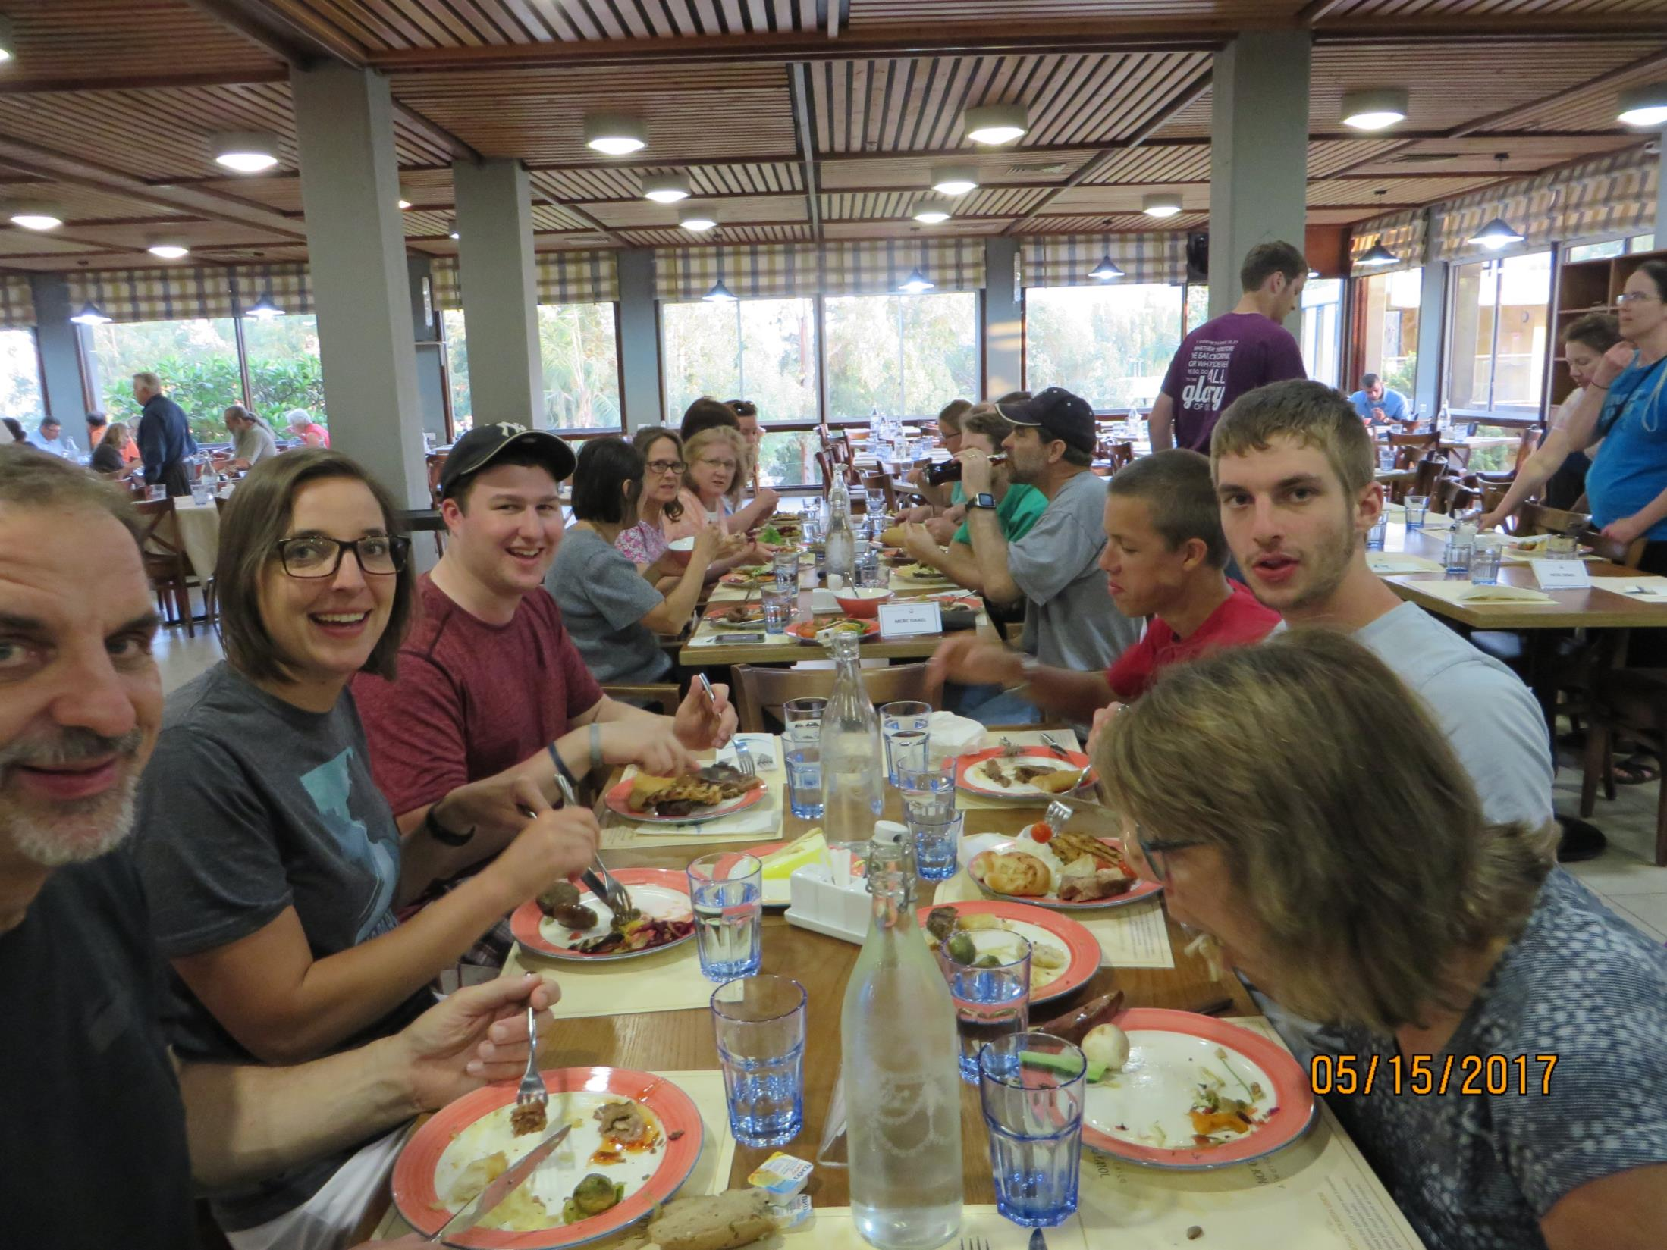

Slide 35
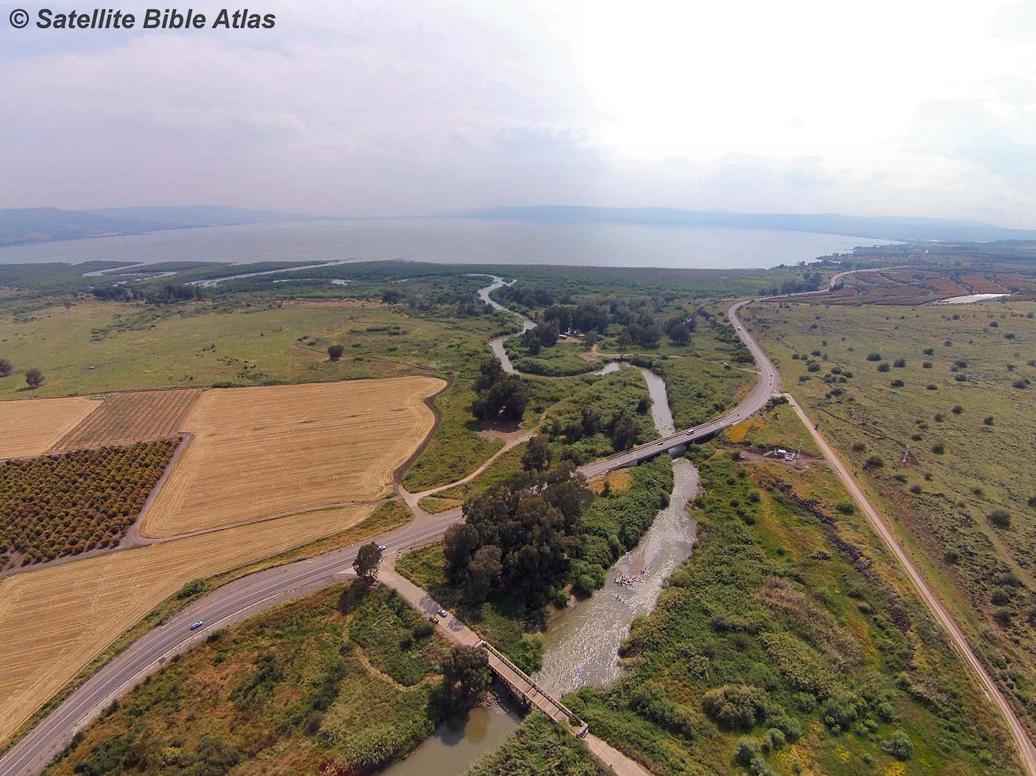
13 x 8 miles. 33 miles in circumference. 140 feet deep. Shoreline of Lake Hartwell is over 900 miles. Jocassee is 75 miles of shoreline.

Slide 36
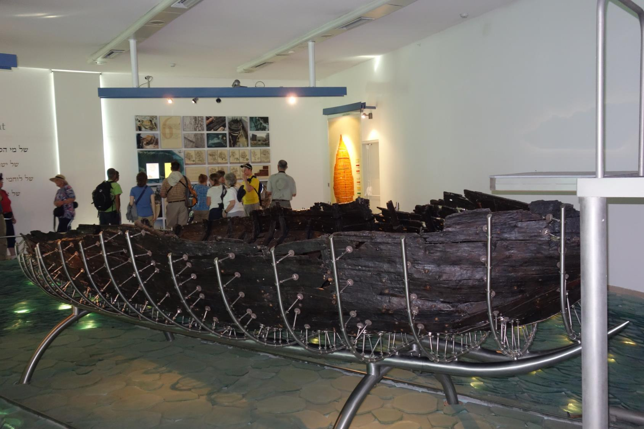

Slide 37
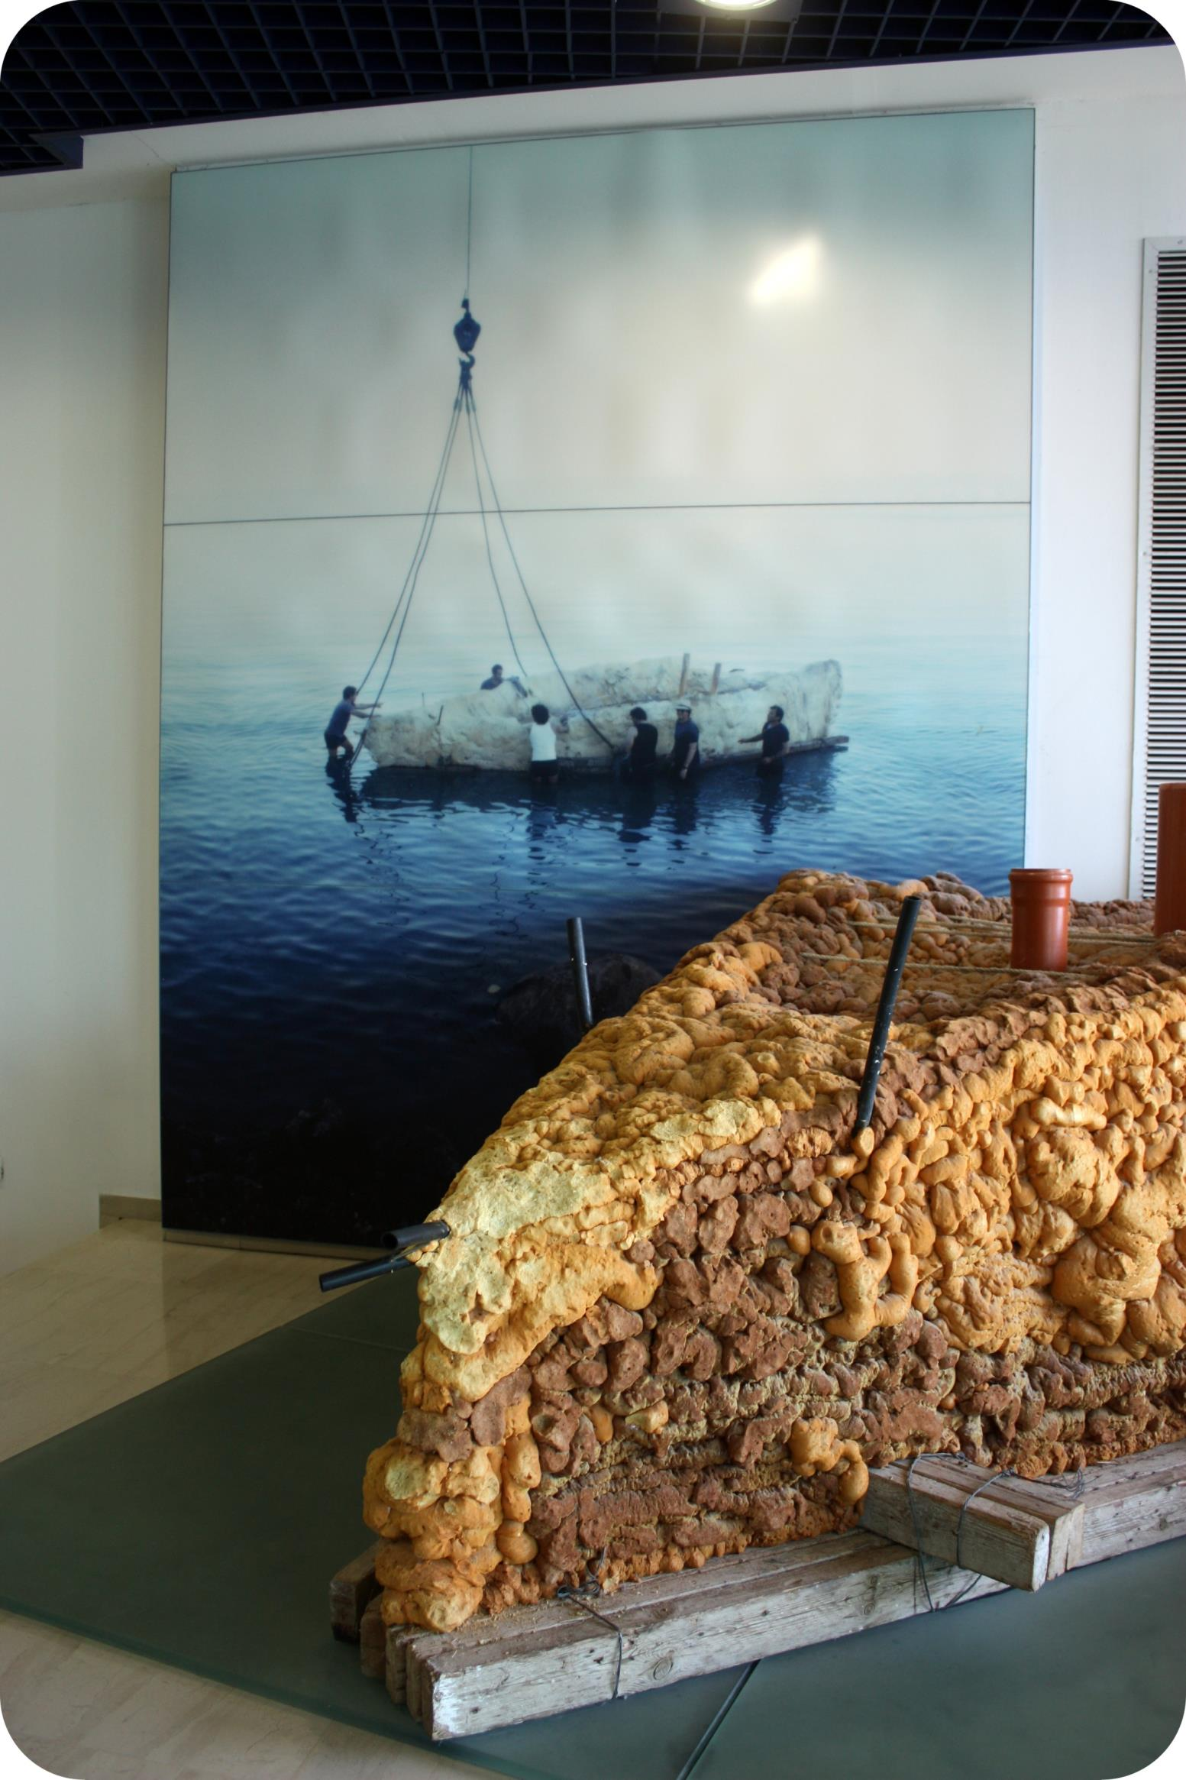

Slide 38
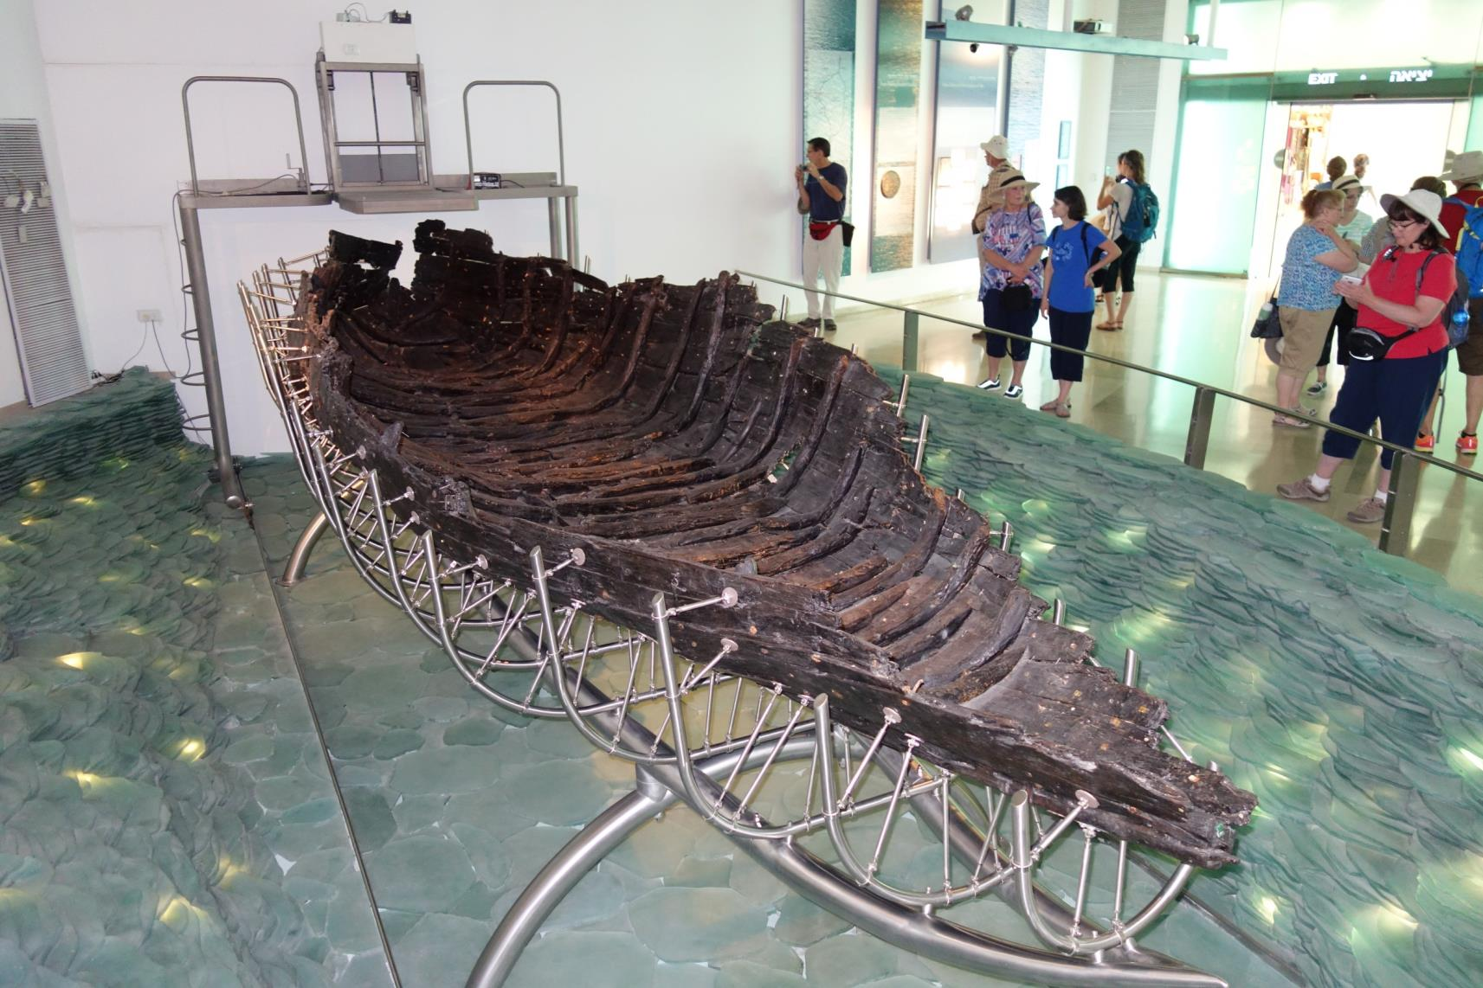

Slide 39
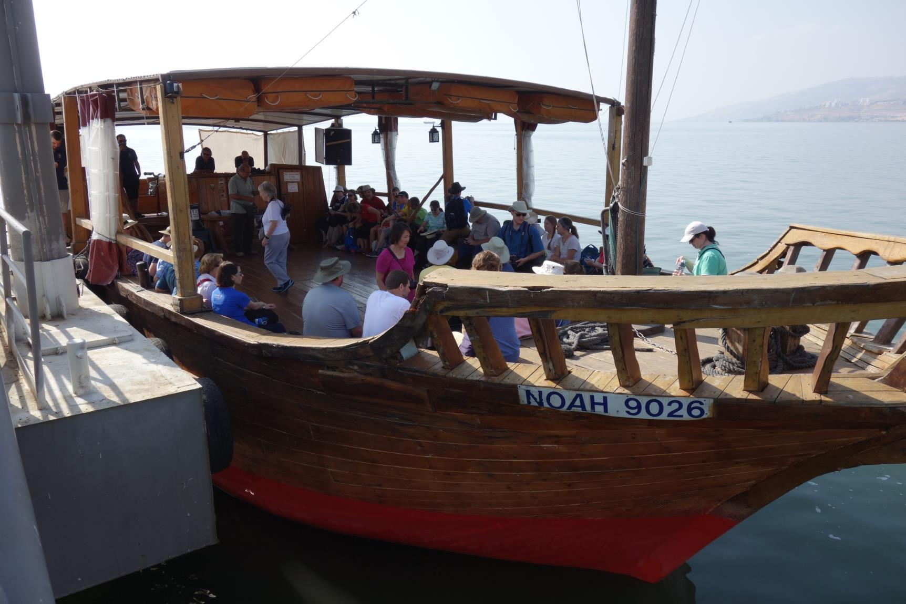

Slide 40
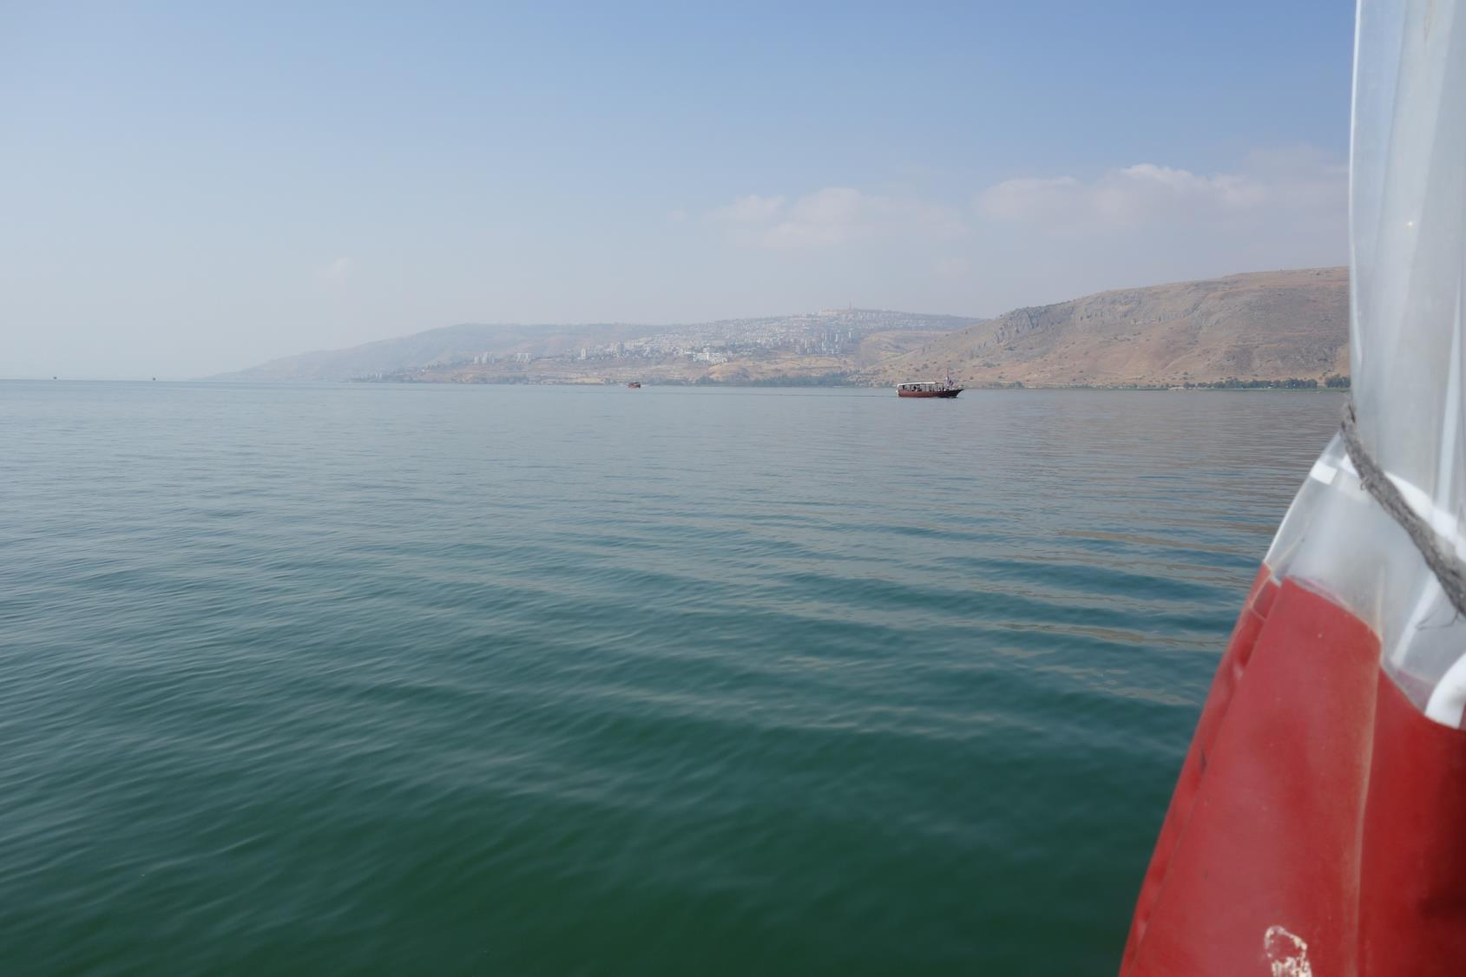

Slide 41
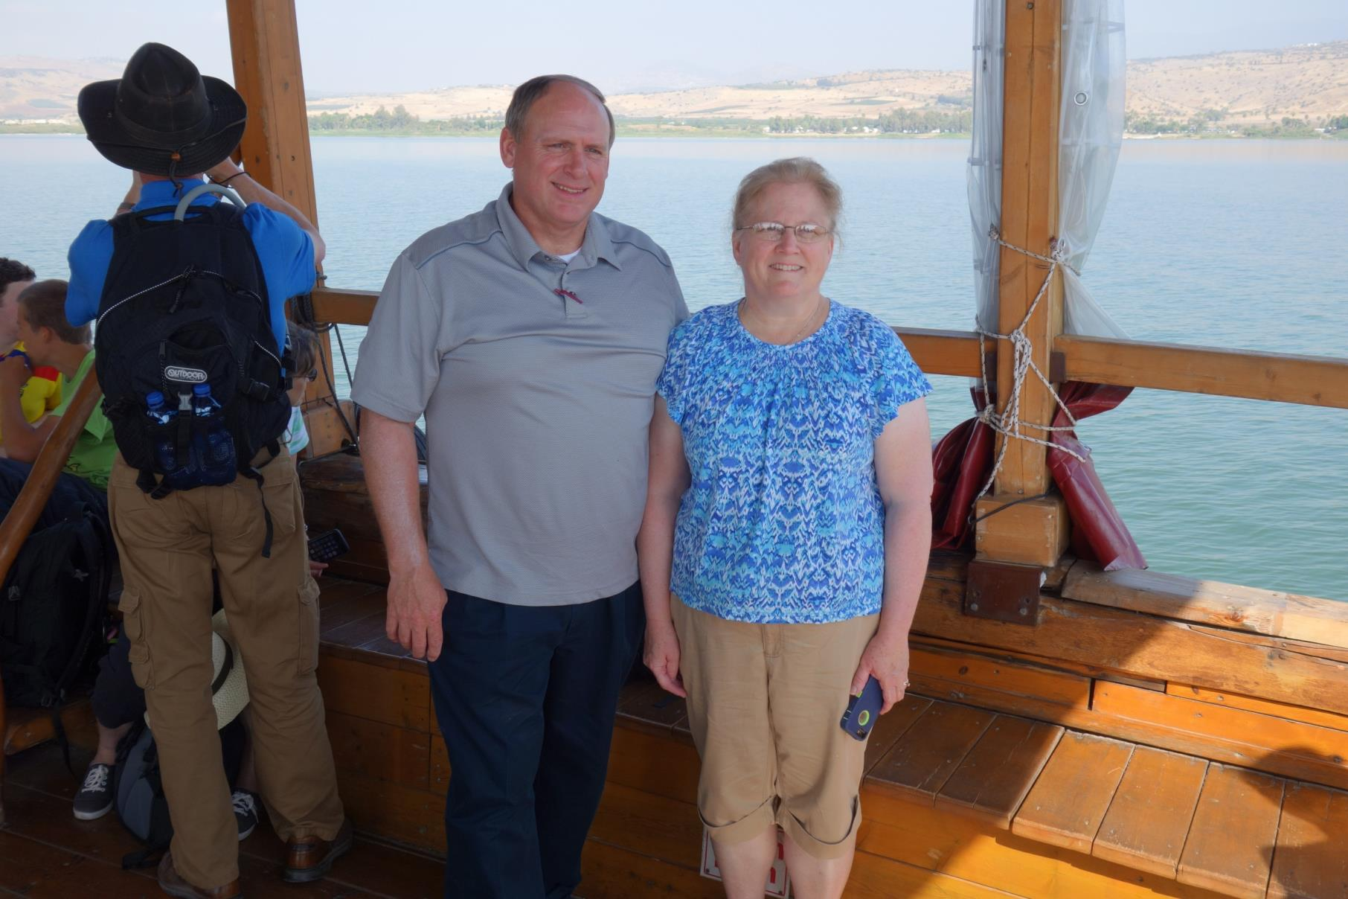

Slide 42
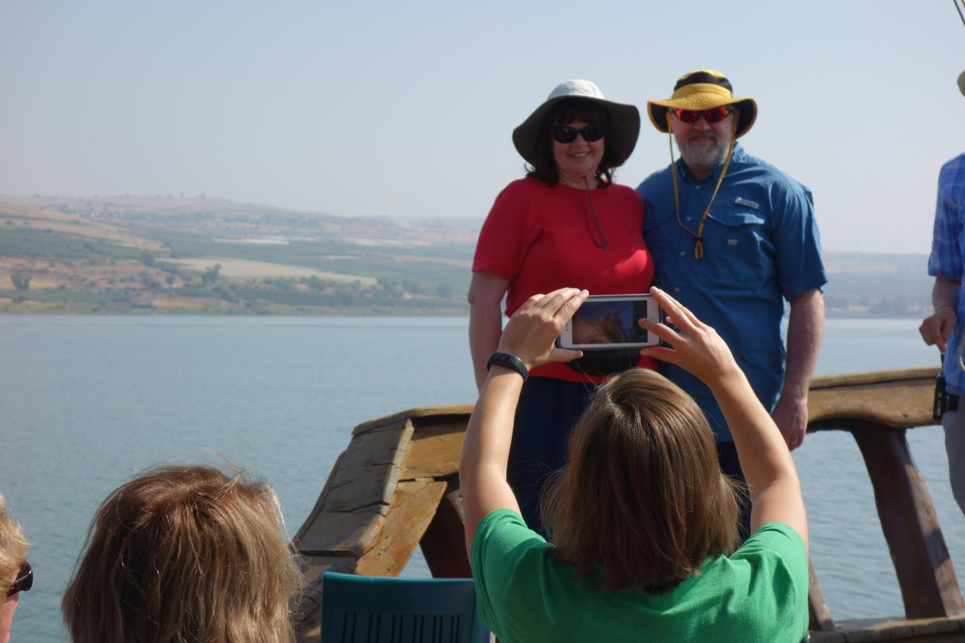

Slide 43
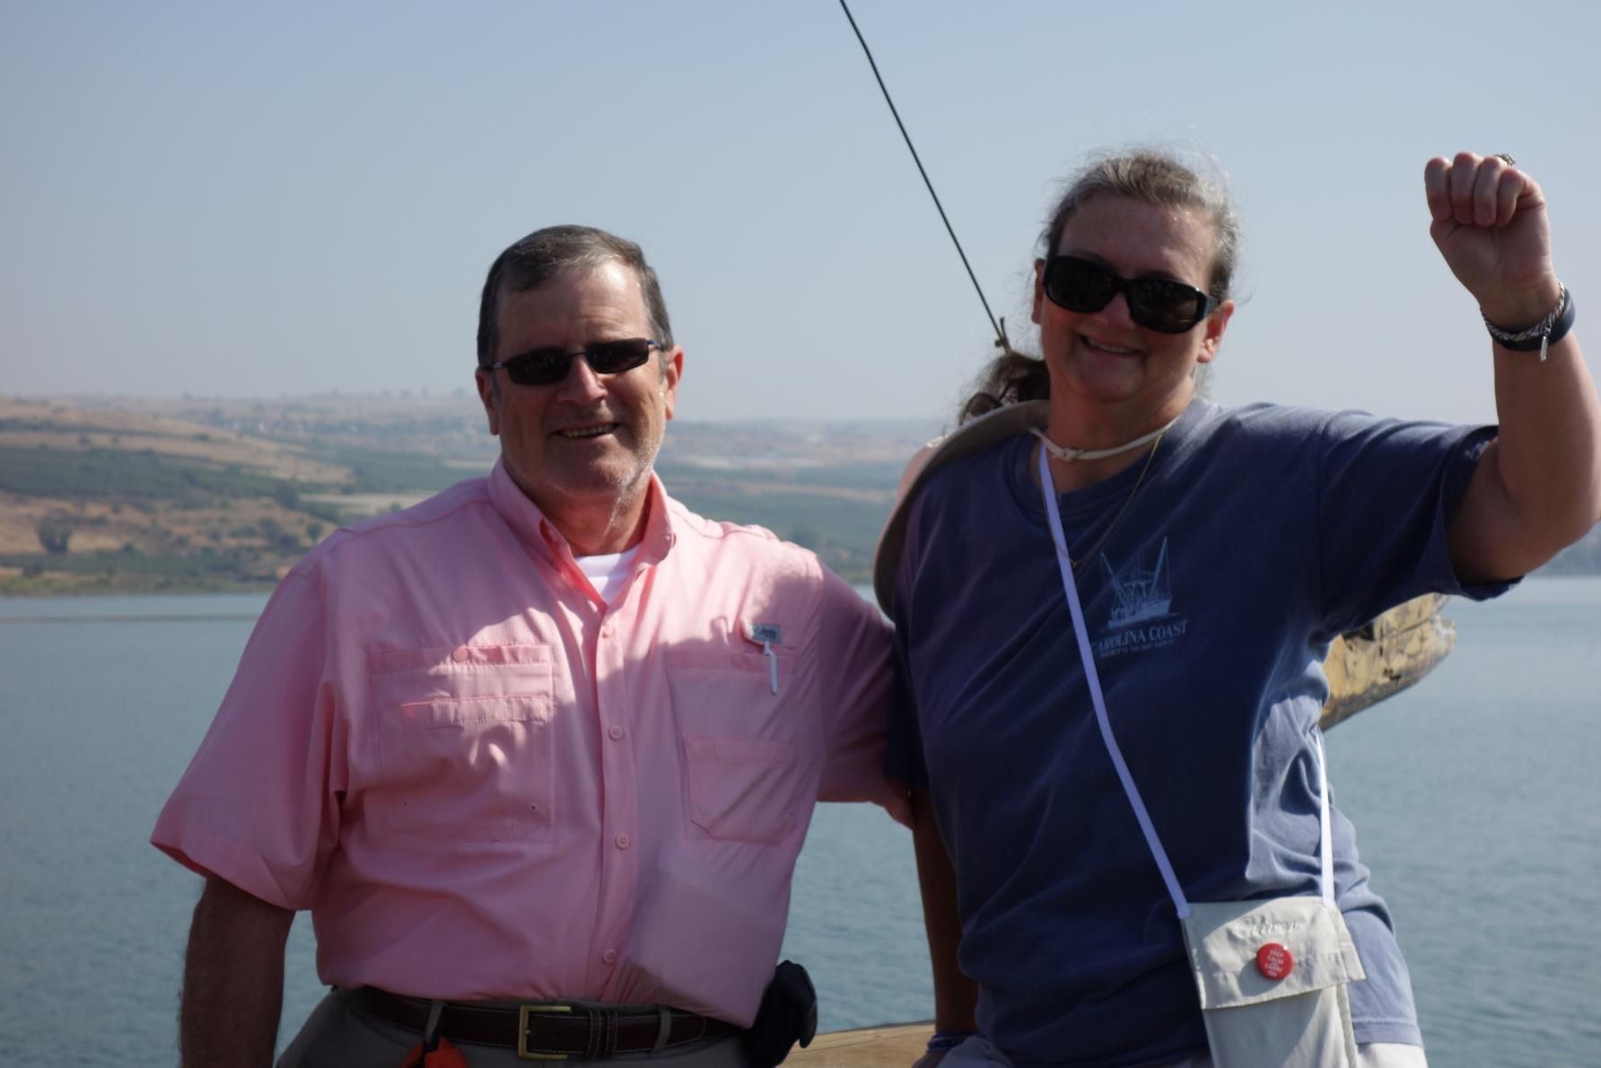

Slide 44
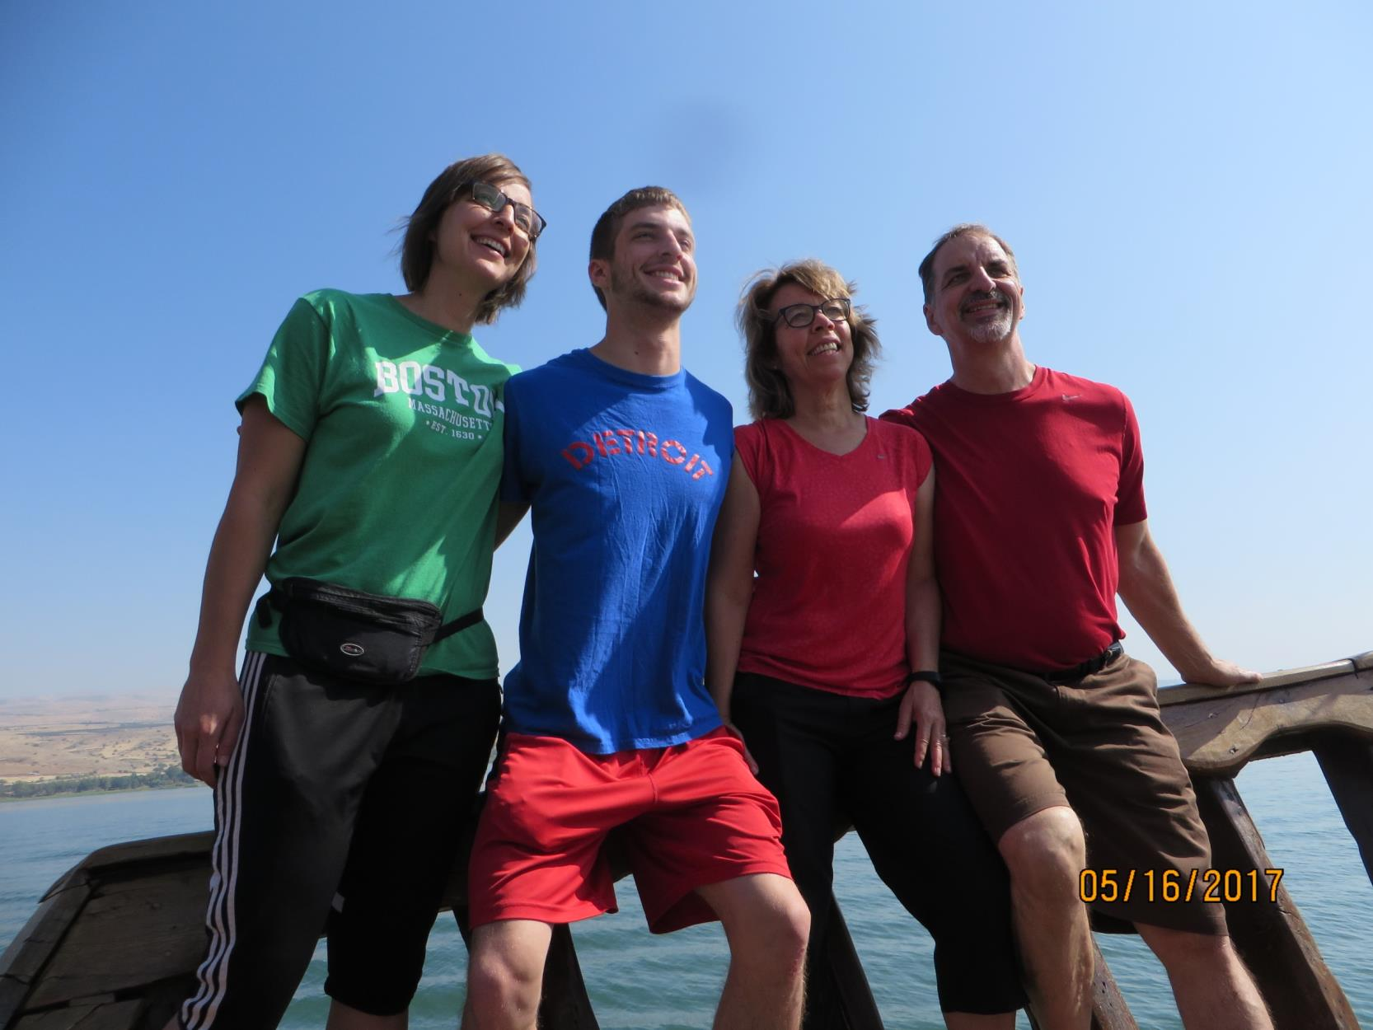

Slide 45
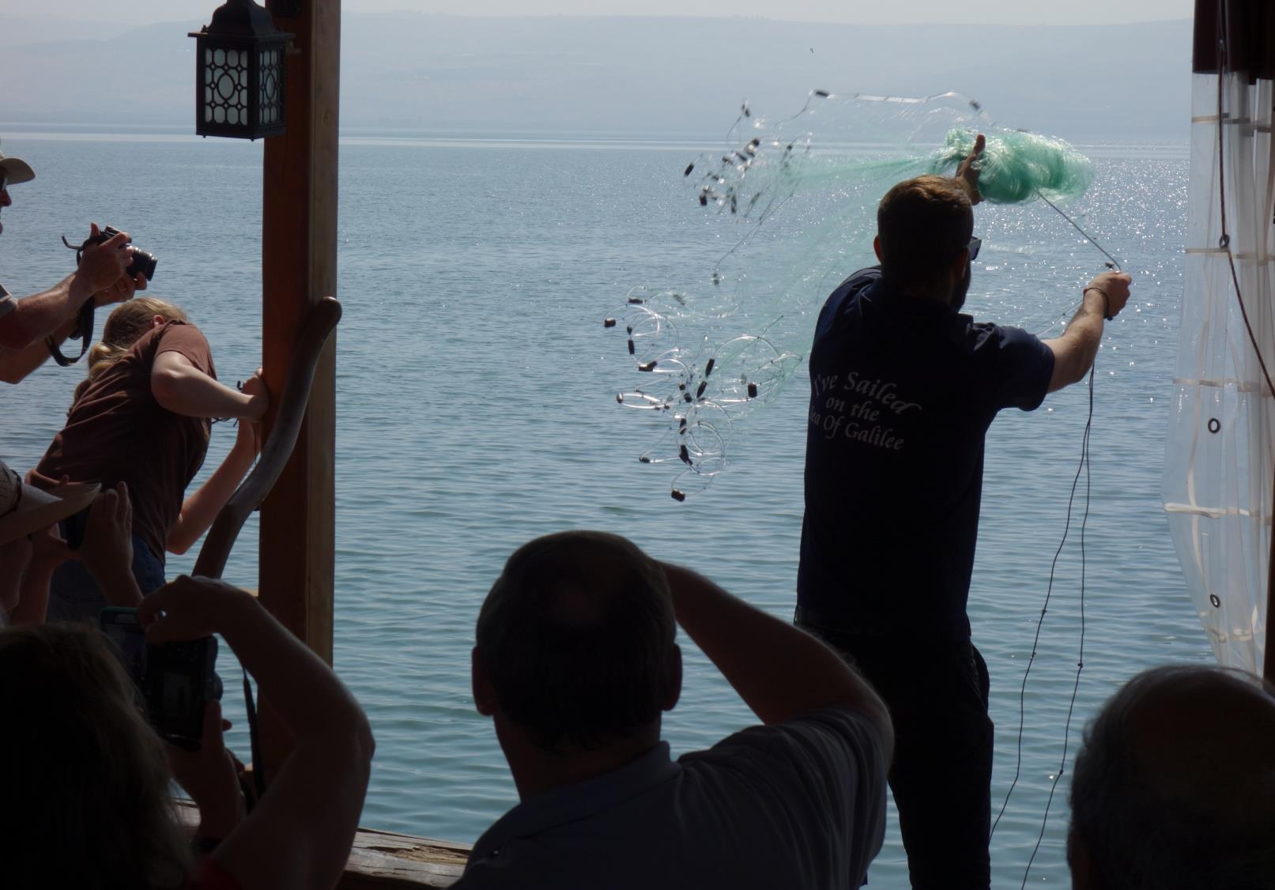

Slide 46
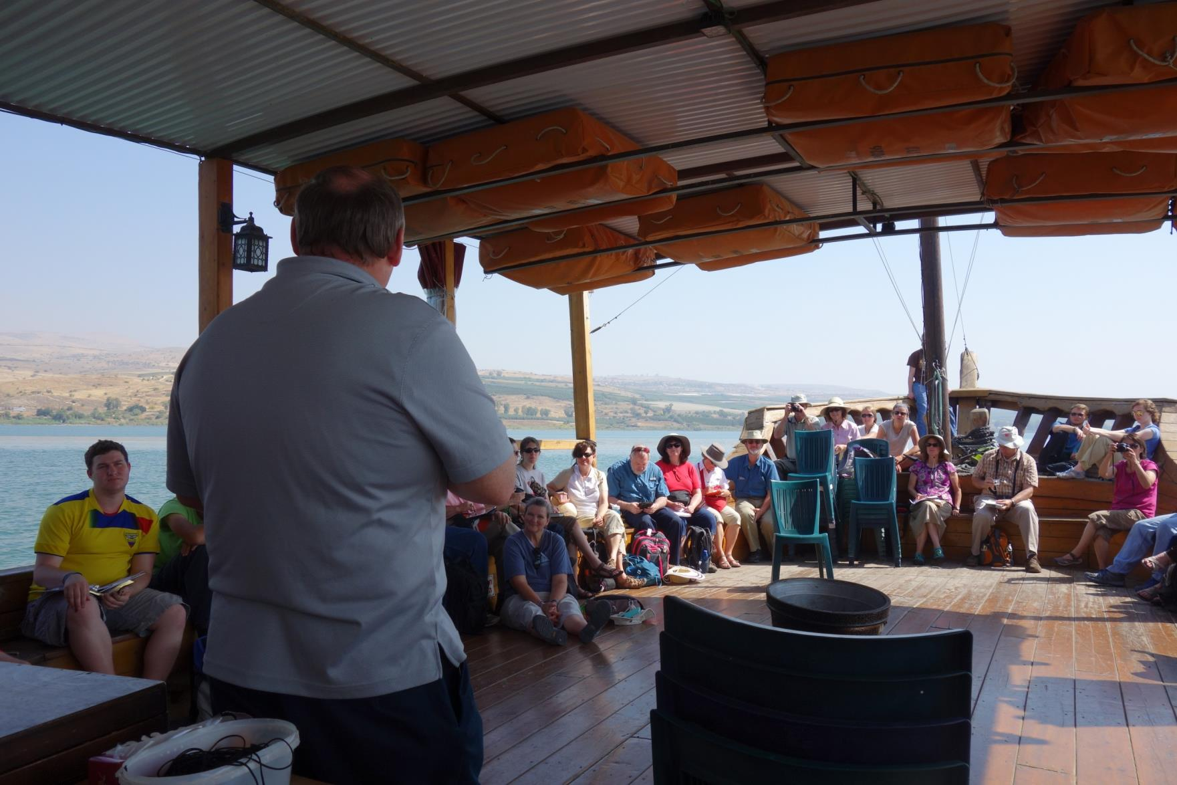

Slide 47
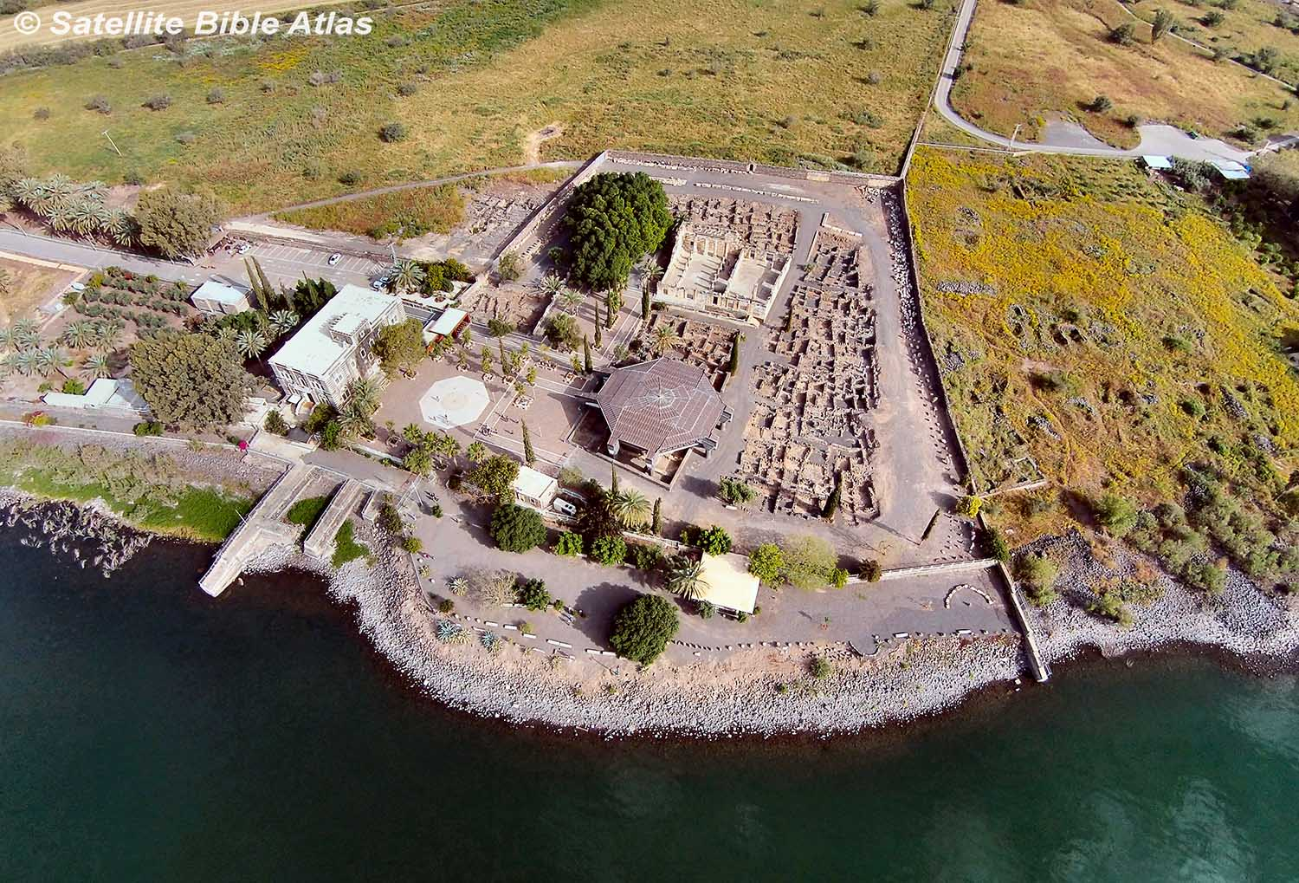

Slide 48
Apostles:
Peter, Andrew, James, John,
and Matthew

Slide 49
Apostles:
Peter, Andrew, James, John,
and Matthew
Jesus’ family:
Mary, James, Jude. . .

Slide 50
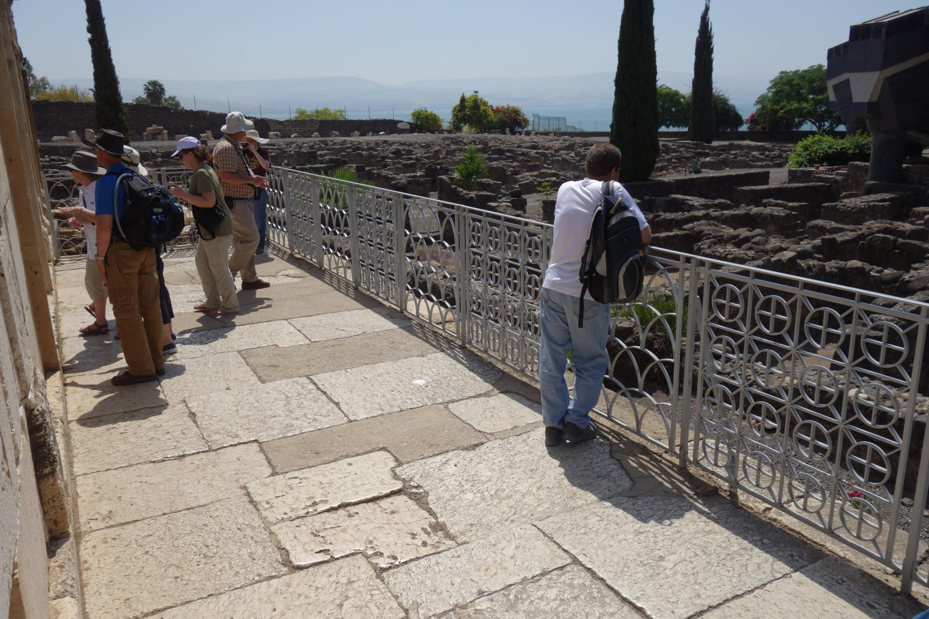

Slide 51
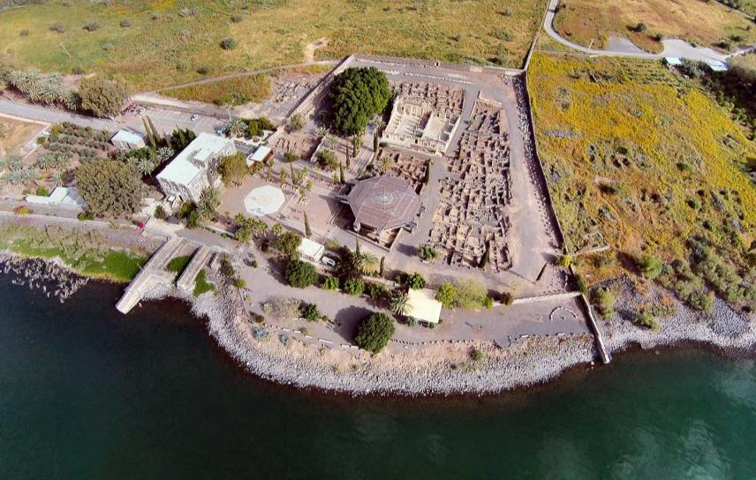
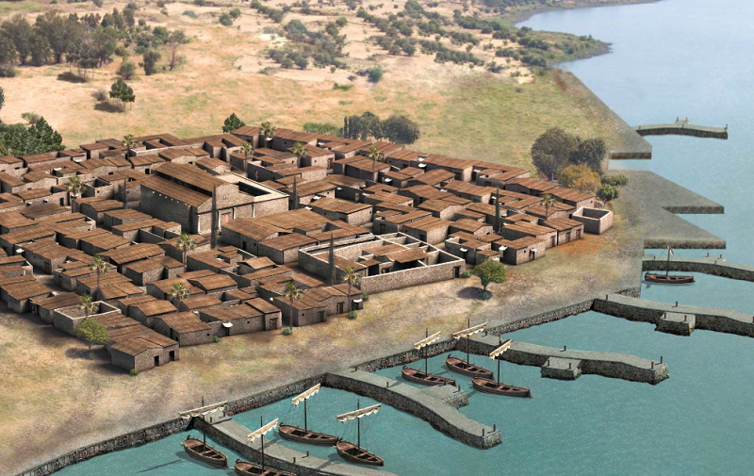

Slide 52
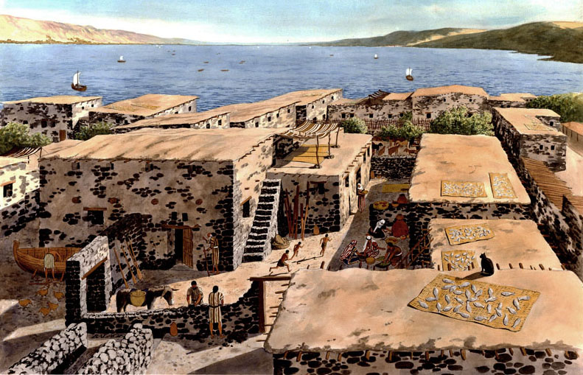

Slide 53
Matthew 4:13-16

Slide 54
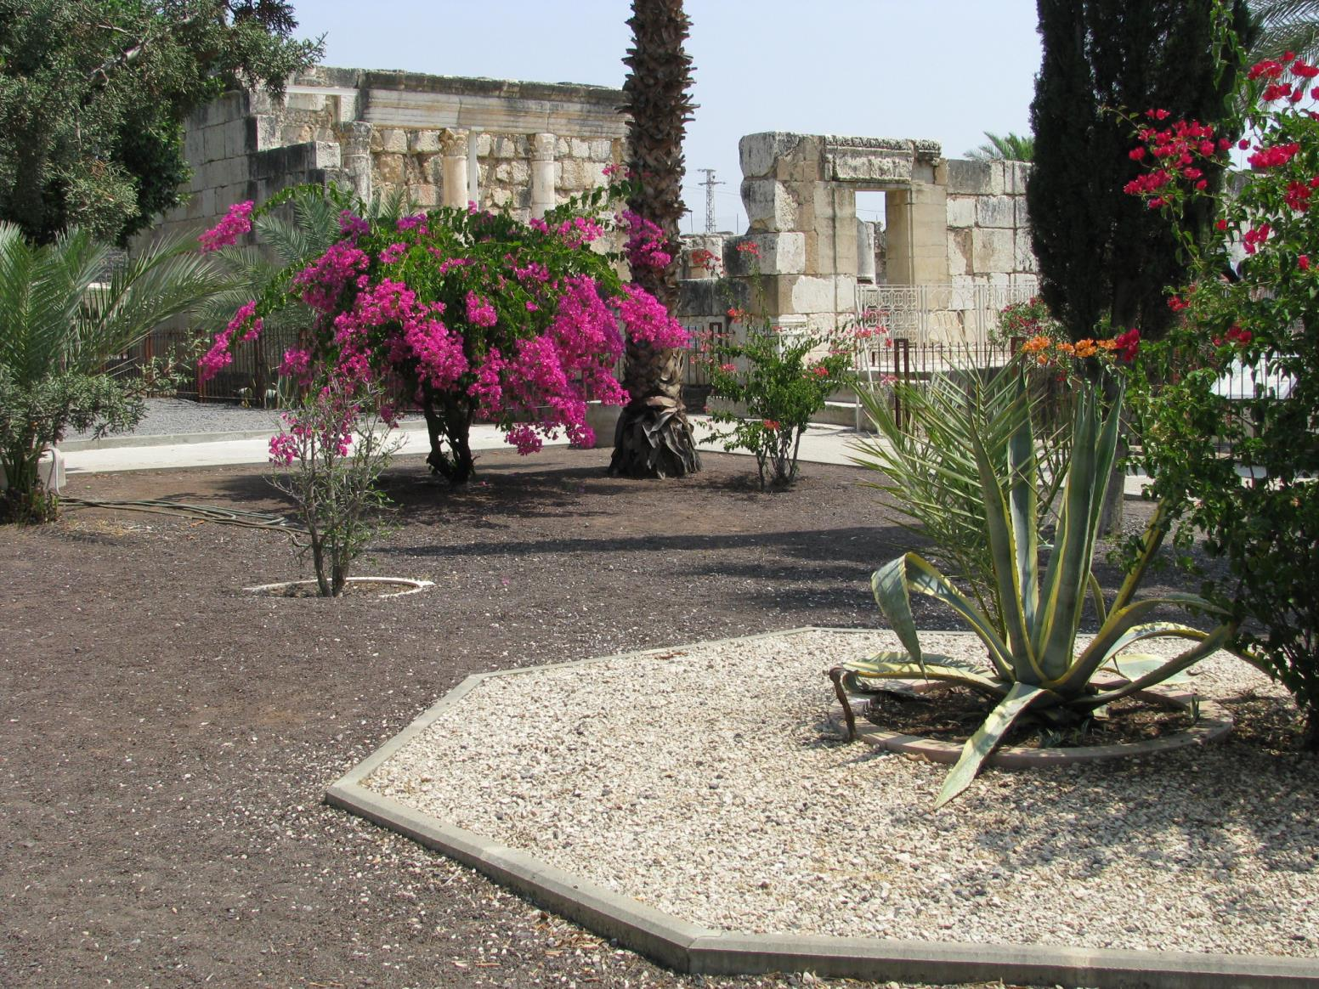

Slide 55
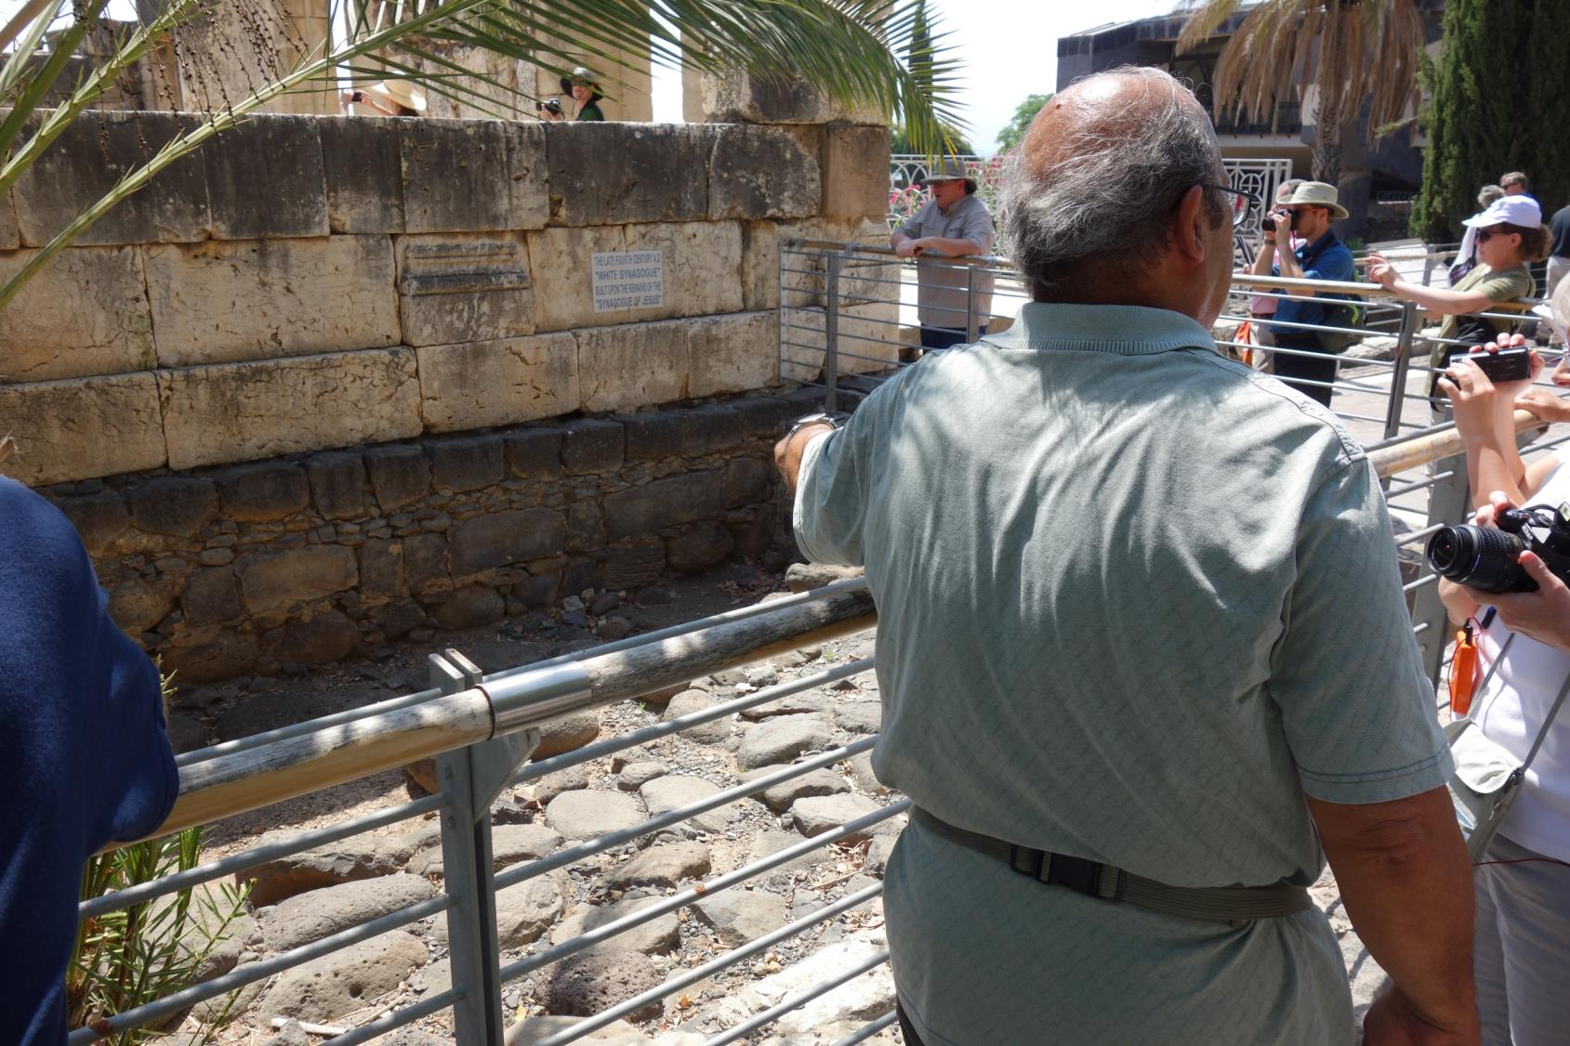

Slide 57
And He entered the synagogue and began to teach. They were amazed at His teaching; for He was teaching them as having authority, and not as the scribes. Just then there was a man in their synagogue with an unclean spirit. . . (Mark 1:21-23).

Slide 60
He is worthy for You to grant this to him; for he
loves our nation and it was he who built us
our synagogue (Luke 7:4b-5).

Slide 61
I am the bread of life

Slide 69
"Then He began to denounce the cities in which most of his miracles were done, because they did not repent. Woe to you, Chorazin! Woe to you, Bethsaida! For if the miracles had been done in Tyre and Sidon which occurred in you, they would have repented long ago in sackcloth and ashes. Nevertheless, I say to you, it will be more tolerable for Tyre and Sidon in the day of judgment than for you.

Slide 70
And you, Capernaum, will not be exalted to heaven will you? You will descend to Hades; for if the miracles had occurred in Sodom which occurred in you, it would have remained to this day. Nevertheless I say to you that it will be more tolerable for the land of Sodom in the day of judgment, than for you.
--Matthew 11:20-24

