Slide 1

Prayer is an offering up of our desires unto God, for things agreeable to His will, in the name of Christ, with confession of our sins, and thankful acknowledgment of His mercies.

Slide 2
. . . in the name of Christ. . .

Slide 3
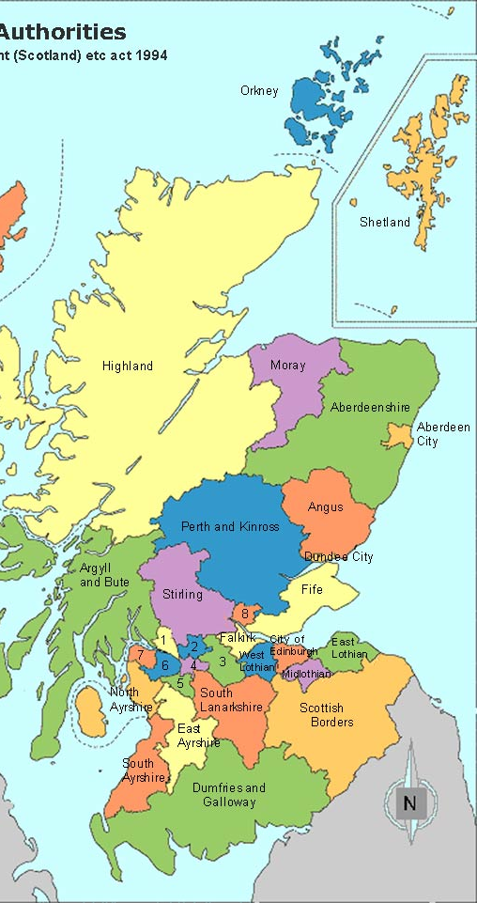
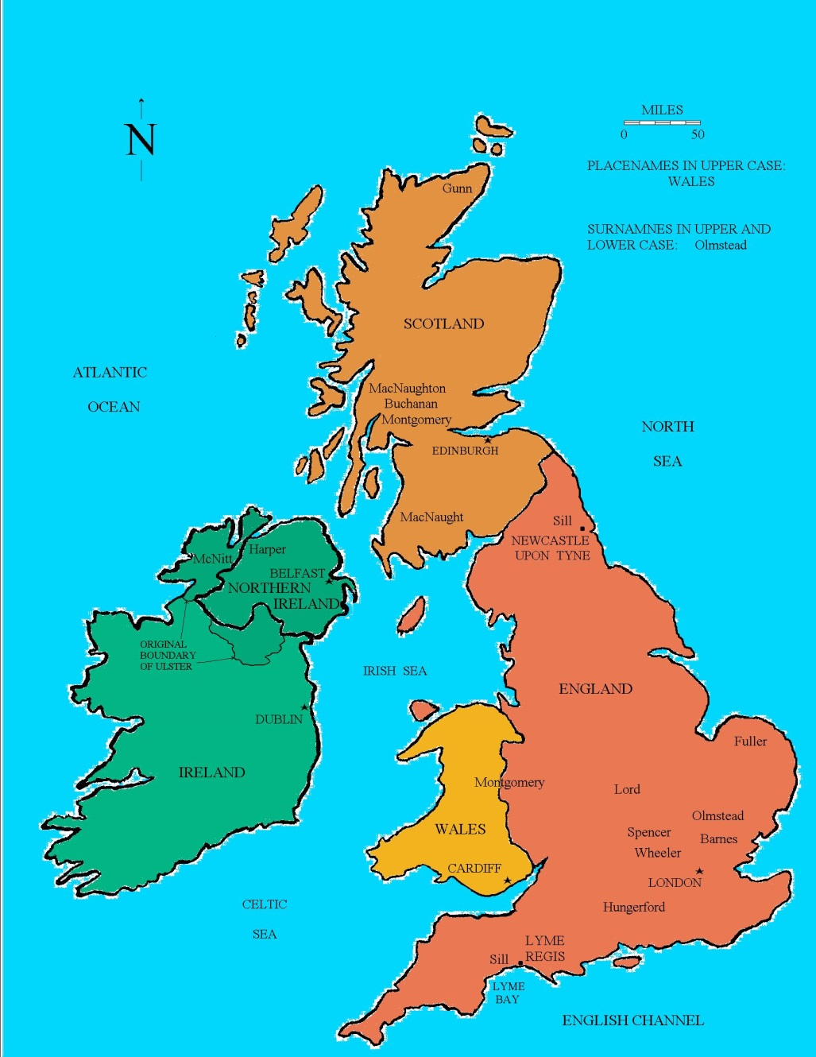

Slide 4
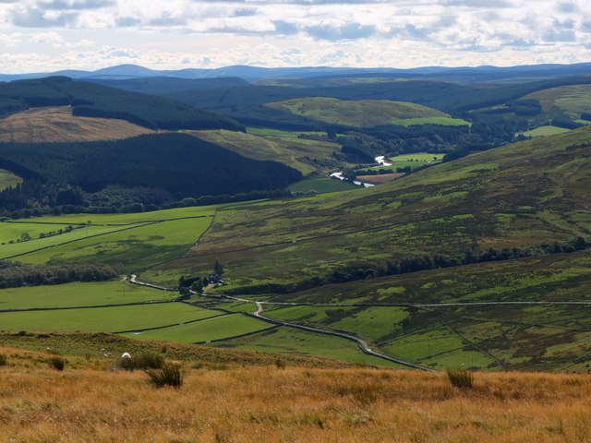

Slide 5
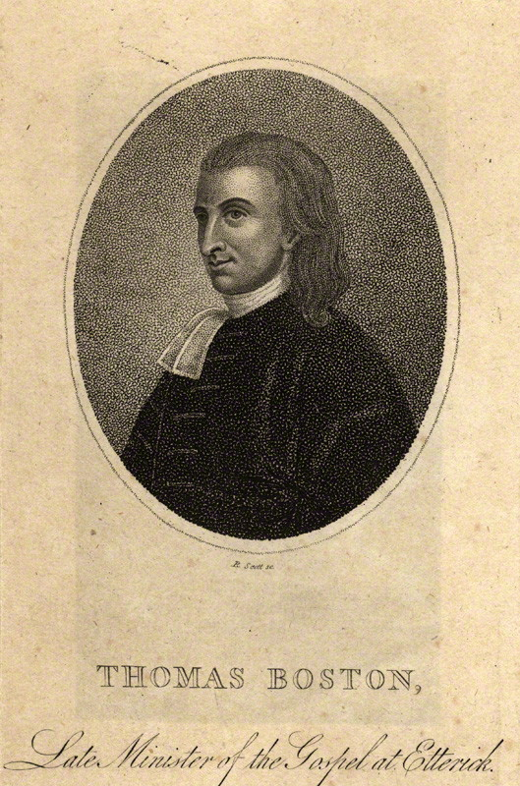
Thomas Boston (1676-1732)

Slide 6


Slide 7
It is not a bare mentioning his name. . . and concluding our prayers therewith.

Slide 8
We must begin, carry on,
and conclude our prayers
in the name of Christ.

Slide 9
In Jesus’ name. . .
Commence. . . Continue. . . . Conclude

Slide 10
The virtue is not in the
words, but in the faith wherewith they are used.

Slide 11
Commencing in His name:

Slide 12
Commencing in His name:
We must go to God
at Christ’s command, and
by order from him.

Slide 13
--Our prayers are under the sense of this
command of God in Christ.

Slide 14
--Our prayers are under the sense of this
command of God in Christ.
--God wants us to live from hand to mouth.

Slide 15
--Our prayers are under the sense of this
command of God in Christ.
--God wants us to live from hand to mouth.
--Christ sends us to God by prayer for
the supply of all our wants.

Slide 16
Continuing in His name:

Slide 17
Continuing in His name:
We must pray for
Christ’s sake, as our motive.
That Christ will be the One Who gains. He’ll develop this in a series of four points which grow successively out of one another.

Slide 18
Commencing in His name:
We must go to God at Christ’s command, and by order from him.
Continuing in His name:
We must pray for Christ’s sake, as our motive.

Slide 19
Concluding in His name:
That Christ will be the One Who gains. He’ll develop this in a series of four points which grow successively out of one another.

Slide 20
Concluding in His name:
We must pray for
Christ’s sake as the only
procuring cause of the
success of our prayers.
That Christ will be the One Who gains. He’ll develop this in a series of four points which grow successively out of one another.

Slide 21
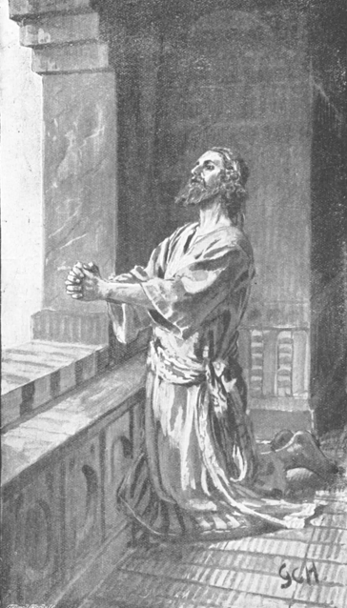
Daniel 9:17-19

Slide 22
Self-denial is absolutely
necessary to this kind of
praying,
That Christ will be the One Who gains. He’ll develop this in a series of four points which grow successively out of one another.

Slide 23
Self-denial is absolutely
necessary to this kind of
praying, that stopping our
eyes to all excellencies in
ourselves or duties, we may
betake ourselves to free grace only.
That Christ will be the One Who gains. He’ll develop this in a series of four points which grow successively out of one another.

Slide 24
I am not worthy of the least of all the mercies, and of all the truth, which thou hast shewed unto thy servant.
--Genesis 32:10

Slide 25
We are to be ashamed
before God in prayer,
ashamed of ourselves,
but not ashamed to beg
in the name of His Son.
That Christ will be the One Who gains. He’ll develop this in a series of four points which grow successively out of one another.

Slide 26
He hath made us accepted __ ___
_______.
--Ephesians 1:6

Slide 27
He hath made us accepted in the
Beloved.
--Ephesians 1:6

Slide 28
Now the promises were spoken to
Abraham and to his seed. . . that
is, Christ.
--Galatians 3:16

Slide 29
The promises of the
covenant were all made
to Jesus Christ, as the
party who fulfilled the
condition of the
Covenant.

Slide 30
Come and receive the
blessing in the elder
brother’s clothes.
That Christ will be the One Who gains. He’ll develop this in a series of four points which grow successively out of one another.

Slide 31
For as many as are the promises of God, in Him they are yes. . .
--II Cor. 1:20

Slide 32
The virtue is not in the
words, but in the faith wherewith they are used.

Slide 33
This glorifies the
Mediator and glorifies the faithfulness of God in the promise; and the lack of it casts dishonour on both.

Slide 34
Commencing in His name:
We must go to God at Christ’s command, and by order from him.

Slide 35
Commencing in His name:
We must go to God at Christ’s command, and by order from him.
Continuing in His name:
We must pray for Christ’s sake, as our motive.

Slide 36
Commencing in His name:
We must go to God at Christ’s command, and by order from him.
Continuing in His name:
We must pray for Christ’s sake, as our motive.
Concluding in His name:
We must pray for Christ’s sake as the only procuring cause of the success of our prayers.

