Slide 1
My house shall be called a house of prayer for all the nations.
--Mark 11:17 (Isaiah 56:7)

Slide 2
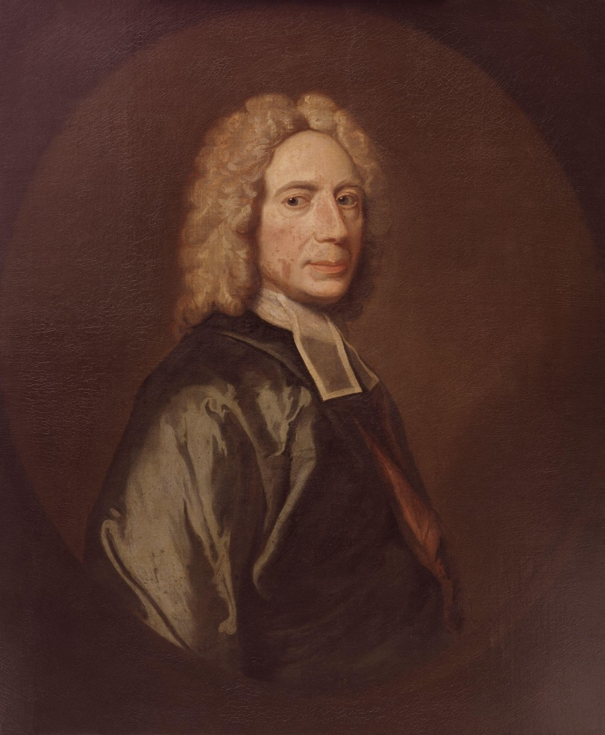

Slide 3


Slide 4
Prayer is required of the churches especially, for the house of God is the house of prayer. f God is the house of prayer.

Slide 5
Prayer is the holy skill of conversation with God.

Slide 6
There are children who can only cry after their father and stammer out a broken word or two by which he can understand their meaning.

Slide 7
But these are ungrown infants. The father would rather see his children advancing to manhood and occupying themselves daily with that broad and free conversation with himself which he allows and to which he graciously invites them.

Slide 8


Slide 9

Prayer is an offering up of our desires unto God, for things agreeable to His will, in the name of Christ, with confession of our sins, and thankful acknowledgment of His mercies.

Slide 10
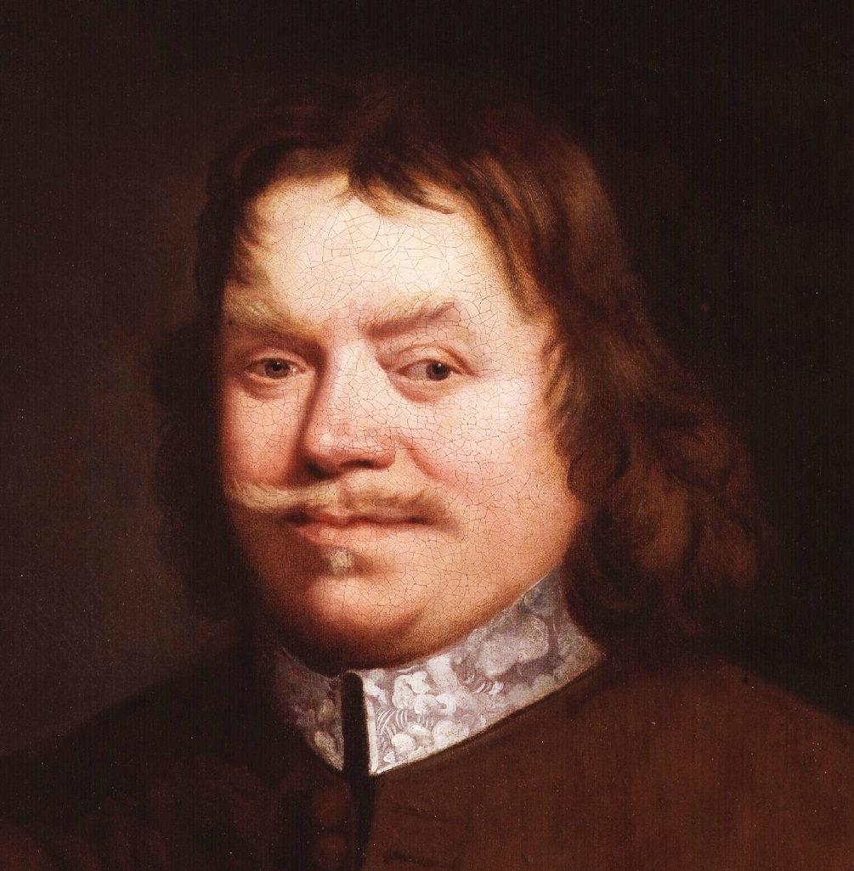

Slide 11
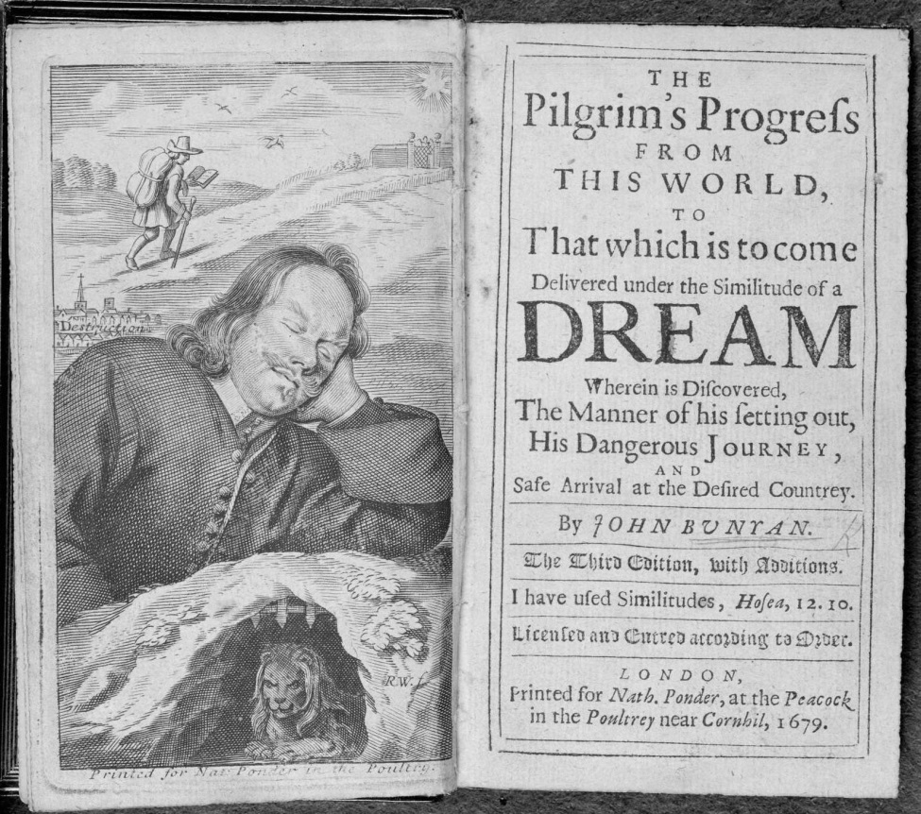

Slide 12
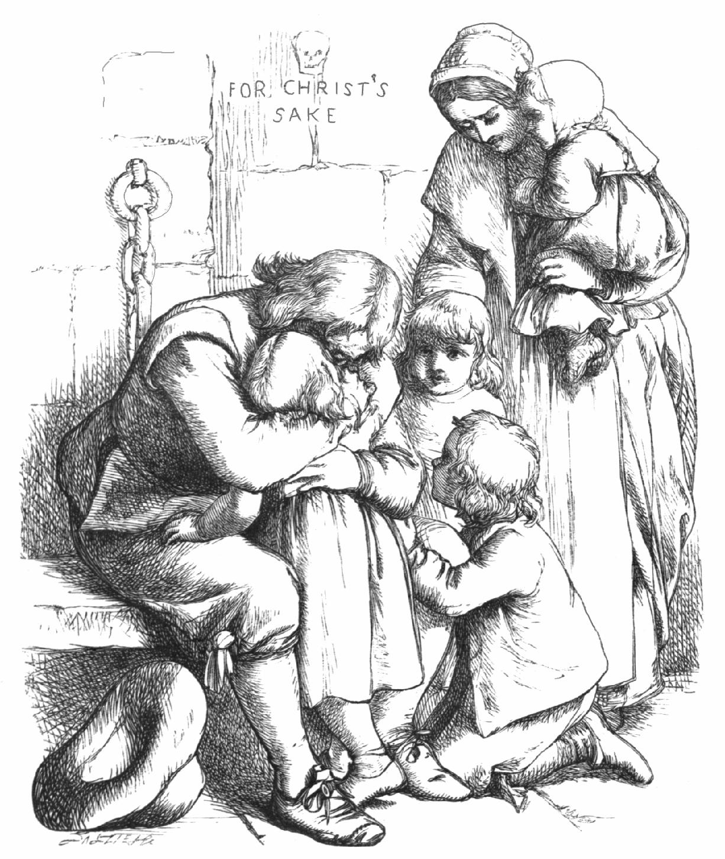

Slide 13
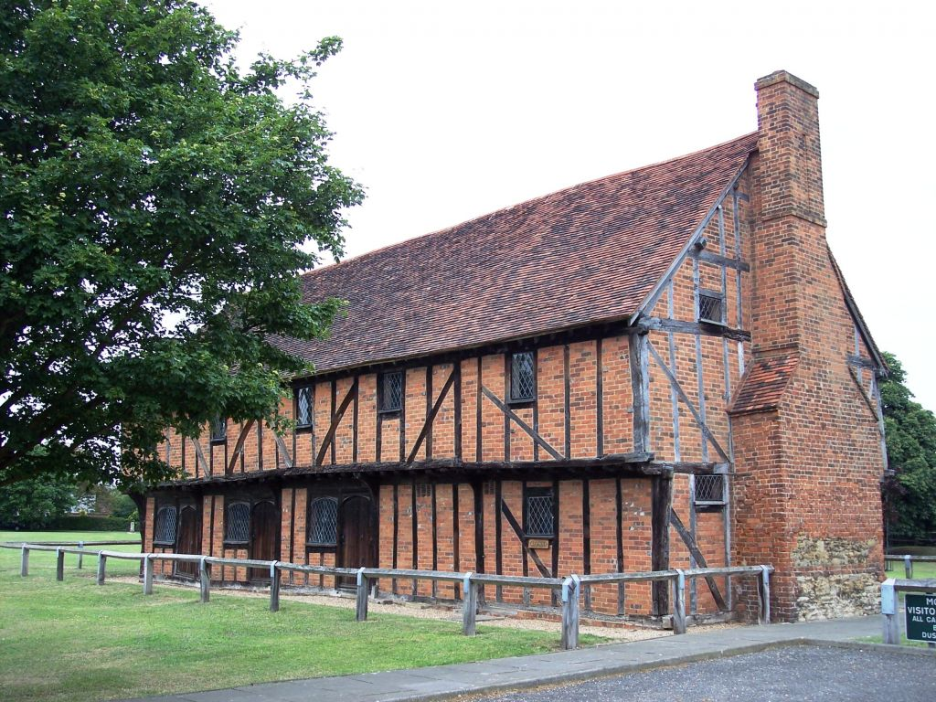

Slide 14
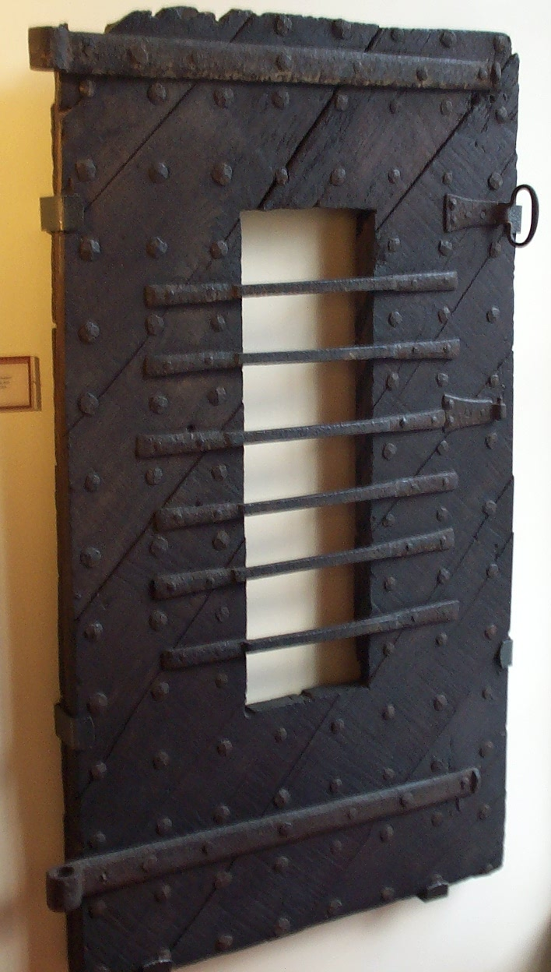

Slide 15

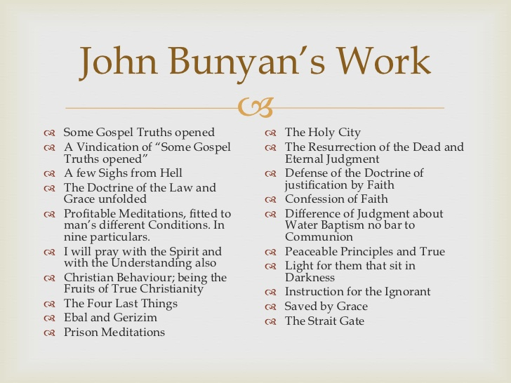

Slide 16
For we know not what we should pray for as we ought; but the Spirit helps our infirmities . . .
--Romans 8:26

Slide 17
There is no man, nor church in the world, that can come to God in prayer, but by the assistance of the Holy Spirit. “For through Christ we all have access by one Spirit unto the Father”
(Eph. 2:18).

Slide 18
We require the Spirit’s assistance. . .

Slide 19
We require the Spirit’s assistance. . .
1. In Order To Pray With Understanding

Slide 20
“For we.” Consider first, the person speaking, even Paul, and in his person all the apostles. We apostles, we extraordinary officers, the wise masterbuilders, that have some of been caught up into Paradise, “We know not what we should pray for.”

Slide 21
Colossians 1:9

Slide 22
Philippians 1:9-10

Slide 23
Men without understanding may say the same words in prayer as others do, but if there be an understanding in the one, and none in the other, there is, oh, there is a mighty difference in speaking the very same words!

Slide 24
We require the Spirit’s assistance. . .
In Order To Pray With Understanding
In Order To Persevere

Slide 25
May I but speak my own experience, and from that tell you the difficulty of praying to God as I ought, it is enough to make you entertain strange thoughts of me.

Slide 26
For, as for my heart, when I go to pray, I find it so loth to go to God, and when it is with him so loth to stay with him, that many times I am forced in my prayers, first, to beg God that he would take mine heart, and set it on himself in Christ, and when it is there that he would keep it there.

Slide 27
Much of mine own experience could I here discover. When I have been in my fits of agonies of spirit, I have been strongly persuaded to leave off, and to seek the Lord no longer;

Slide 28
but being made to understand what great sinners the Lord hath had mercy upon, and how large his promises were still to sinners, and that it was not the whole, but the sick, not the righteous, but the sinner, not the full, but the empty that he extended his grace and mercy unto; this made me, through the assistance of his Holy Spirit, to cleave to him, to hang upon him, and yet to cry, though for the present he made no answer.

Slide 29
We require the Spirit’s assistance. . .
In Order To Pray With Understanding
In Order To Persevere
A Word of Encouragement

Slide 30
The parable of the unjust judge (Luke 18)

Slide 31
The parable of the unjust judge (Luke 18)
And verily mine own experience tells me, that there is nothing that doth more prevail with God than importunity. Is it not so with you in respect of beggars that come to your door?

Slide 32
The parable of the unjust judge (Luke 18)
Though you have no heart to give them anything at their first asking, yet if they follow you, bemoaning themselves, and will take no nay without an alms, you will give them, for their continual begging overcometh you. . .

Slide 33
The parable of the unjust judge (Luke 18)
Though you have no heart to give them anything at their first asking, yet if they follow you, bemoaning themselves, and will take no nay without an alms, you will give them, for their continual begging overcometh you. . . Go thou and do the like.

Slide 34
Private prayer; lifeless, lifeless;
--Howell Harris (1739)

Slide 35
Private prayer; lifeless, lifeless; but I was given a determination to wait.
--Howell Harris (1739)

Slide 36
Who would not stretch out a beggar’s hand to receive a jewel of infinite value? . . . Many would cast off this duty, because they are ashamed to go to it with crutches. . .

Slide 37
but many dumb beggars have been relieved at Christ’s gate by making signs.
--William Secker

Slide 38
but many dumb beggars have been relieved at Christ’s gate by making signs. . . Your affections should soar like an eagle when your lips cannot move faster than a snail.
--William Secker

