Slide 1
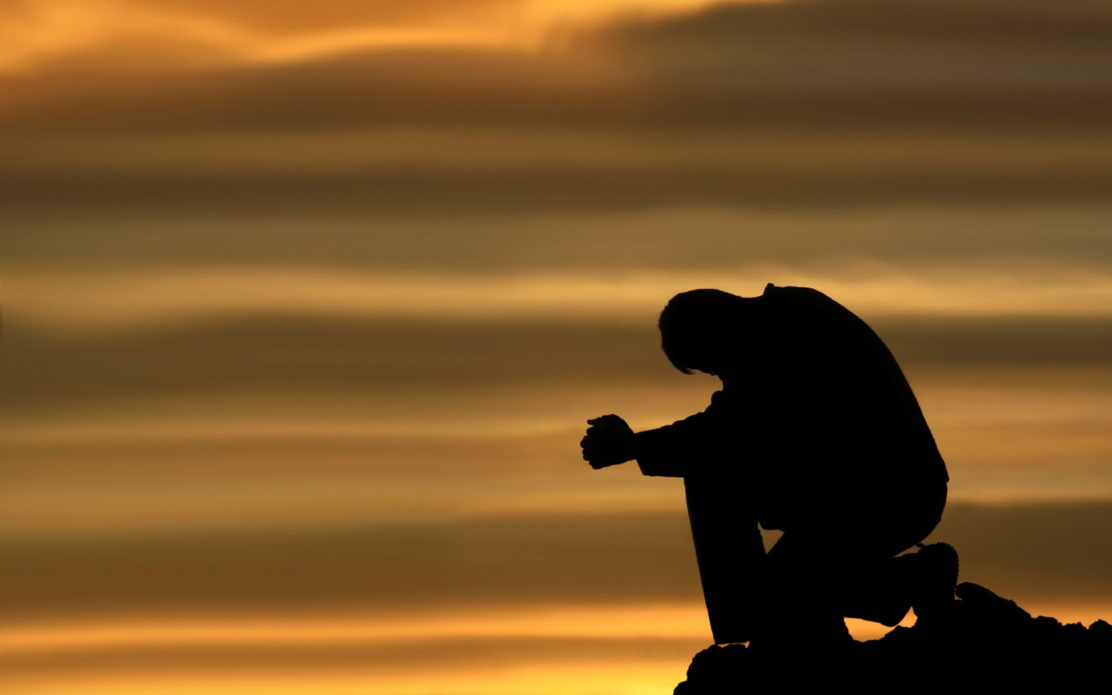

Slide 2
Prayer is an offering up of our desires unto God, for things agreeable to His will, in the name of Christ, with confession of our sins, and thankful acknowledgment of His mercies.

Slide 3
I John 1:9
I John 2:23
The opposite is to deny.

Slide 4
I John 1:9
I John 2:23
I John 4:2
To confess is to profess. . .

Slide 5
I John 1:9
I John 2:23
I John 4:2
I John 4:15
To confess is to profess. . .

Slide 6
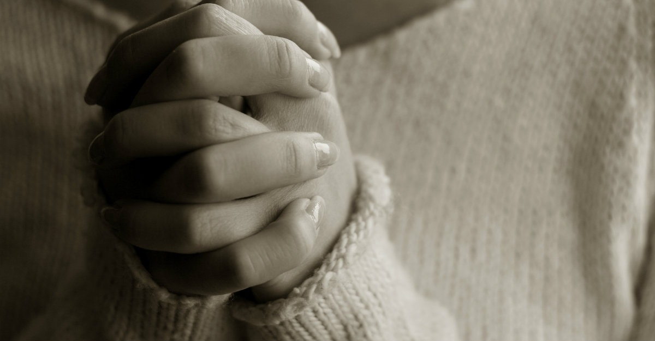
To Confess sin:
To profess ______?

Slide 7
Confession Of Sin Illustrated by the Cases of Dr. Pritchard and Constance Kent
Delivered on Sunday Morning, July 23rd, 1865, by C. H. SPURGEON, at the Metropolitan Tabernacle

Slide 8
The confession which has been made by Dr. PRITCHARD, maybe taken as a specimen of those which are full often made by impenitent sinners. . . Here is a man who is accused of the atrocious crime of murdering his wife and his mother-in-law, and when he answers to the indictment, we are not astonished to hear him plead, "Not Guilty!"

Slide 9
Constance Kent. . . surrendered herself voluntarily, and when she stood before the judge, she pleaded guilty. . . How distinctly she says "Guilty;" and though the question is repeated and space is given her to retract, her reply is still the one self-condemning word "GUILTY!"

Slide 10
Confess:
To profess the truth.

Slide 11
Whenever we come to confess we must approach him with this cry, Guilty, Guilty! "Lord, I cannot say anything else. If hell be my eternal portion for it, I dare say no other. The stones in
the streets would cry out against me if I denied
my guilt.

Slide 12
Now sinner, thou shalt never be at peace
with God until thou art willing unreservedly to plead "Guilty." That self-righteous spirit of thine must be cast out as though it were the very devil, for it is next akin to the devil, and is quite as mischievous. . . You must plead "Guilty," or
remain guilty for ever.

Slide 13
I acknowledged my sin unto thee, and mine iniquity have I not hid. I said, I will confess my transgressions unto the Lord; and thou forgavest the iniquity of my sin.—Psalm 32:5.

Slide 14
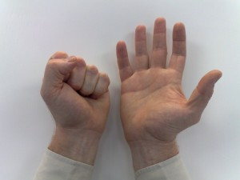

Slide 15
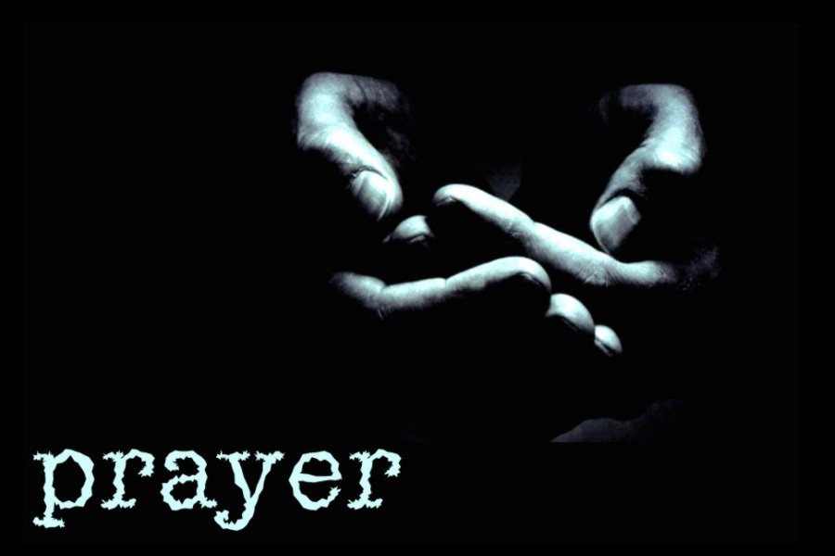
He who conceals his transgressions will not
prosper, but he who confesses and forsakes them
will find compassion.
Proverbs 28:13

