Slide 1
Prayer is an offering up of our desires unto God, for things agreeable to His will, in the name of Christ, with confession of our sins, and thankful acknowledgment of His mercies.

Slide 2
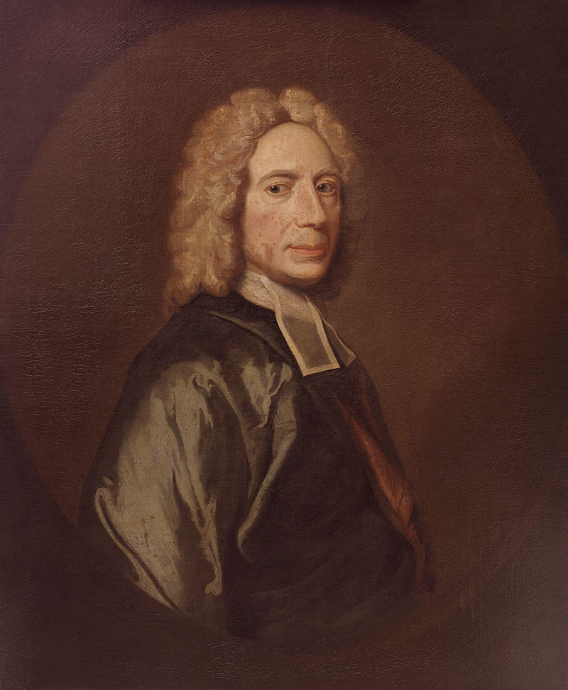
1674-1748
One of three known examples and perhaps an early copy of the portrait in Dr Williams' Library or that at New College, London. It is said to have been painted for Sir Thomas Abney, Lord Mayor of London, and an enthusiastic nonconformist, in whose house Watts spent the last thirty years of his life.

Slide 3
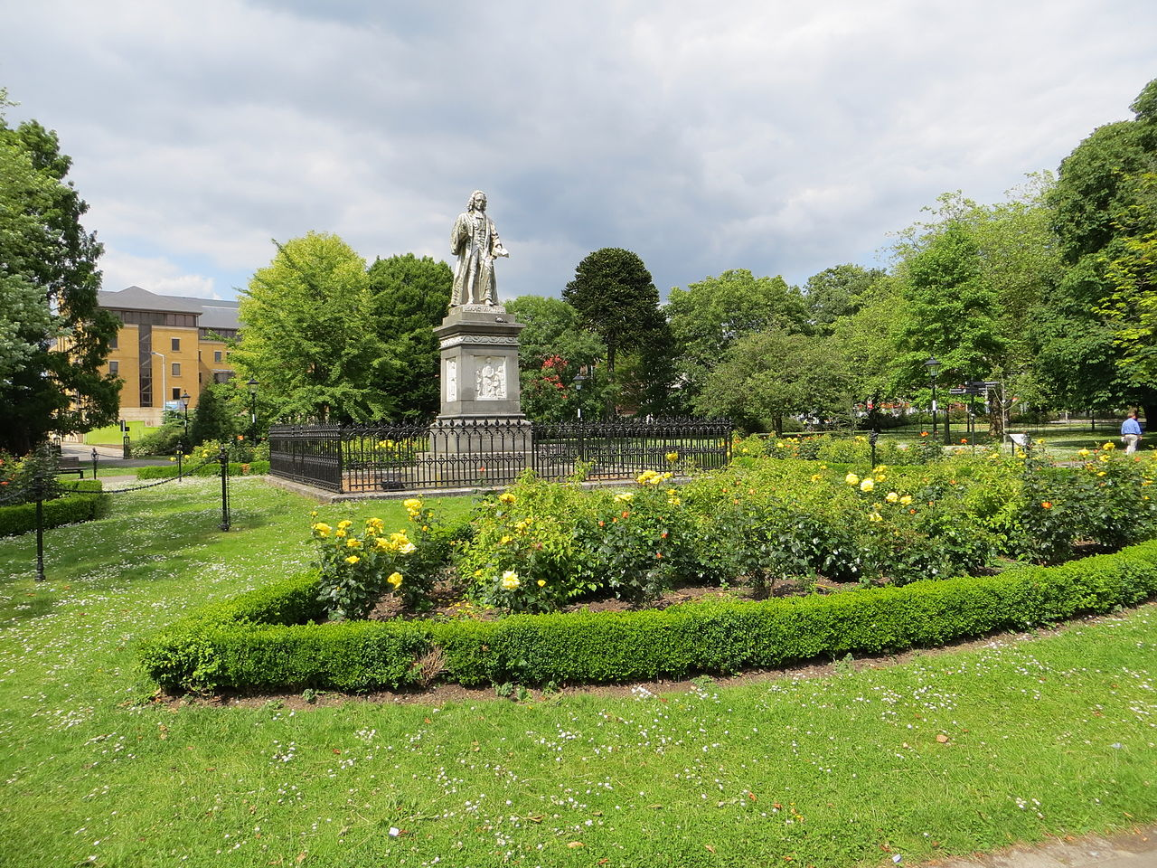

Slide 4
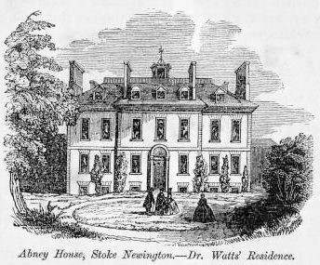
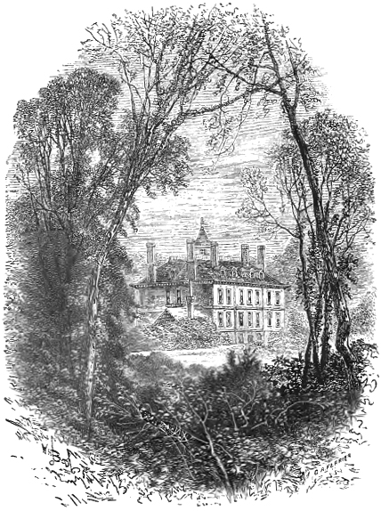
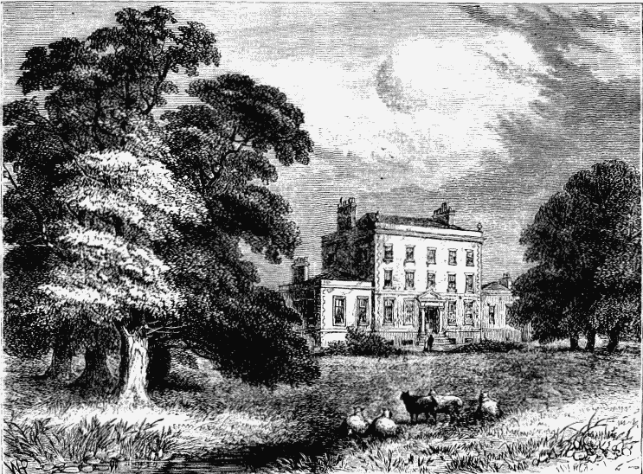

Slide 5
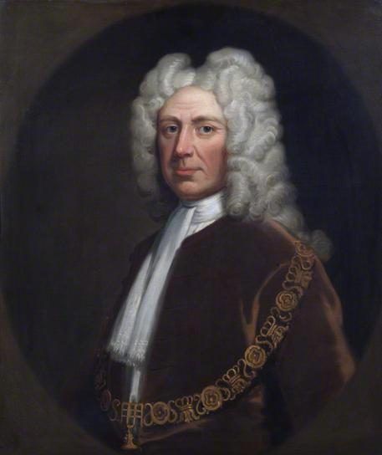
Sir Thomas Abney (1640-1721).
. . . the honour and service of God were his aim and business in life.
Sir Thomas Abney (1640-1721). He was a Presbyterian and an important figure in Nonconformist circles, his piety leading his biographer to declare that "the honour and service of God were his aim and business in life. His first wife, Sarah, to whom he was married 30 years, was the daughter of Rev. Joseph Caryl.
His standing in the City was further attested when he was appointed in June 1694 as one of the commissioners to take subscriptions for the Bank of England. He was elected one of its founding directors, and served intermittently in that capacity for the rest of his life. He was president and benefactor of St. Thomas' Hospital. On Michaelmas Day 29 Sep 1700 he was elected Lord Mayor of London. He was elected to the House of Commons in 1701, but served only one term.Lord and Lady Abney attended the Mark Lane Independent Chapel in London whose pastor was Dr. Isaac Watts (1674-1748), the eminent minister and hymn-writer. In 1712 Dr. Watts suffered a breakdown, from which he never fully recovered. The Abneys invited him to spend a weekend at their estate at Theobalds. Isaac accepted-- and became a permanent houseguest, living with them the next 36 years until his death. He assisted her ladyship in the design of the landscaping of Abney Park at Stoke-Newington. Isaac Watts' association with the Abneys, in his capacity of the family's long term guest, became legendary. He became part of the family and wrote many of his well-known books, poems and hymns at Abney House, or in its parkland grounds. His famous hymns include When I Survey the Wondrous Cross, O God Our Help in Ages Past and the great Christmas carol, Joy to the World . He is known as the "Father of English hymnody."⁸ At the time of his death Sir Thomas had been one of the wealthiest men in the world, with a net worth valued at a moderns equivalent of £2.6 billion. In the absence of a male heir, his estate, fell to his widow and three maiden daughters. Elizabeth (1704-1782) the last surviving child and ultimate sole heiress of her father and mother, was "lady of the manor of Stoke-Newington," and died unmarried in August 1782 at the age of 78. By her will she directed that on her death the lease of the estate of Abney Park, together with the rest of her property in Stoke-Newington, should be sold, and the proceeds distributed amongst the poor. Since 1840 Abney Park has been a general cemetery for the city of London and Abney House was torn down in 1845. The gates to the house were preserved as a side entrance to the cemetery.³

Slide 6
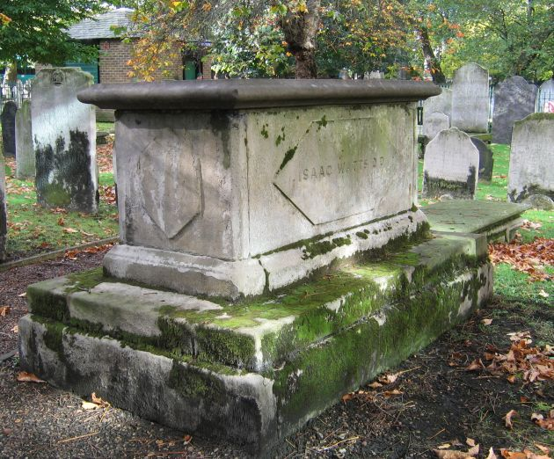

Slide 7
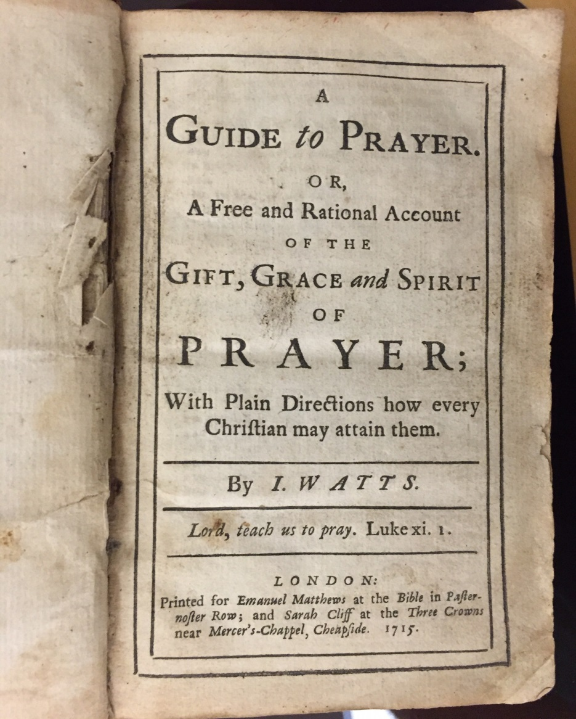

Slide 8
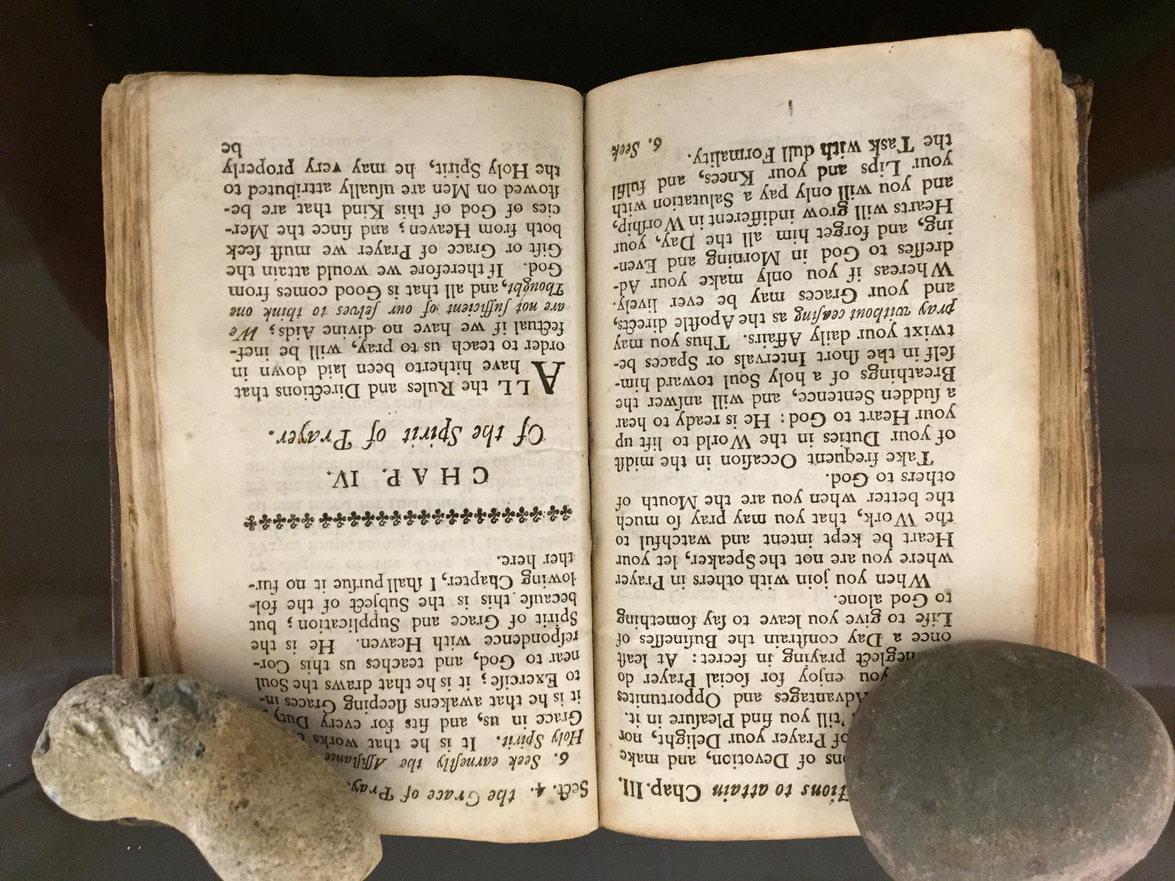

Slide 9
First: Proofs of the Assistance of the Spirit of God in Prayer

Slide 10
First: Proofs of the Assistance of the Spirit of God in Prayer
Express Texts

Slide 11
First: Proofs of the Assistance of the Spirit of God in Prayer
Express Texts
Collateral Scriptures

Slide 12
First: Proofs of the Assistance of the Spirit of God in Prayer
Express Texts

Slide 13
Proofs of the Assistance of the Spirit of God in Prayer
Galatians 4:6

Slide 14
Proofs of the Assistance of the Spirit of God in Prayer
Galatians 4:6
Romans 8:26

Slide 15
Proofs of the Assistance of the Spirit of God in Prayer
Galatians 4:6
Romans 8:26
Luke 11:13

Slide 16
Proofs of the Assistance of the Spirit of God in Prayer
Galatians 4:6
Romans 8:26
Luke 11:13
Ephesians 6:18

Slide 17
Proofs of the Assistance of the Spirit of God in Prayer
Galatians 4:6
Romans 8:26
Luke 11:13
Ephesians 6:18
Jude 20

Slide 18
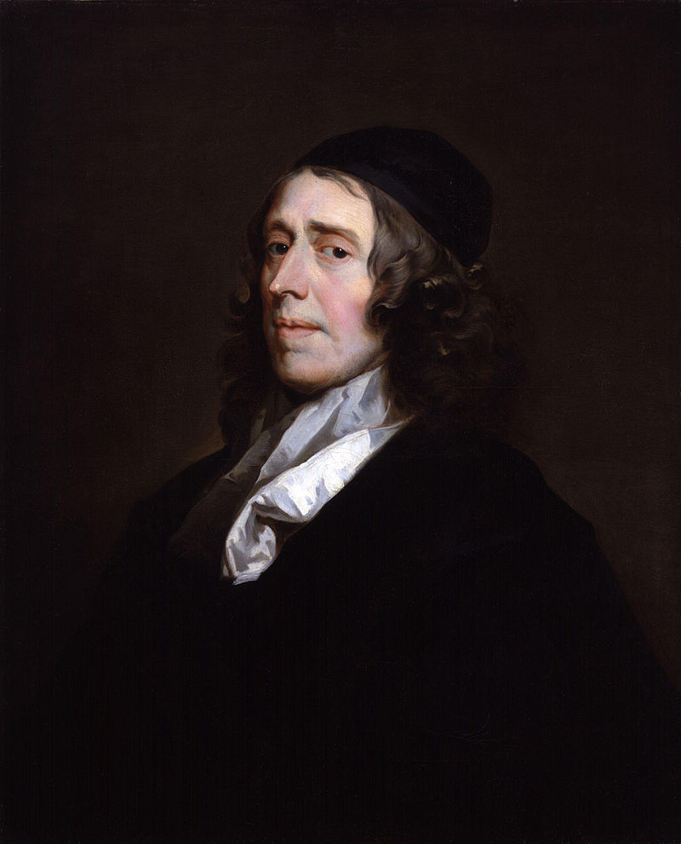

Slide 19
John Owen (1616-1683)

Slide 20
I do not think that the Spirit worketh supplications in us by an immediate, supernatural, divine afflatus, so he inspired the prophets of old. . . But I do say (let the proud, carnal world despise it whilst they please, and at their peril) that the Spirit of God doth graciously, in the prayers of believers, carry out and act their souls and minds in desires and requests, which, for the matter of them, are far above their natural contrivances and inventions.
Works, III, 398

Slide 21
Proofs of the Assistance of the Spirit of God in Prayer

Slide 22
Proofs of the Assistance of the Spirit of God in Prayer
How the Spirit Assists Us in Prayer

Slide 23
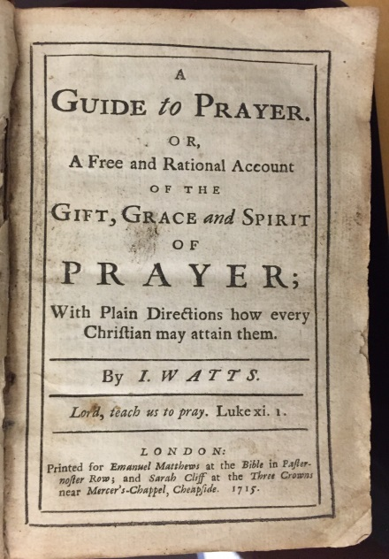
I have diligently consulted the Word of God. And so far as I am able to judge or determine, his assistance in prayer may be reduced to the following particulars.

Slide 24
1. He bestows upon us our natural capacities,

Slide 25
1. He bestows upon us our natural capacities, some degree of understanding, judgment, memory, intelligence and natural temperament; some measure of fluency of speech; and readiness to
utter the conceptions of our mind.

Slide 26
2. He blesses our diligence in reading, hearing, meditation, study and attempts of prayer

Slide 27
2. He blesses our diligence in reading, hearing, meditation, study and attempts of prayer by which, while we attend to useful rules and instructions, we treasure up a store of material for this duty and learn by degrees to express our thoughts with propriety and decency, to our own and others’ edification.

Slide 28
He sanctifies our memory, to treasure up those parts of the Holy Scripture that are proper to be used in prayer; he makes it faithful to retain them and ready to recall them at proper times.

Slide 29
He inclines our hearts to pray and keeps them intent upon the work.

Slide 30
There is a natural reluctance to the duties of immediate communion with God and a weariness in them. It is only the Spirit of God that works a heavenly disposition in us, that makes us ready to pray always. . . It is he that kindly and secretly suggests, “Now is the accepted time.”

Slide 31
The Spirit says to the soul secretly, “Seek my face”; and the soul replies, “Thy face, Lord, will I seek” (Ps. 27:8).

Slide 32
4. He often, by his secret teachings, supplies us with the content for prayer

Slide 33
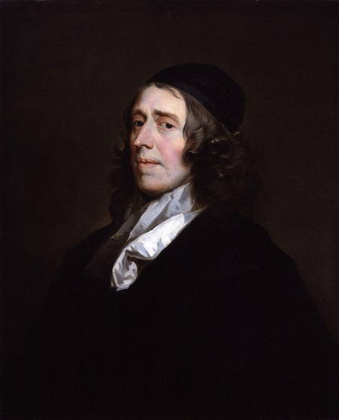
John Owen (1616-1683)
By giving us a spiritual insight into the promises of God and the grace of the covenant, whereby we know what to ask upon a spiritual view of the mercy and grace that God hath prepared for us.

Slide 34
He now and then also gives a hint of some argument to plead with God, either the name and mediation of Christ or some of his own promises in the gospel. . .
It is he that brings divine things to our remembrance, things that are suited to the various parts of prayer.

Slide 35
John 14:26

Slide 36
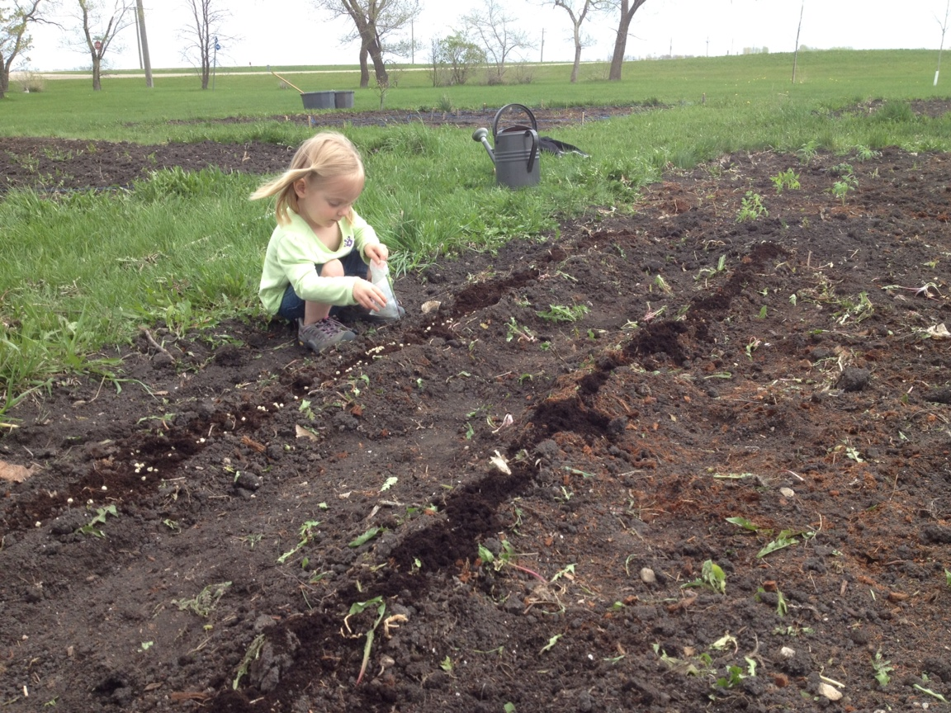

Slide 37
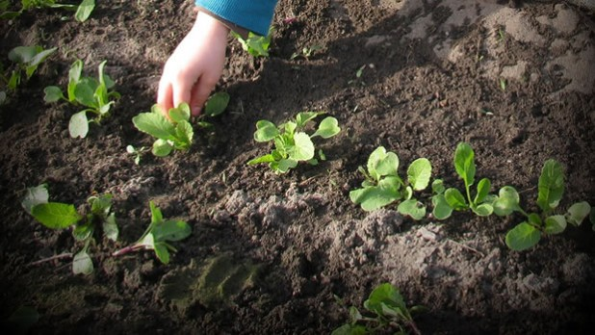

Slide 38
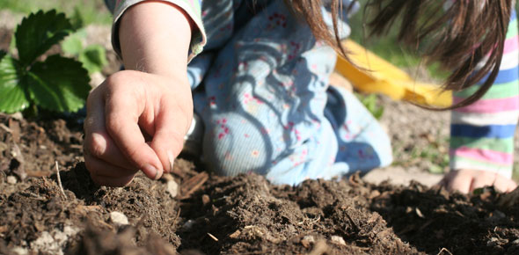

Slide 39
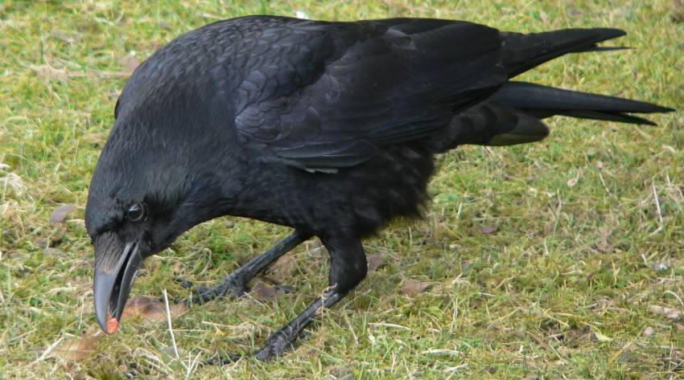

Slide 40
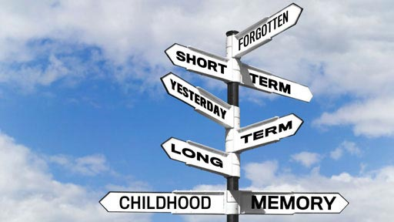

Slide 41
John 14:26

Slide 42
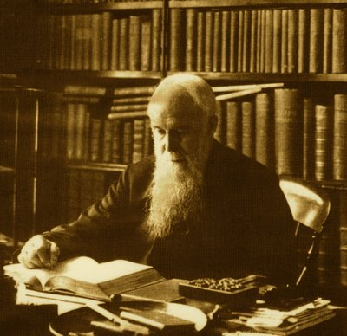
John 14:26
J. C. Ryle (1816-1900)
Notes:
1816-9

Slide 43
Some apply these words exclusively to the eleven. I cannot see this. . . To my eyes they seem a general promise,

Slide 44
Some apply these words exclusively to the eleven. I cannot see this. . . To my eyes they seem a general promise, primarily, no doubt, applying specially to the eleven, but after them belonging also to all believers in every age. As a matter of experience I believe that the awakening of the memories of true Christians is one of the peculiar works of the Holy Ghost on their souls. Once converted, they understand things and remember things in a way they did not before.
--J. C. Ryle

Slide 45
He bestows upon us our natural capacities.

Slide 46
He bestows upon us our natural capacities.
He blesses our diligence in reading, hearing, meditation, study and attempts of prayer.

Slide 47
He bestows upon us our natural capacities.
He blesses our diligence in reading, hearing, meditation, study and attempts of prayer.
He inclines our hearts to pray.

Slide 48
He bestows upon us our natural capacities.
He blesses our diligence in reading, hearing, meditation, study and attempts of prayer.
He inclines our hearts to pray.
He often, by his secret teachings, supplies us with the content for prayer

Slide 50
1674-1748
One of three known examples and perhaps an early copy of the portrait in Dr Williams' Library or that at New College, London. It is said to have been painted for Sir Thomas Abney, Lord Mayor of London, and an enthusiastic nonconformist, in whose house Watts spent the last thirty years of his life.

