Slide 1

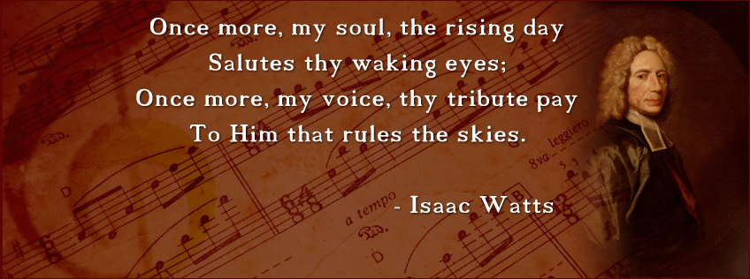
To tune of, Alas, and did My Savior Bleed?

Slide 2
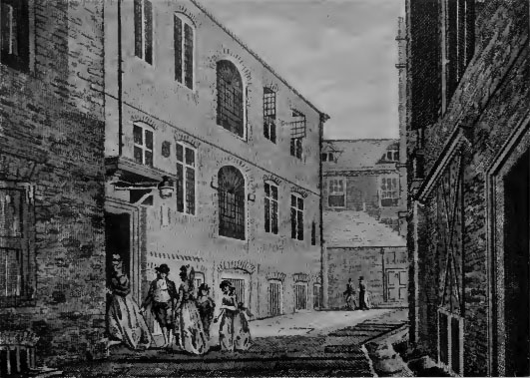
Pinner’s Hall. Watts preached here from 1704-1708.

Slide 3
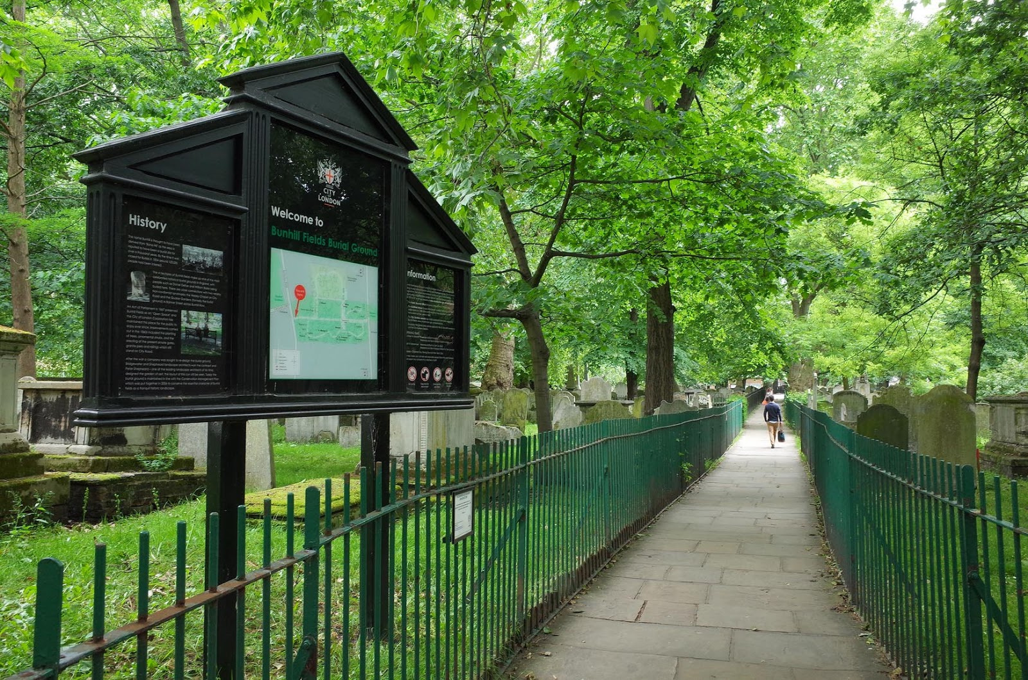

Slide 4
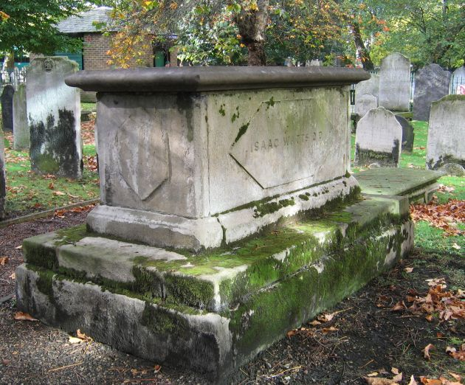

Slide 5
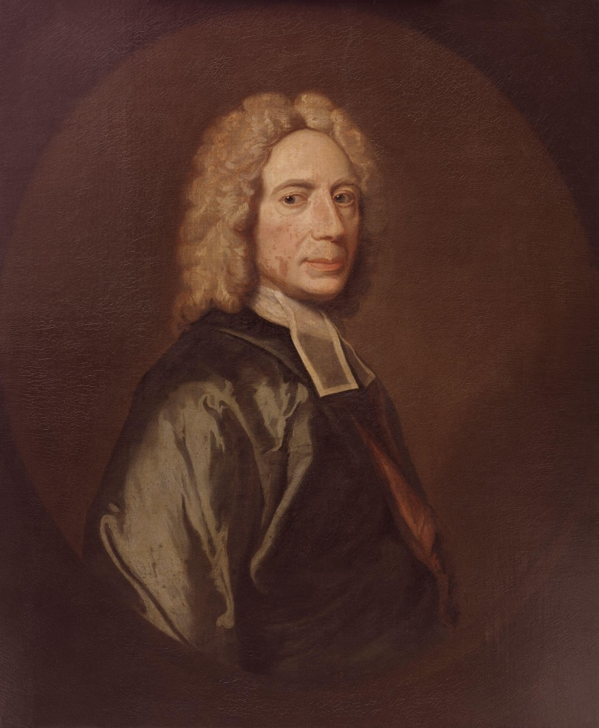


Slide 6

The Gift of Prayer
The gift of prayer may be described as an ability to suit our thoughts to all the various parts and designs of this duty, and a readiness to express those thoughts before God in the fittest manner to profit our own souls as well as the souls of others that join with us.

Slide 7
The Gift of Prayer
The gift of prayer may be described as an ability to suit our thoughts to all the various parts and designs of this duty, and a readiness to express those thoughts before God in the fittest manner to profit our own souls as well as the souls of others that join with us.

Slide 8
The Gift of Prayer
The gift of prayer may be described as an ability to suit our thoughts to all the various parts and designs of this duty, and a readiness to express those thoughts before God in the fittest manner to profit our own souls as well as the souls of others that join with us.

Slide 9
Our thoughts:
Ability to suit our thoughts to all the parts and designs of it.
(2) Our expression:
Readiness to express those thoughts to God in the fittest manner.

Slide 10
Blessed and faithful God, hast thou not promised that “the meek Thou wilt guide in judgment, the meek Thou wilt teach Thy way?” Hast Thou not taught us by Isaiah, Thy prophet, that Thou wilt “bring the blind by a way they know not, and wilt lead them in paths which they have not known?” Hast Thou not informed us by the prophet Hosea, that “if we follow on to know the Lord, then we shall know Him?” Hath not Thy Son, our Saviour, assured us, that our Heavenly Father will give His Holy Spirit to them that ask Him? And is He not appointed “to guide us into all truth?”

Slide 11
Have I not sought the gracious guidance of thy Good Spirit continually? Am I not truly sensible of my own darkness and weakness, my dangerous prejudices on every side, and my utter insufficiency for my own conduct? Wilt Thou leave such a poor creature bewildered among a thousand perplexities, which are raise by the various opinions and contrivances of men, to explain Thy Divine Truth?

Slide 12
Help me, Heavenly Father, for I am quite tired and weary of these human explainings, so various and uncertain. When wilt Thou explain it to me Thyself, O my God, by the secret and certain dictates of Thy Spirit, according to the intimation of Thy Word? Nor let any pride of reason, nor any affectation of novelty, nor any criminal bias whatever, turn my heart aside from hearkening to these Divine dictates of thy Word and Thy Spirit. Suffer not any of my native corruptions, nor the vanity of my imagination, to cast a mist over my eyes while I am searching after the knowledge of Thy mind and will, for my eternal salvation.

Slide 13
I entreat, O most merciful Father, that Thou wilt not suffer the remnant of my short life to be wasted in such endless wanderings in quest of Thee and Thy Son Jesus. . . but let my sincere endeavours to know Thee, in all the ways whereby Thou hast discovered Thyself in Thy Word, be crowned with such success that my soul, being established in every needful truth by Thy Holy Spirit, I may spend my remaining life according to the rules of Thy Gospel, and may, with all the holy and happy creation, ascribe glory and honour, wisdom and power, to Thee who sittest upon the throne, and to the Lamb forever and ever.

Slide 14
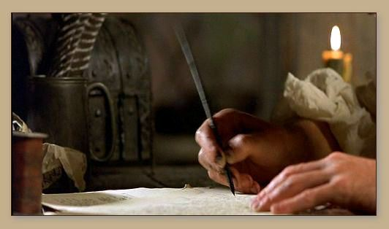

Slide 15
The Gift of Prayer
The gift of prayer may be described as an ability to suit our thoughts to all the various parts and designs of this duty, and a readiness to express those thoughts before God in the fittest manner to profit our own souls as well as the souls of others that join with us.

Slide 16
1) Strive for a large acquaintance with all
things that belong to
religion.
I GOD
His nature, His persons,
His perfections, His works.

Slide 17
1) Strive for a large acquaintance with all
things that belong to
religion.
I GOD
II OURSELVES
Our spirit, our needs,
our sorrows, our joys.

Slide 18
1) Strive for a large acquaintance with all
things that belong to
religion.
I GOD
II OURSELVES
THE WORD OF GOD
GOD’S DEALINGS WITH US

Slide 19
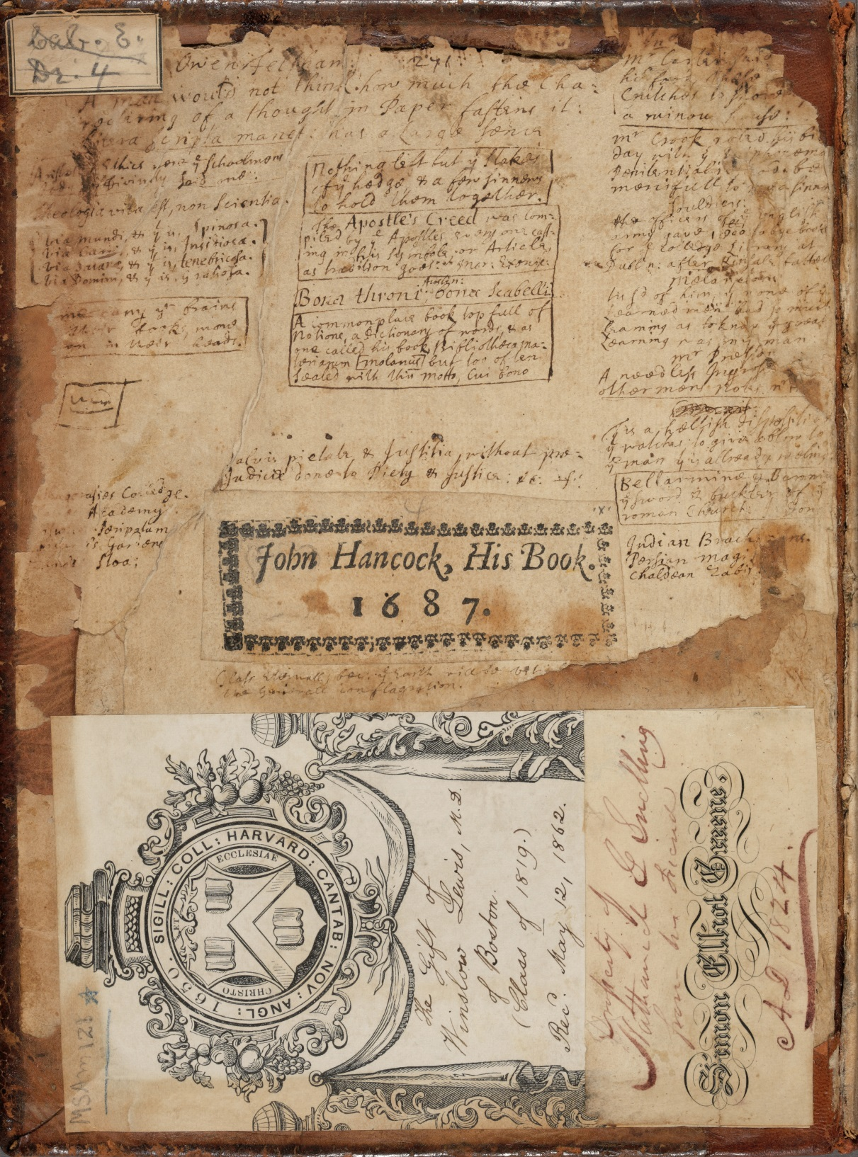

Slide 20
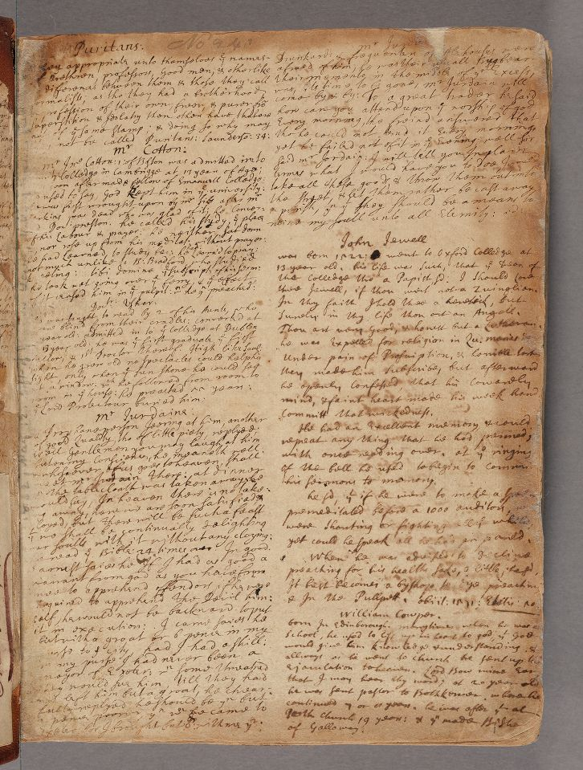

Slide 22
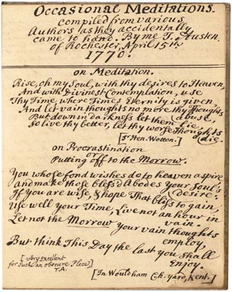

Slide 23
To tune of, Alas, and did My Savior Bleed?

Slide 24
And as though he were not a God of order, they address him often in confusion. Because the heart is the chief thing in divine worship, like some foolish Israelite, they are unconcerned what beast they offer him, so long as it has a heart.

Slide 25
The reputation of religion in the world depends much on the honorable discharge of the duty of prayer. There is an inward beauty in divine worship that consists in the devout temper of the worshippers and the living exercise of holy devotion; but God only, who sees the heart, is witness to this.

Slide 26
There is also an outward beauty that arises from a decent and acceptable performance of all the parts of it that comes within the notice of our fellow creatures, that those that observe us may be forced to acknowledge the excellency of religion in our practice of it.

Slide 27
