Slide 1
Praying to
Our Father in Heaven
Matthew 6:9

Slide 2
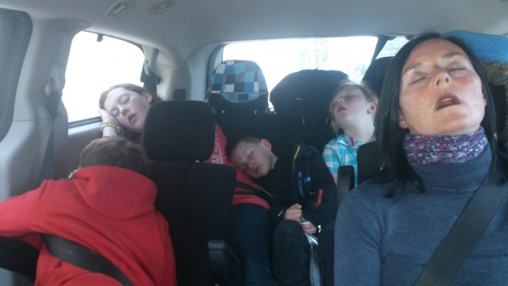

Slide 3
Psalm 121:3-4
He who keeps you will not slumber. Behold, He who keeps Israel shall neither slumber nor sleep.

Slide 4
Mathew 6
Pray, then, in this way: Our Father who is in heaven . . .

Slide 5
Titles for Deity in the Sermon on the Mount
King—1x
Lord—5x
God—6x
Father—17x
  MT 44x; MK 5x; LK 17x

Slide 6
God as Father in the OT
Psa 68:5 A father of the fatherless ... is God in His holy habitation.
Psa 103:13 As a father pities his children, so the LORD pities those who fear Him.

Slide 7
God as Father in the OT
Deu 32:6 Is He not your Father, your Creator, who made you and formed you?
Psa 89:26 He shall cry to Me, `You are my Father, My God, the rock of my salvation.'
Isa 63:16 Doubtless You are our Father .... You, O LORD, are our Father ....
Isa 64:8 But now, O LORD, You are our Father

Slide 8
Sermon on the Mount:
Overview
Public Righteousness (ch. 5)
anger, adultery, integrity, revenge, compassion

Slide 9
Sermon on the Mount:
Overview
Private Religion (ch. 6)
public vs. private deeds (6:1-4)
public vs. private prayer (6:5-6)
pagan vs. pious prayer (6:7-15)
proper fasting (6:16-18)
personal priorities (6:19-34)

Slide 10
Sermon on the Mount:
Overview
Personal Response (ch. 7)

Slide 11
Jesus’ Teaching on Prayer: Overview
6:5-6—Don’t Be Like the Hypocrites
Where to Pray: pray privately, not ostentatiously
Why to Pray: pray to be seen by God, not men

Slide 12
Jesus’ Teaching on Prayer: Overview
6:7-8—Don’t Be Like the Heathen
How to Pray: pray thoughtfully, not mindlessly

Slide 13
Jesus’ Teaching on Prayer: Overview
6:9-13—Pray Like This
What to Pray: pray this way and for these kinds of things
“Our Father who is in heaven”
Condescension + Transcendence

Slide 14
Your Father in Heaven
5:16—should be glorified by your life
5:45, 48—is gracious and generous to all
6:1-6—sees and rewards secret charity and secret praying
6:14-15—deals with you as you deal with others
6:26, 32—will never abandon you or cease caring for you

Slide 15
