Slide 1
Who this disciple was we do not know.
What he did will be remembered as long as the world stands. Happy are those who partake of his feelings and often cry, “Lord, teach me to pray.”
--J. C. Ryle

Slide 2
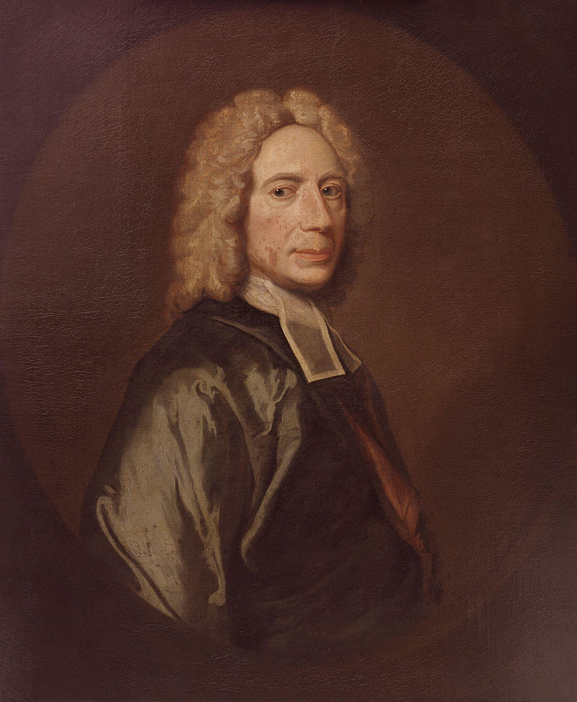
1674-1748
One of three known examples and perhaps an early copy of the portrait in Dr Williams' Library or that at New College, London. It is said to have been painted for Sir Thomas Abney, Lord Mayor of London, and an enthusiastic nonconformist, in whose house Watts spent the last thirty years of his life.

Slide 3
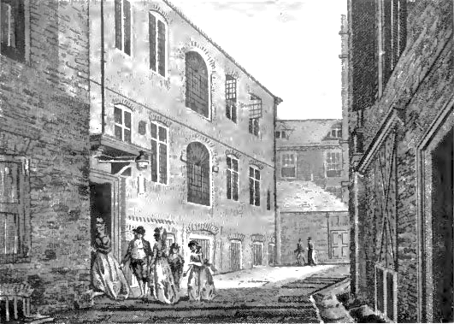
Pinner’s Hall. Watts preached here from 1704-1708. Watts wrote in his journal, “Removed our meeting-place to Pinner’s Hall, and began expositions of Scripture Jun. 1704”

Slide 4
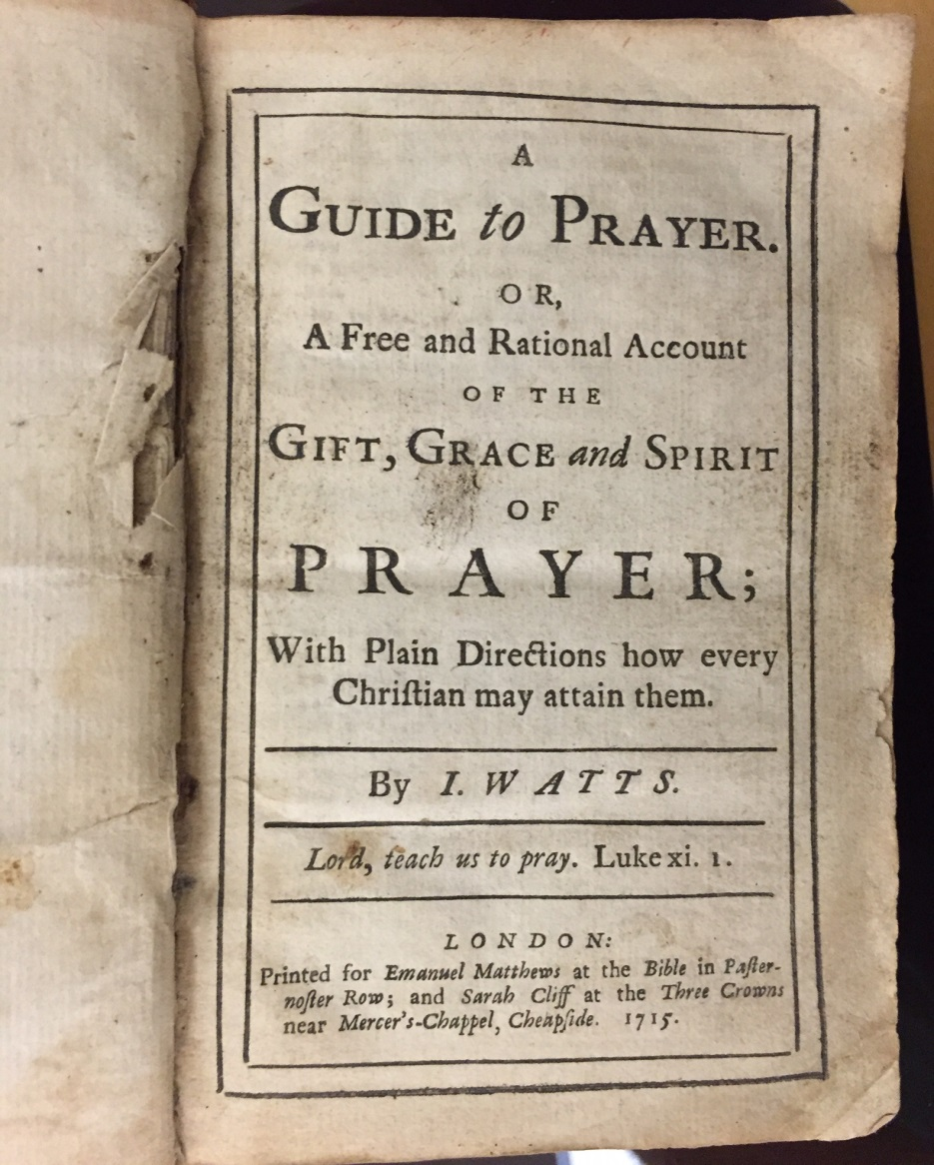

Slide 5



Slide 6
Prayer is the holy skill of conversation with God.
Prayer is the holy skill of conversation with God.

Slide 7

The Gift of Prayer
The gift of prayer may be described
as an ability to suit our thoughts to all
the various parts and designs of this duty,

Slide 8
The Gift of Prayer
The gift of prayer may be described
as an ability to suit our thoughts to all
the various parts and designs of this duty, and a readiness to express those thoughts before God

Slide 9
The Gift of Prayer
The gift of prayer may be described
as an ability to suit our thoughts to all
the various parts and designs of this duty, and a readiness to express those thoughts before God in the fittest manner to profit our own souls as well as the souls of others that join with us.

Slide 10
The Gift of Prayer
It is called a gift, partly because it was bestowed on the apostles and primitive Christians in an extraordinary manner by the Spirit of God. . .

Slide 11
The Gift of Prayer
It is called a gift, partly because. . . and because the
ordinary assistance of the Spirit
of God is required even to attain this holy skill or ability to pray.

Slide 12
1) Strive for a large acquaintance with all
things that belong to
religion.

Slide 13
1) Strive for a large acquaintance with all
things that belong to
religion.
I God
His nature, persons, perfections, works

Slide 14
1) Strive for a large acquaintance with all
things that belong to
religion.
I God
II Ourselves
Our spirit, needs, sorrows, joys

Slide 15
1) Strive for a large acquaintance with all
things that belong to
religion.
I GOD
II Ourselves
III The Word of God
IV God’s dealings with us

Slide 16
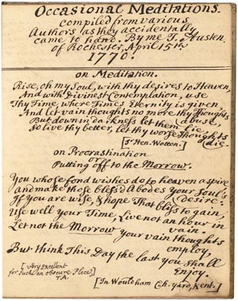
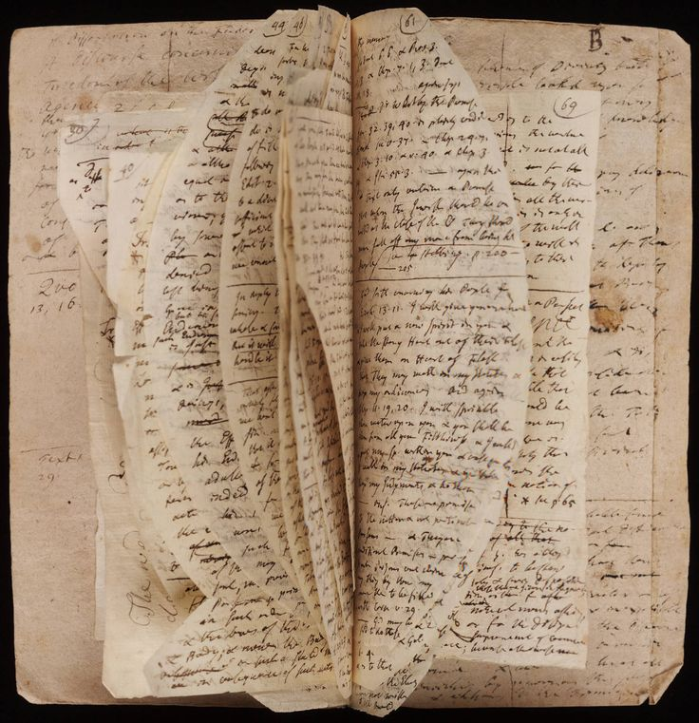

Slide 17
1) Large acquaintance
with all things religious
2) Remember the kinds

Slide 18
Call upon God, adore, confess,
Petition, plead, and then declare
You are the Lord’s, give thanks, and bless,
And let Amen confirm the prayer.

Slide 19
1) Large acquaintance
with all things religious
2) Remember the kinds
3) Expand to details

Slide 20
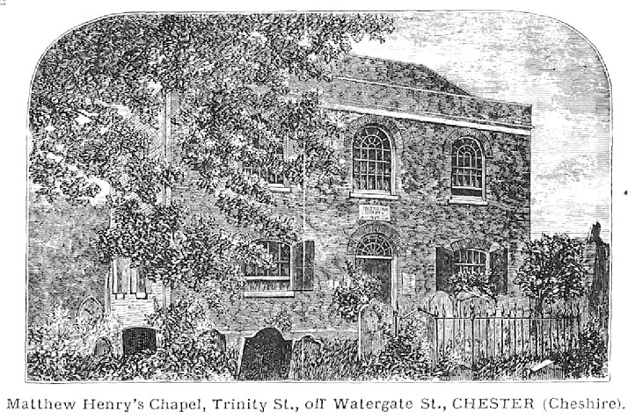
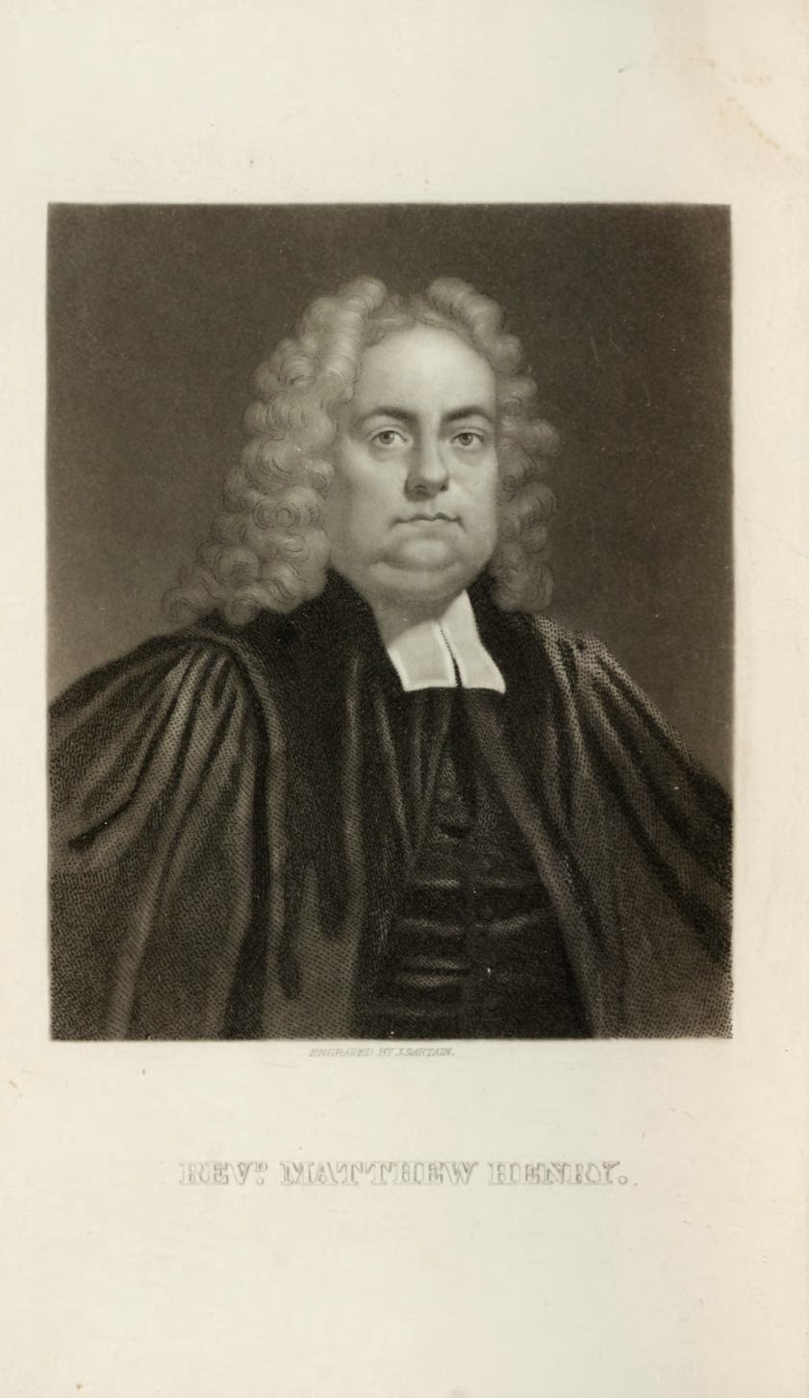

Slide 21

M A T T H E W H E N R Y
Published four years before his death in 1710, and just 5 years before Watts published his guide to prayer.

Slide 22
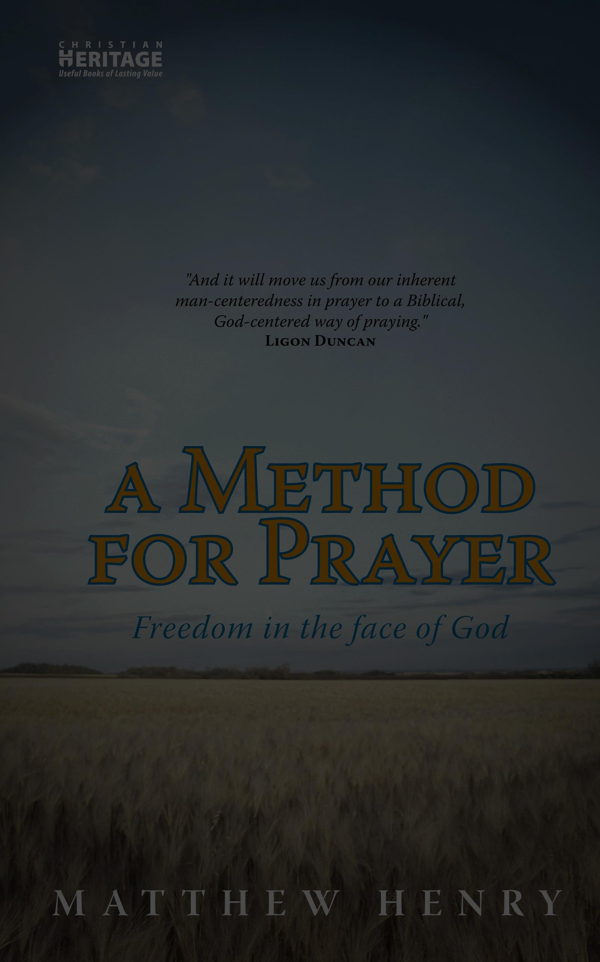
2. B. 1). b). (1) We must give thanks that he has made us reasonable creatures, capable of knowing, loving, serving, and enjoying him, and that he hath not made us like the beasts that perish.
We will praise thee, for we are fearfully and wonderfully made, and that our souls, our

Slide 23
nobler part, knows right well; for no man knows the things of man, save the spirit of man, which is in him. Thou hast made us of that rank of beings which is a little lower than the angels, and is crowned with glory and honour; for there is a spirit in man, and the inspiration of the Almighty giveth them understanding.

Slide 24
And the spirit of man is the candle of the Lord. Our bodies are capable of being the temples of the Holy Ghost, and our souls of having the Spirit of God dwell in them; we therefore glorify thee with our bodies, and with our spirits, which are thine. Thou, Lord, hast formed us for thyself, that we might shew forth thy praise.

Slide 25
Psalm 139:14 We are fearfully. . .
I Corinthians 2:11 no man knows. . .
Psalm 8:5 Thou hast made. . .
Job 32:8 there is a spirit. . .
Proverbs 20:27 the spirit of man. . .
I Corinthians 6:19 know ye not that. . .
I Corinthians 6:20 therefore glorify. . .
Isaiah 43:21 hast formed us. . .
Over 2300 scripture quotations.

Slide 26
2. B. 1). b). (1) We must give thanks that he has made us reasonable creatures, capable of knowing, loving, serving, and enjoying him, and that he hath not made us like the beasts that perish.
We will praise thee, for we are fearfully and wonderfully made, and that our souls, our
9 headings and scores of subheadings.

Slide 27
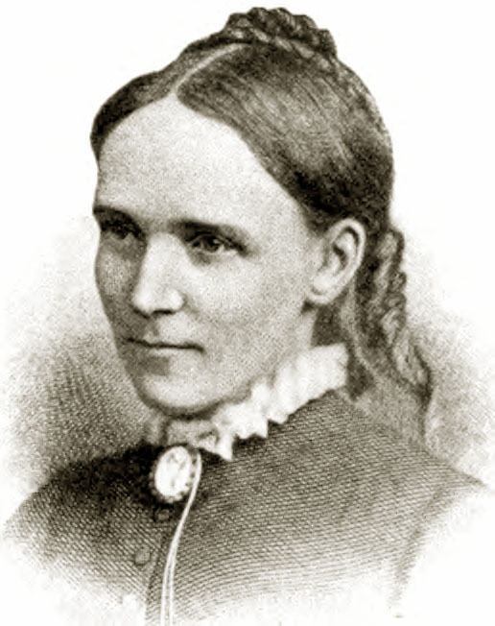
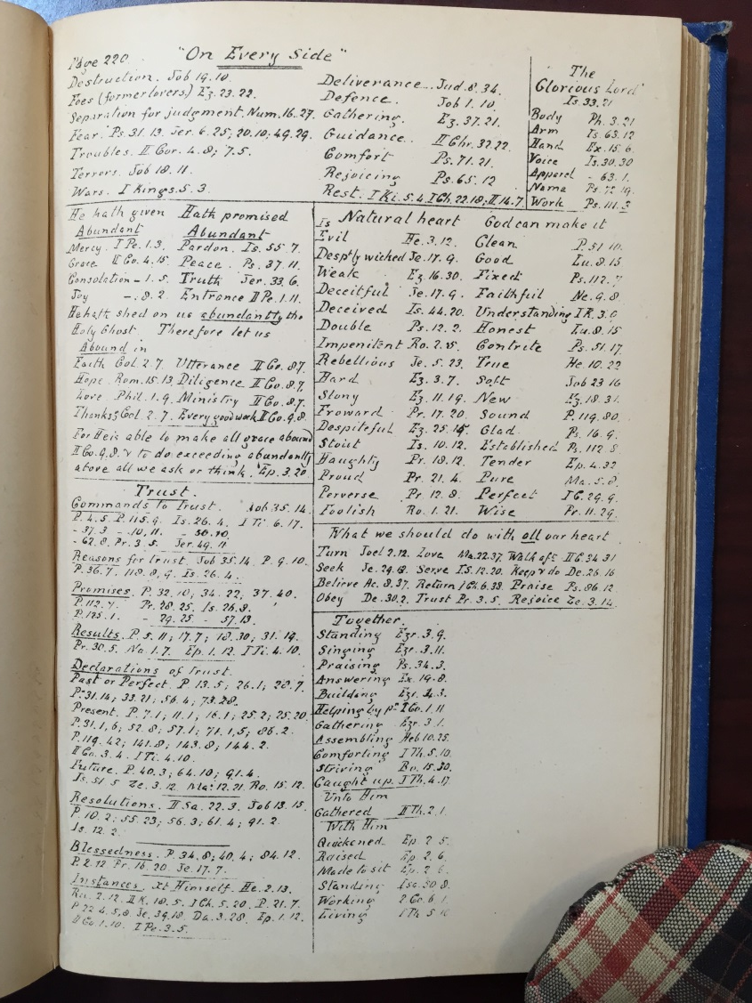

Slide 28
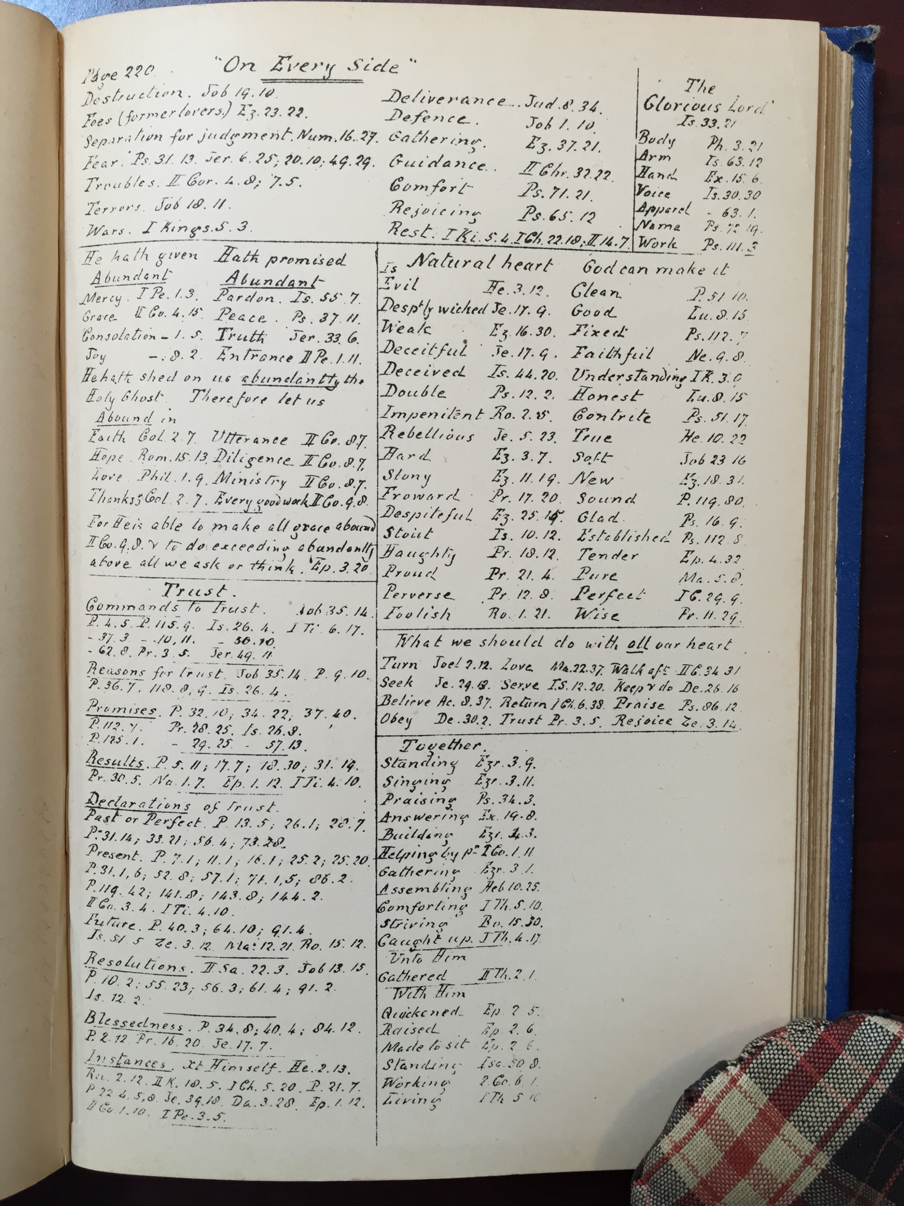

Slide 29
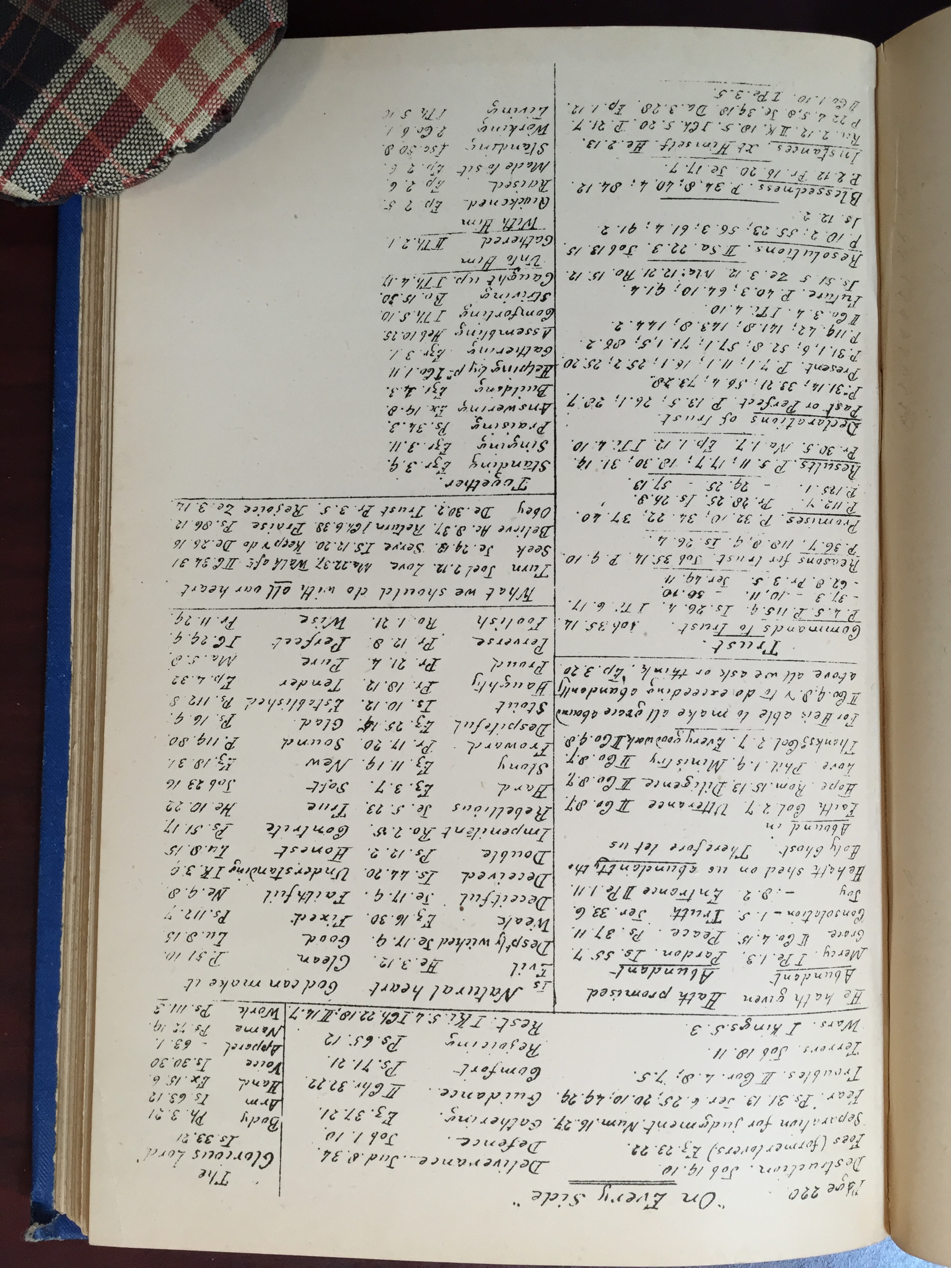

Slide 31
1) Large acquaintance
with all things religious
2) Remember the kinds

Slide 32
Call upon God, adore, confess,
Petition, plead, and then declare
You are the Lord’s, give thanks, and bless,
And let Amen confirm the prayer.

Slide 33
1) Large acquaintance
with all things religious
2) Remember the kinds
3) Expand to details
A saint in a right frame loves to pour out his soul before God in a hundred particulars.

Slide 35
1) Large acquaintance
with all things religious
2) Remember the kinds
3) Expand to details
4) Read
5) Borrow
6) Plead

Slide 36
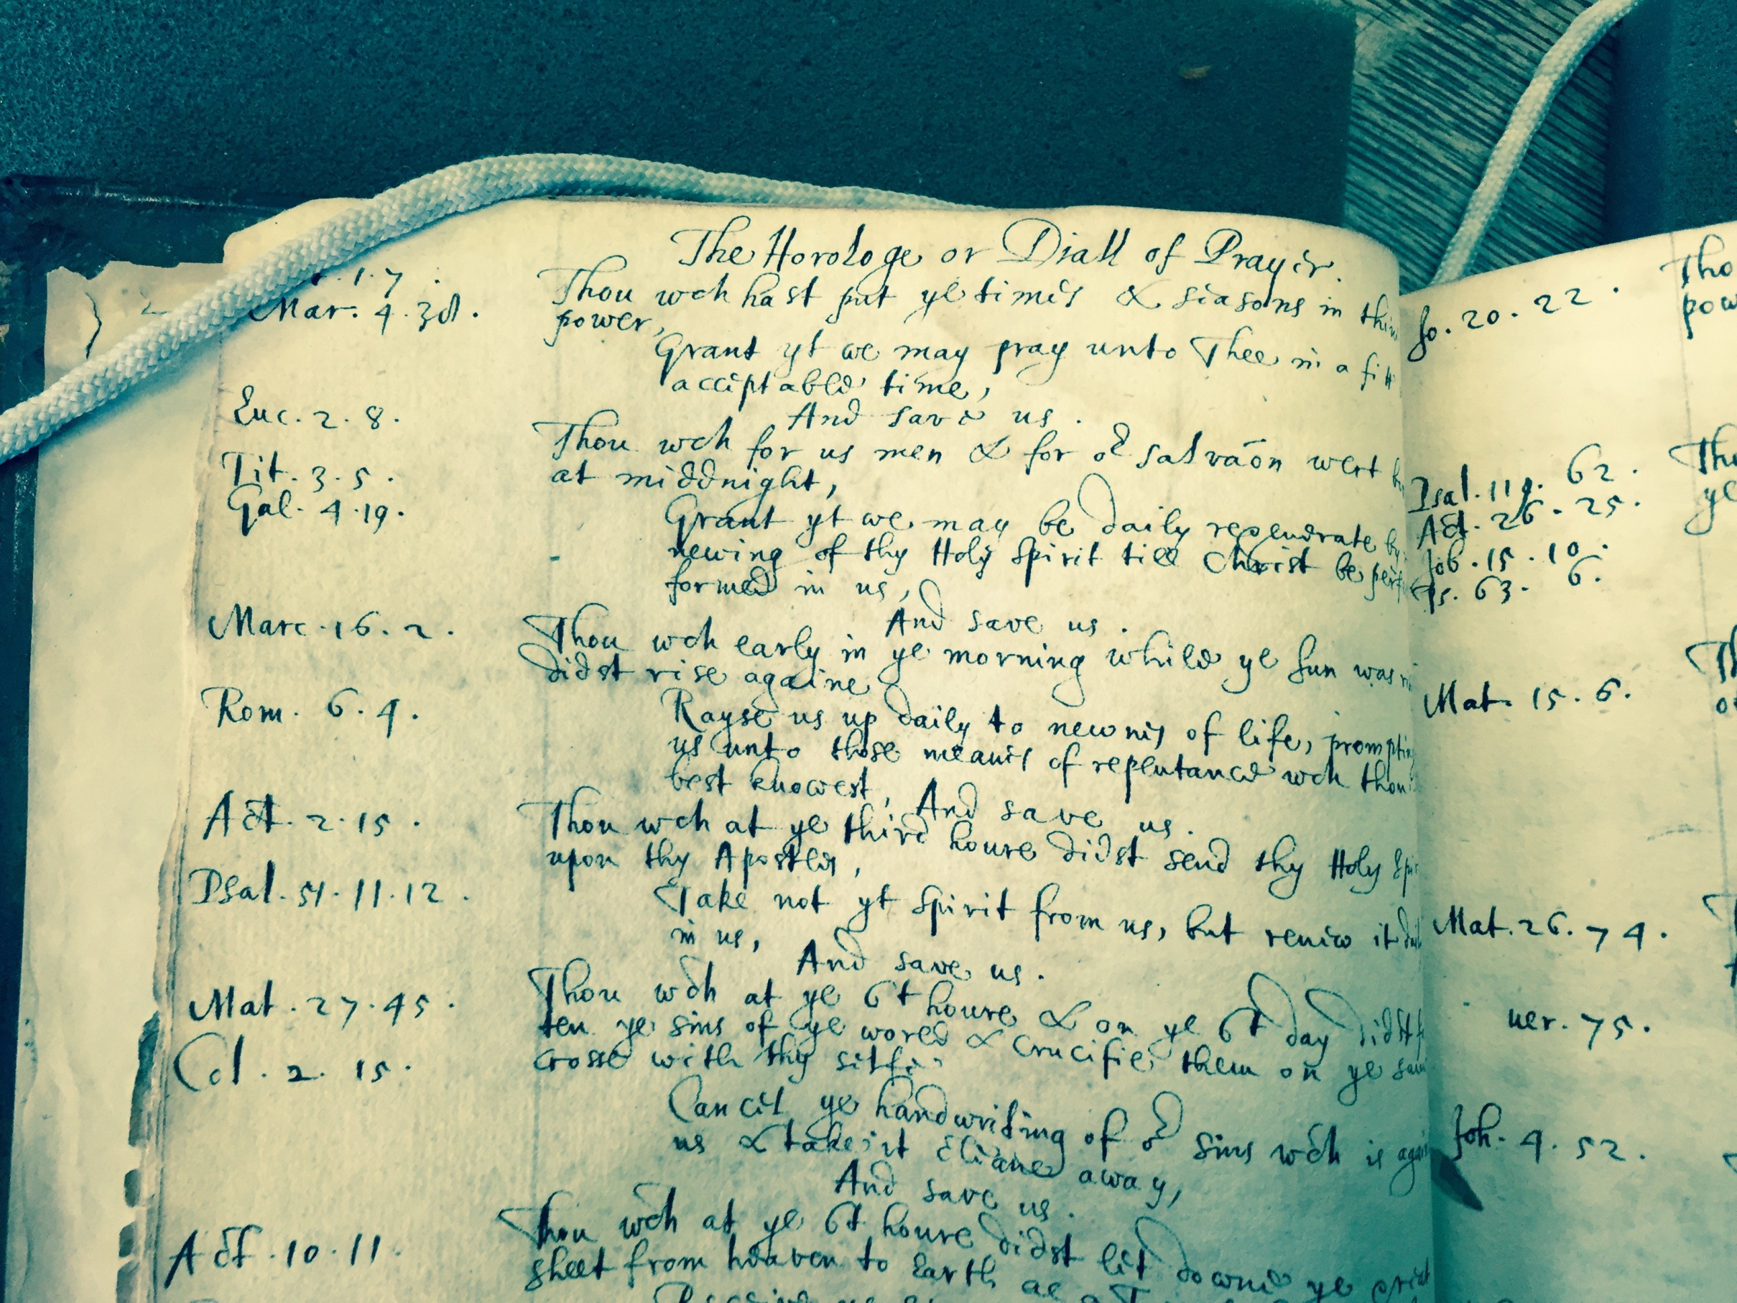

Slide 37

