Slide 1
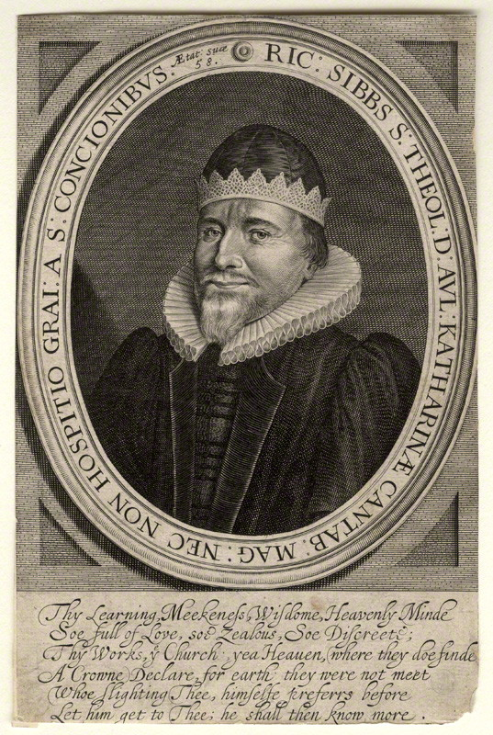
Richard Sibbes (1577-1635)
Richard Sibbes (Sibbs, Sibs)
by John Payne
line engraving, circa 1635
7 3/8 in. x 4 7/8 in. (188 mm x 124 mm) paper size
National Portrait Gallery D10733

Slide 2
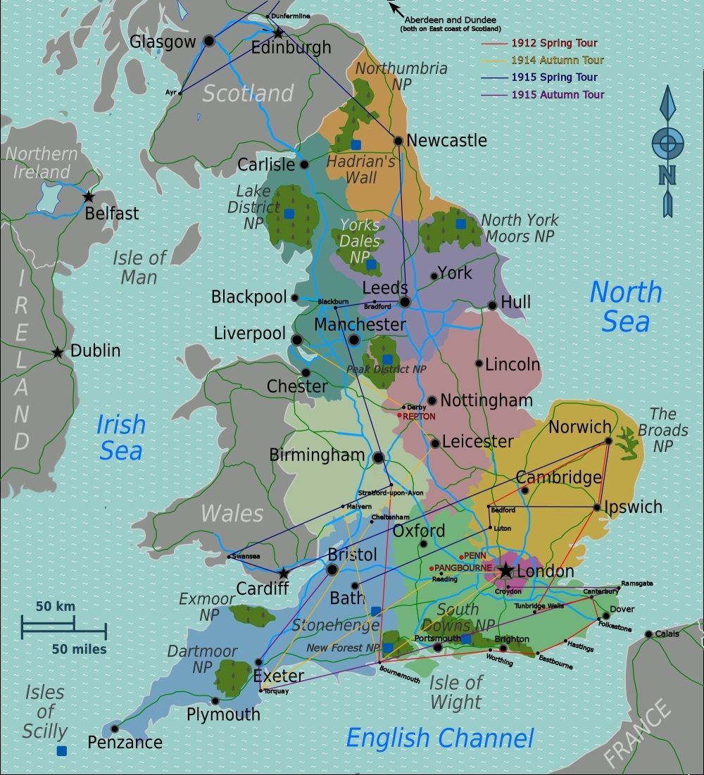

Slide 3
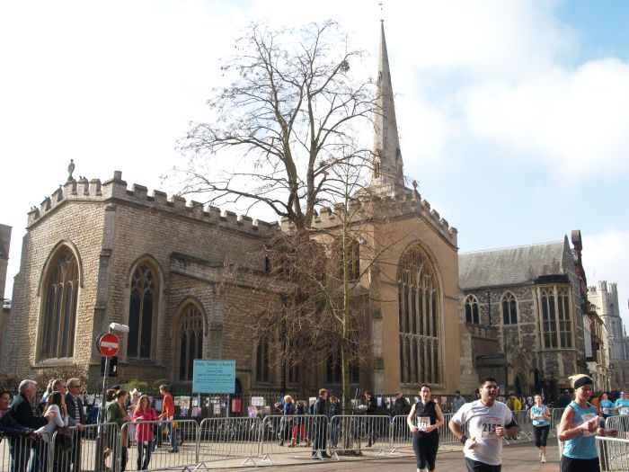
Holy Trinity Cambridge

Slide 4
No writings in practical theology seem to have been so much read in the mid-seventeenth century among the pious English middle classes as those of Sibbes
--David Masson

Slide 5
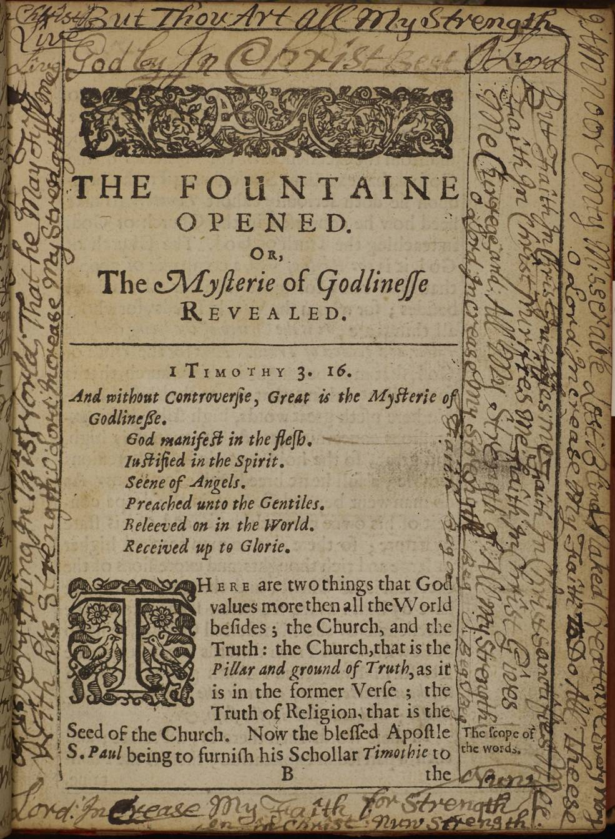
This Northern Congregational College copy (R217058) of a sermon of the Puritan divine Richard Sibbes’s Light from heaven, 1638, (VLS record 35118, item 45082), contains extensive 17th-century annotations and pen trials throughout.

Slide 6
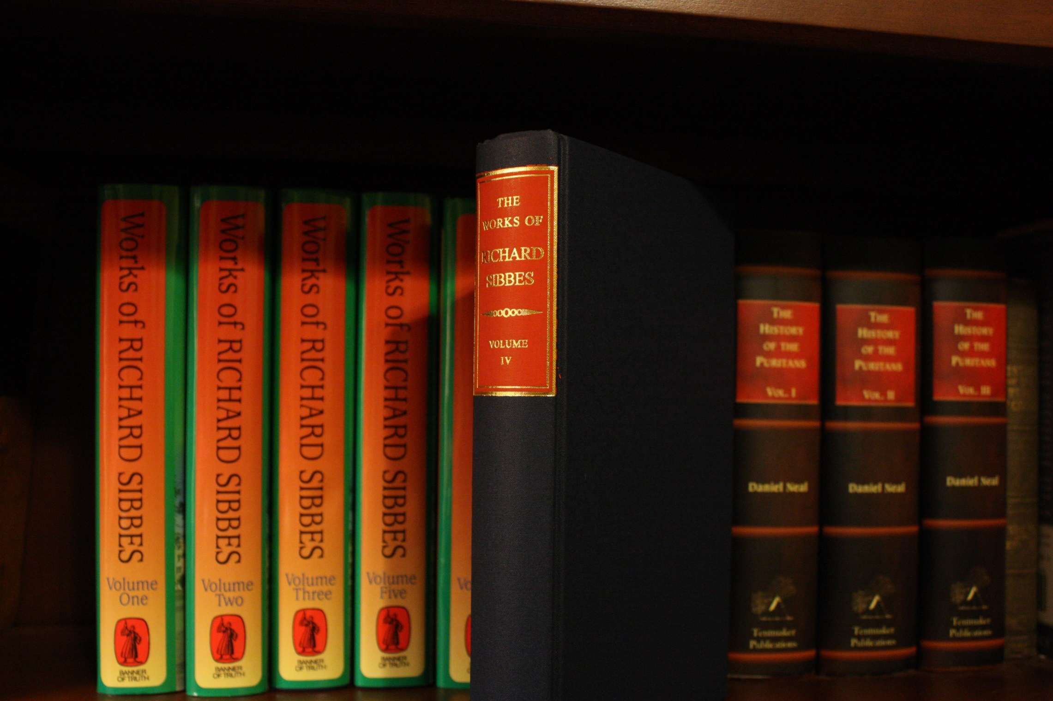

Slide 7
Satan gives Adam an apple, and takes away Paradise.
Therefore, in all temptations, let us consider not what he offers, but what we shall lose.

Slide 8
There is more mercy in Christ than sin in us.

Slide 9
Godly friends are walking sermons.

Slide 10
I shall never cease to be grateful to Richard Sibbes who was a balm to my soul at a period in my life when I was overworked and badly overtired, and therefore subject in an unusual manner to the onslaughts of the devil. . . I found at that time that Richard Sibbes, who was known in London in the early seventeenth century as the “Heavenly Doctor Sibbes,” was an unfailing remedy. . . The Bruised Reed, quieted, soothed, comforted, encouraged and healed me.
--David Martyn Lloyd-Jones

Slide 11
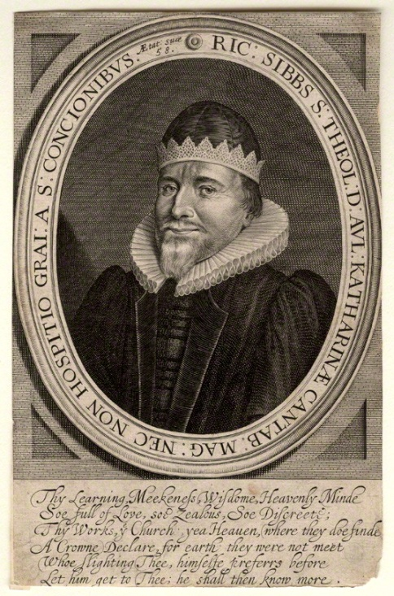
Matthew 7:7-10

Slide 12
Sibbes says that a great many Christians are full of complaints and discouragements about prayer.

Slide 13
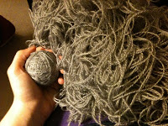
. . . I’ve prayed a long time
. . . I’m worse and worse
. . . I’m not heard
. . . I might as well quit praying
The Knot of Prayer

Slide 14
The Knot of Prayer Loosed

Slide 15
Conditions on our part
(2)Limitations on God’s part

Slide 16
Conditions on our part
Fourthly: The thing prayed for
must be lawful.
Seventhly: Things must be asked
and desired in the right order.

Slide 17
If we would speed in temporal things, we must first seek spiritual, saith our Saviour; . . . If we miss of this, we may knock long ere we have entrance. To come to God and seek oil and wine, and the like things, and in the mean time to neglect the oil of grace, what a disorder is here.

Slide 18
If in this case thou be crossed, it is not because he would put thee off without hearing, but because he would teach thee a better way to speed. . . Many times God doeth beat his dearest children and put off their prayers for a long time, that he may teach them in due order what is first and principally to be desired.

Slide 19
This is the confidence we have in him, that if we ask anything according to his will, he heareth us.
--I John 5:14

Slide 20
And if we know that he hear us, whatsoever we ask, we know that we have the petitions that we desired of him.
--I John 5:15

Slide 21
