Slide 1
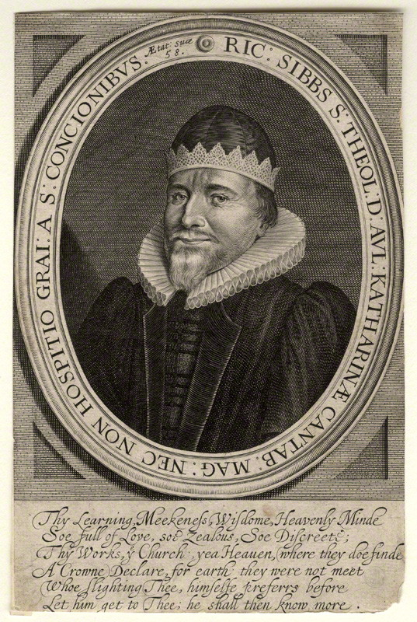
Richard Sibbes (1577-1635)
Richard Sibbes (Sibbs, Sibs)
by John Payne
line engraving, circa 1635
7 3/8 in. x 4 7/8 in. (188 mm x 124 mm) paper size
National Portrait Gallery D10733

Slide 2
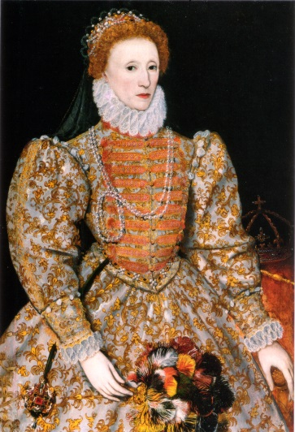
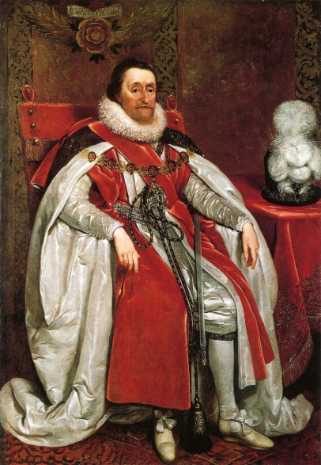
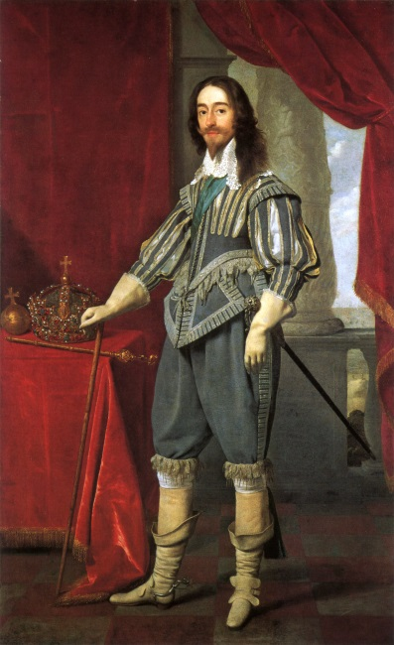
Richard Sibbes (1577-1635)
Richard Sibbes (Sibbs, Sibs)
by John Payne
line engraving, circa 1635
7 3/8 in. x 4 7/8 in. (188 mm x 124 mm) paper size
National Portrait Gallery D10733

Slide 3
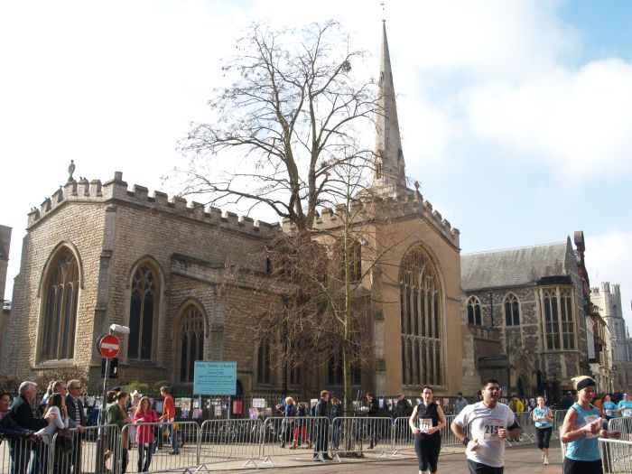
Holy Trinity Cambridge

Slide 4
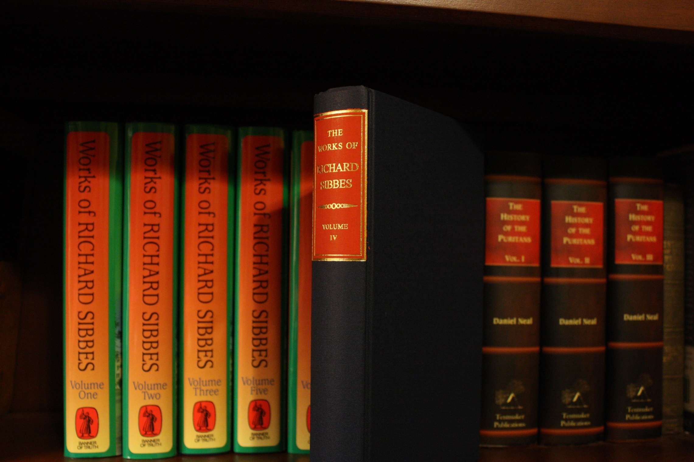

Slide 5
Satan gives Adam an apple, and takes away Paradise.
Therefore, in all temptations, let us consider not what he offers, but what we shall lose.

Slide 6
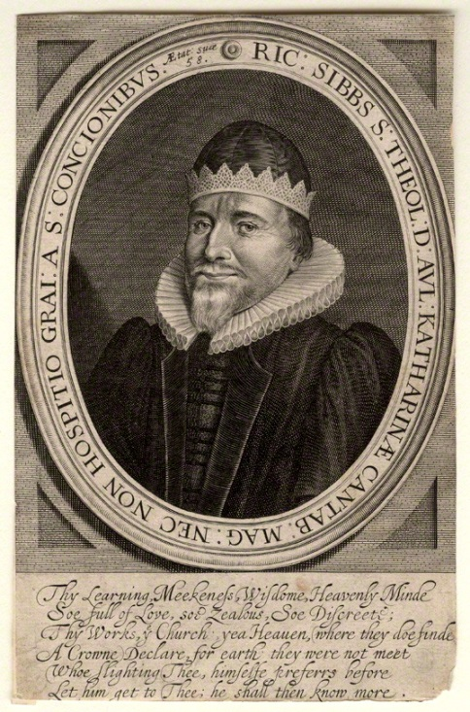
Poverty and affliction take away the fuel that feeds pride.

Slide 7
Factions always breed fractions.

Slide 8
Better to be in trouble with Christ, than in peace without him.

Slide 9
. . . I’ve prayed a long time
. . . I’m worse and worse
. . . I’m not heard
. . . I might as well quit praying

Slide 10
Matthew 7:7-10 ???

Slide 11
The Knot of Prayer Loosed
Matthew 7:7-10

Slide 12
Conditions on our part

Slide 13
Conditions on our part
(2) Limitations on God’s part

Slide 14
Conditions on our part
(2) Limitations on God’s part
--The quality of the thing

Slide 15
Romans 8:28

Slide 16
Romans 8:28 Therefore, that which cannot be unto thee for good is not intended, nor ever shall be given, if God do love thee. . .

Slide 17
Romans 8:28 Therefore, that which cannot be unto thee for good is not intended, nor ever shall be given, if God do love thee. . . As we see fathers will keep from their children knives, burning sticks, and all such sharp and dangerous things, not because they love them not, but because they love them so much.

Slide 18
Conditions on our part
(2) Limitations on God’s part
--The quality of the thing
--The timing for the thing

Slide 19
Abraham’s experience (Gen. 22:14)

Slide 20
Even in the most desperate cases we should not despair, but hope against hope, as he did.

Slide 21
Conditions on our part
(2) Limitations on God’s part
--The quality of the thing
--The timing for the thing
To try our faith

Slide 22
Conditions on our part
(2) Limitations on God’s part
--The quality of the thing
--The timing for the thing
To try our faith
To humble

Slide 23
Judges 20:18-28

Slide 24
Thus, “God resists the proud, and gives grace to the humble” (Jam. 4:6). Till we be nothing in our own eyes, he
never comes up with comfortable deliverance.

Slide 25
Conditions on our part
(2) Limitations on God’s part
--The quality of the thing
--The timing for the thing
To try our faith
To humble
To quicken our appetite

Slide 26
The Lord, in a manner, fisheth with us. The fisher, we know, doth draw back the hook when he finds the fish is like to bite, that the fish may follow. So God gives back from our suits sometimes, not to make us give over, but that we may press him so much the more.

Slide 27
Conditions on our part
(2) Limitations on God’s part
--The quality of the thing
--The timing for the thing
To try our faith
To humble
To quicken our appetite
To enhance the value

Slide 28
So if the things of God did not cost us sights, tears, weepings, lamentations, watchings, strivings, earnest longings, and many prayers, we would think them easy, to be got at our pleasure, and so despise, condemn, or let them lightly pass as they came. God therefore, to enhance the price, doth keep them off.

Slide 29
Conditions on our part
(2) Limitations on God’s part
--The quality of the thing
--The timing for the thing
--The means of obtaining the
thing

Slide 30
Because of our idolatrous conceit in lifting up the means beyond their places, God is forced many times to dash the means in pieces, and help us some other way, of all others least expected.

Slide 31
Acts 27:22

Slide 32
A strange manner of deliverance! How should they then be saved, this being in all appearance the only means of safety?

Slide 33
By the wreck of the ship God did perform his promise, some by swimming, the rest on boards, and some on broken pieces of the ship, all get on land; and even so, I say, we many times escape on boards, and broken pieces of ship; I mean those means we least thought of, or least trusted unto.

Slide 34
We are all much to blame in this, even those who have the greatest measures of grace, that we do not aright make use of the nature of God.

Slide 35
It is strange to think that when we were enemies to God, with our backs to him in our natural blindness, and in sin running from him, then to think he should receive us, and now to stab us with our faces toward him in the state of reconciliation.

Slide 36
If we would speed in temporal things, we must first seek spiritual, saith our Saviour; . . . If we miss of this, we may knock long ere we have entrance. To come to God and seek oil and wine, and the like things, and in the mean time to neglect the oil of grace, what a disorder is here.

Slide 37
