Slide 1
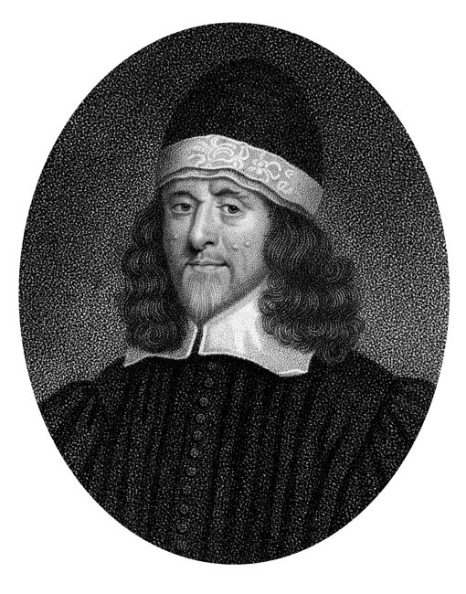
Thomas Goodwin (1600-1679)

Slide 2
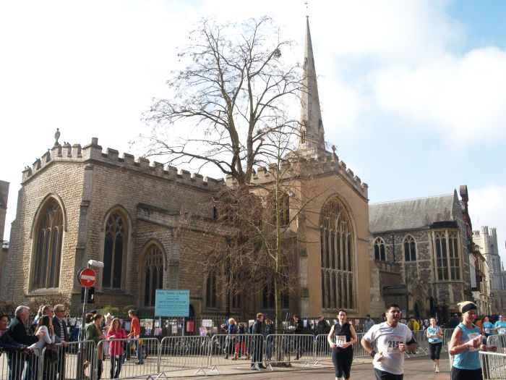

Slide 3
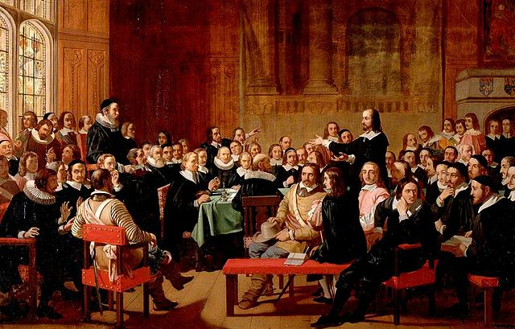

Slide 4

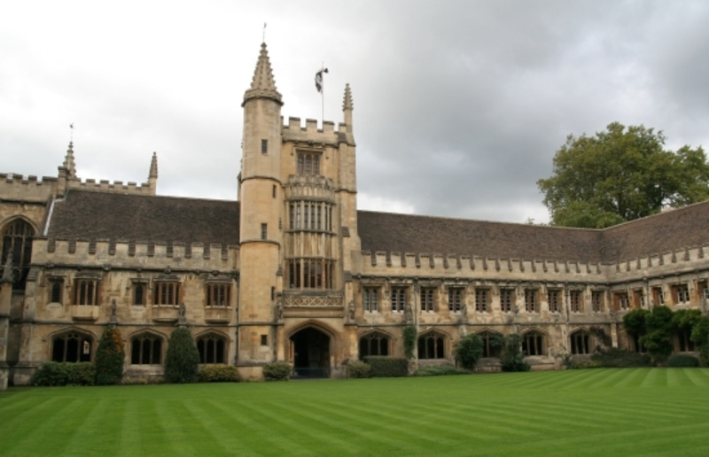

Slide 5
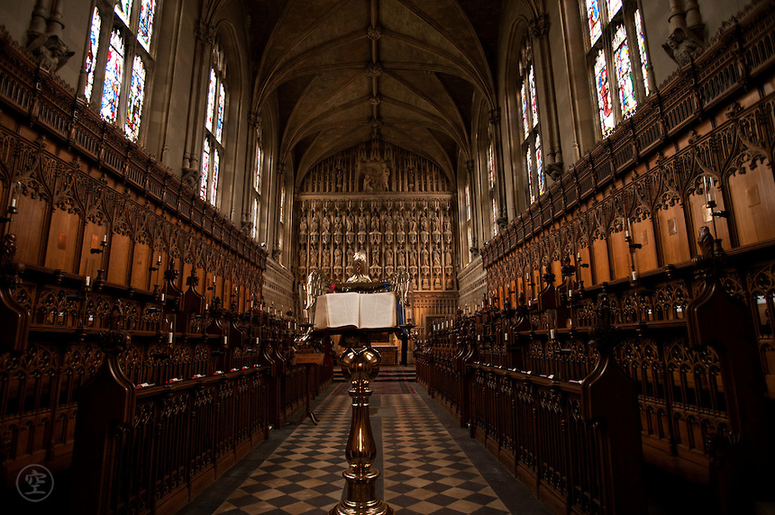

Slide 6
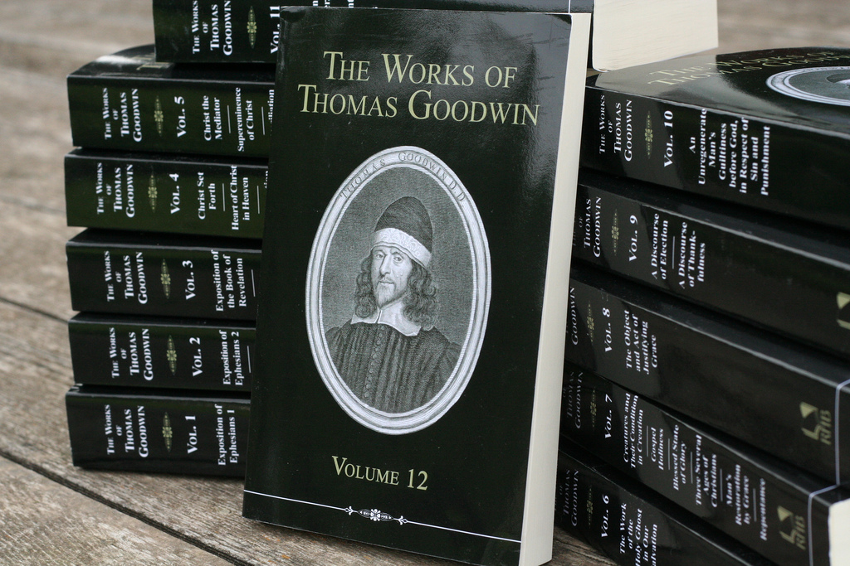

Slide 7
“The greatest pulpit exegete of Paul that has ever lived.”
--J. I. Packer

Slide 8
Have communion with Him as His friend.
When you come into his presence, be telling him how well thou lovest him.

Slide 9
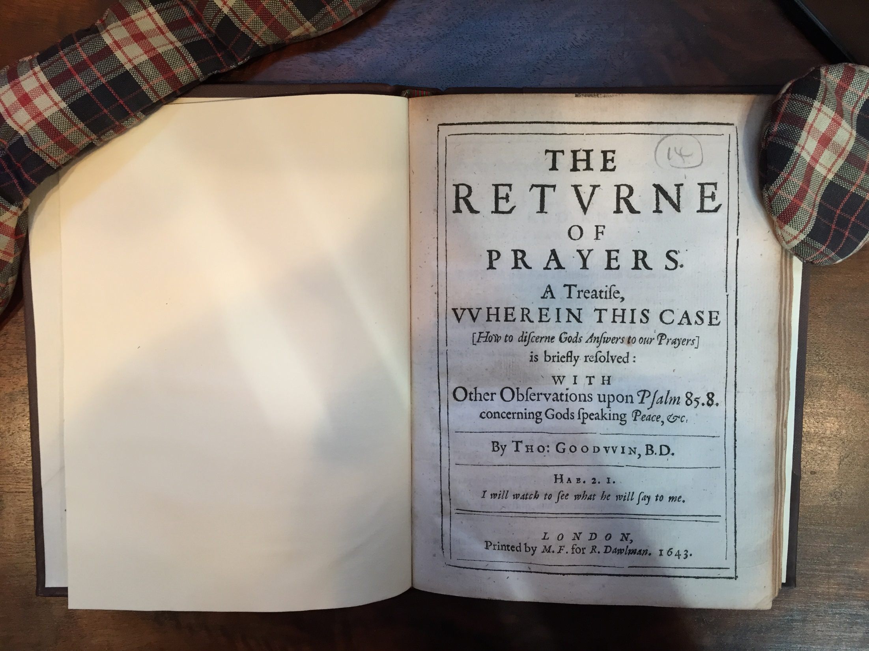

Slide 10
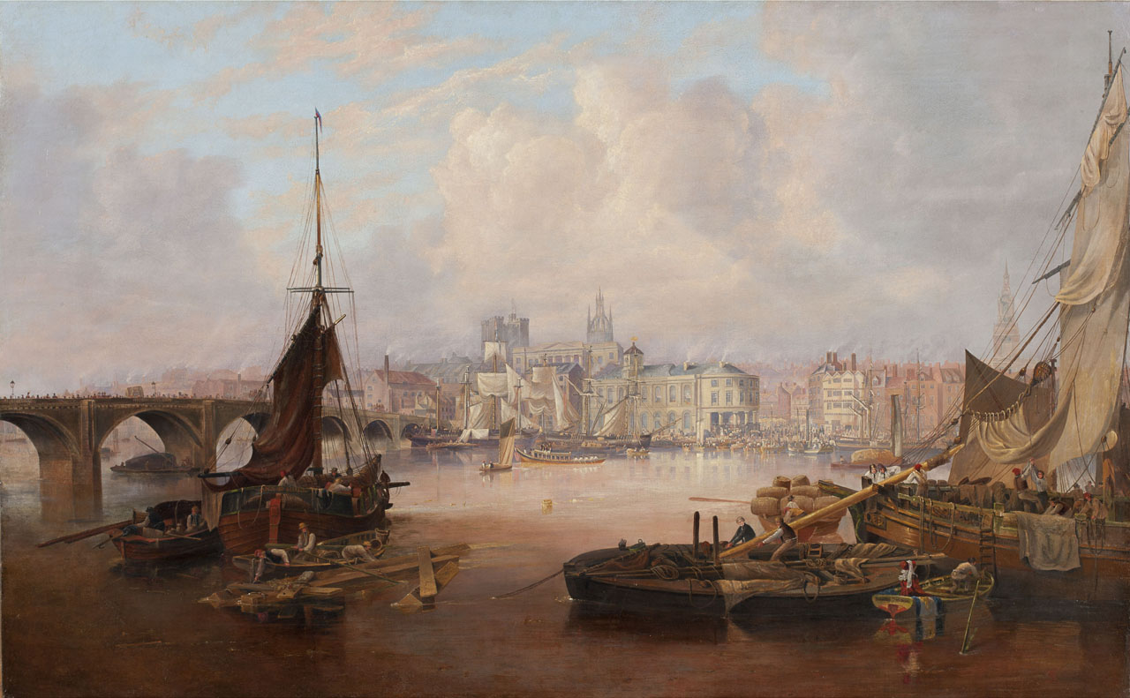

Slide 11
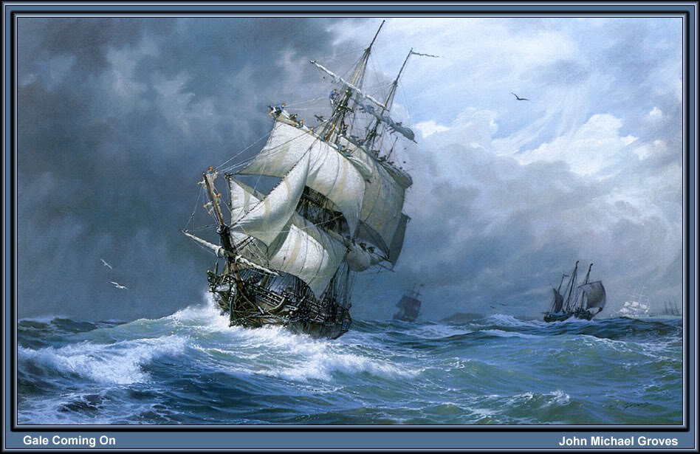

Slide 12
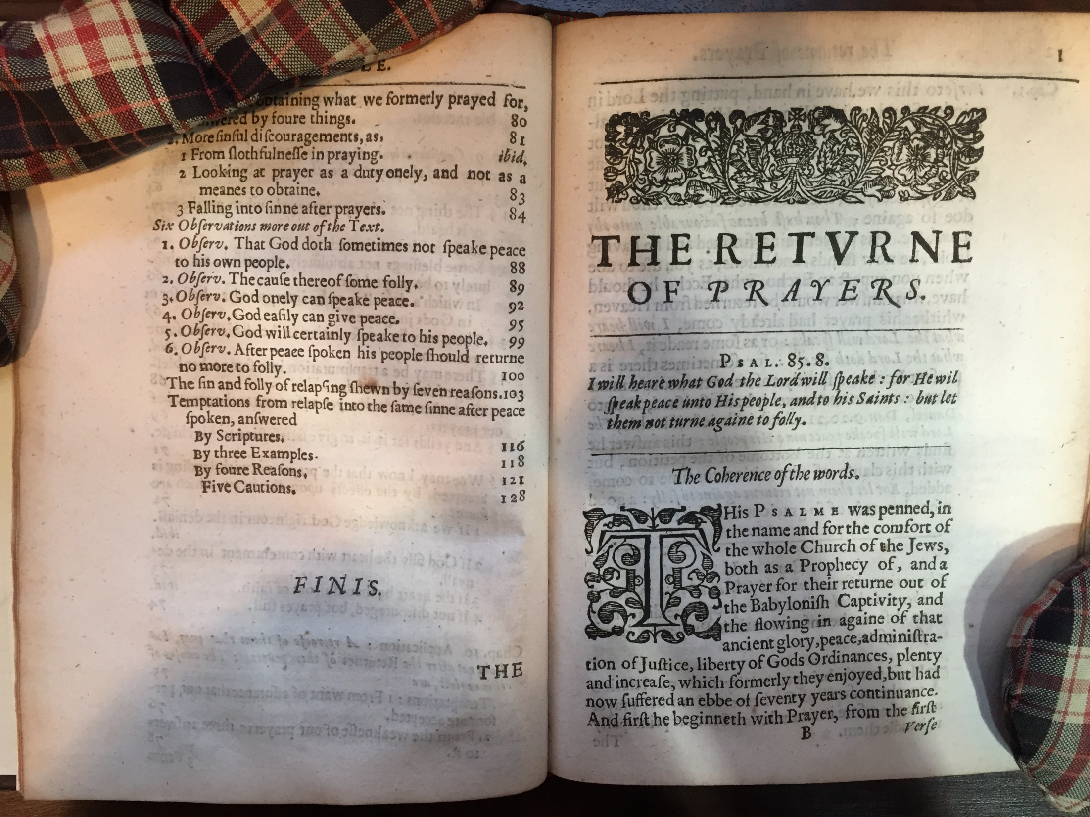

Slide 13
Yet many who are true investors in prayer neglect to watch for the return of answers. When the voyage of their prayers proves long, they grow discouraged, as though their ships were lost at sea.

Slide 14
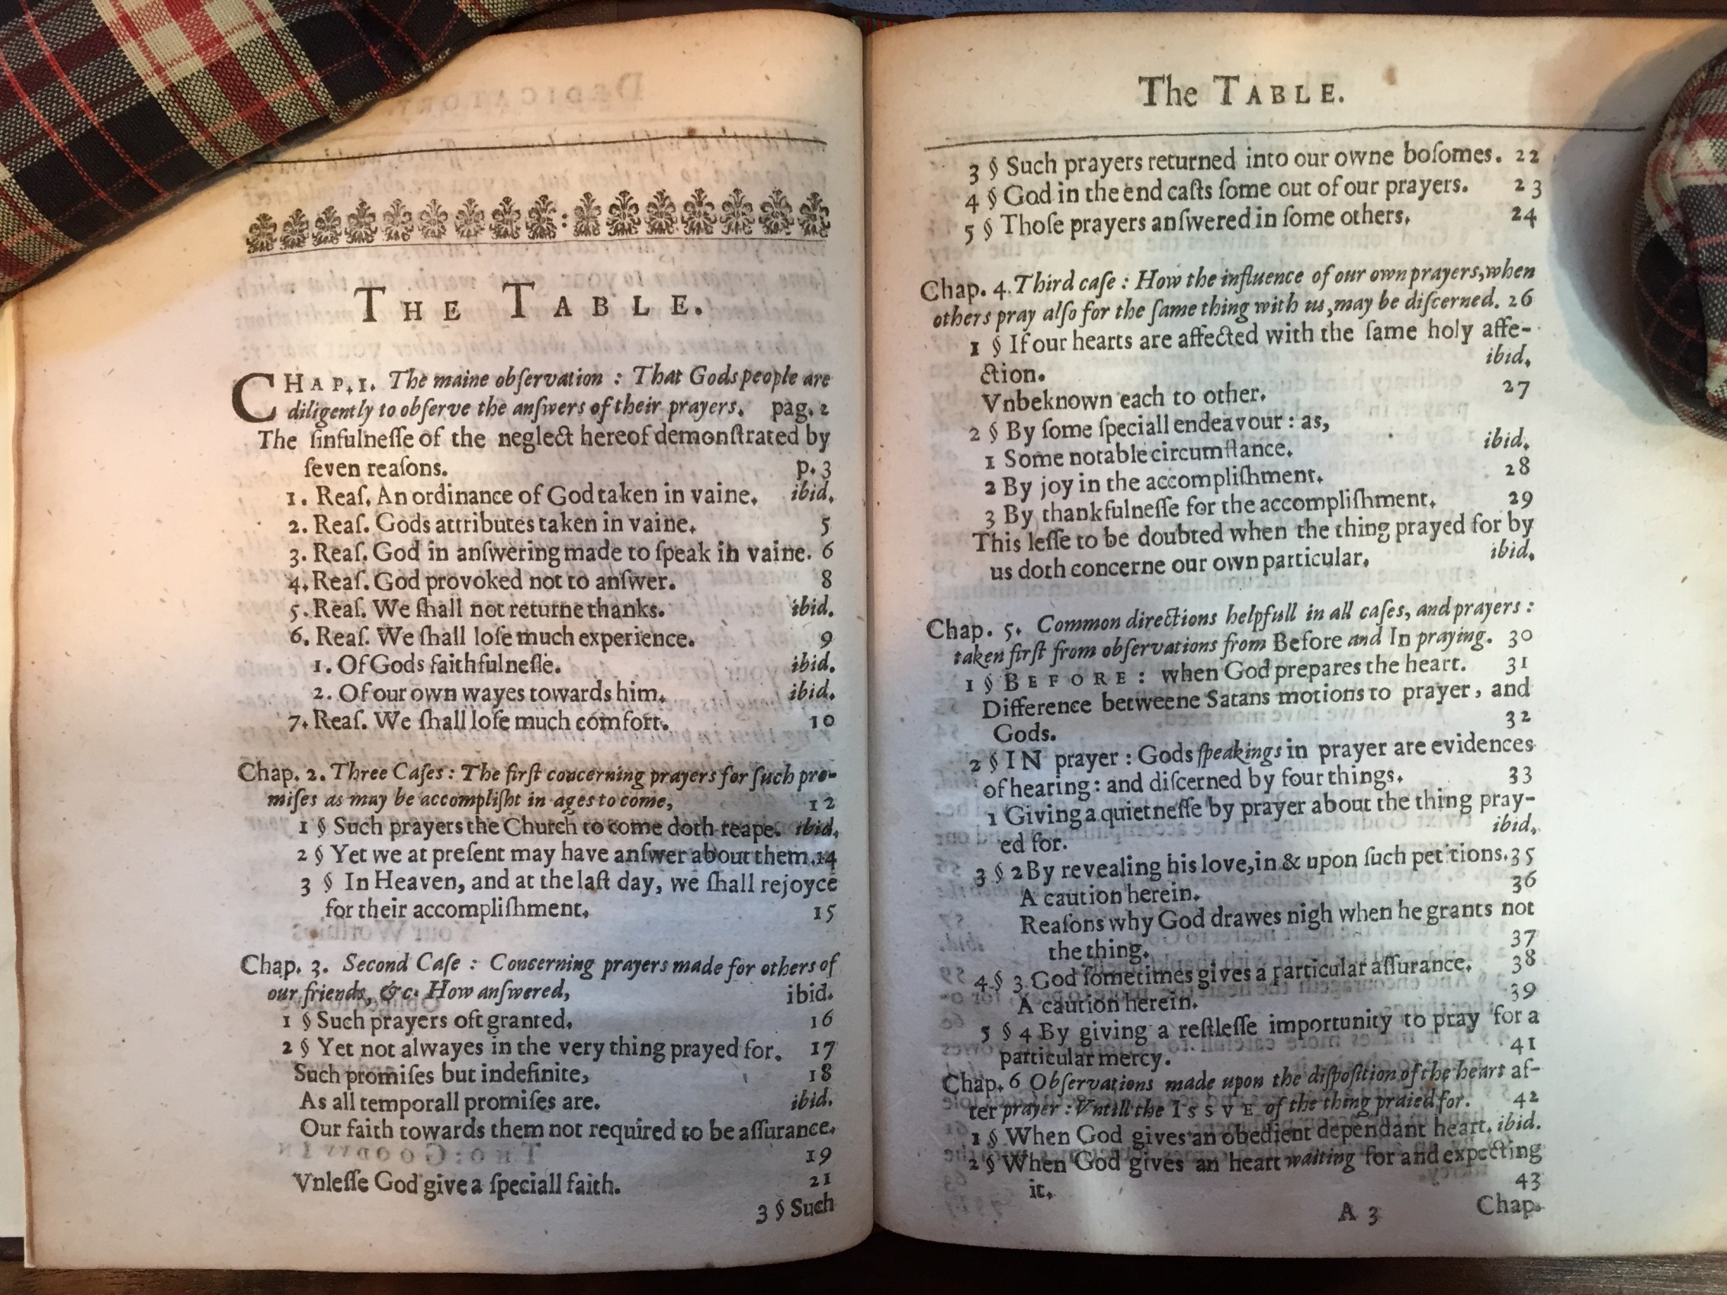

Slide 15
(1) So that we do not take one of God’s ordinances in vain.

Slide 16
God has ordained prayer to be the the means of obtaining things. If we use this means without expecting to receive those things, it is a sign that we regard His ordinance of prayer to be in vain.

Slide 17
(2) So that we do not take God’s attributes in vain.

Slide 18
By neglecting to look for answers, we make an idol god of Him, as if He has ears but hears not or eyes but sees not. In this way we rob Him of one of his royal titles, “a God that heareth prayers” (Ps. 65:2).

Slide 19
(3) So that God’s answers will not be sent in vain.

Slide 20
Not a word of His answers should be allowed to fall to the ground by our failing to catch them when they come. Solomon could say, “There hath not failed one word of all his good promise” (I Kings 8:56). . .

Slide 21
So that God will not be provoked
to cease from answering

Slide 22
So that we will have reasons to
return thanks

Slide 23
The reason that we pray so much and give thanks so little is that we do not observe God’s answers when they come. We do not study them.

Slide 24
(6) So that we do not miss certain
experiences

Slide 25
David recalled an experience of having his prayers answered and cited it as a reason to continue calling on the Lord, “Because he hath inclined his ear unto me, therefore will I call upon him as long as I live” (Psalm 116:2).

Slide 26
Such as the experience of new insight into our own hearts and ways. If God does not grant your prayers, it will cause you to seek the reason He does not answer. David discovered, “If I regard iniquity in my heart, the Lord will not hear me” (Psalm 66:18).

Slide 27
(7) So that we do not lose our comfort

Slide 28
You are to “ask, and . . . receive, that your joy may be full” (John 16:24). By this means, even the smallest things which we enjoy or use become sources of comfort if they were obtained by prayer.

Slide 29
When we hear even a line or two from a close friend about even a small matter it cheers our hearts. So when we hear anything, be it ever so small, from God in answer to our prayers. But this joy we will forfeit if we do not observe the answers.

Slide 30
